Slide 1
URINARY TRACT INFECTIONS

Slide 2
Welcome to the module on
Please take this brief pre-module quiz
https://goo.gl/forms/sCaTGHdGAId9nGa63

Slide 3
Table of contents
Introduction
Anatomy: Lower vs upper
COMPLICATED vs Uncomplicated uti
Pathogenesis & pathogens
host defenses
Diagnosis
Treatment
RECURRENCE & RISK FACTORS
urinary tract infections in men
CASES
Click a section on the left to jump ahead if you like!

Slide 4
URINARY TRACT INFECTIONs: Introduction
Return to Table of Contents
Schappert & Rechtsteiner, Vital Health Stat 2011
May L, Mullins P, Pines J, Acad Emerg Med 2014
The UTI is the most common bacterial infection encountered in ambulatory settings
Between 2006 and 2010, there were an estimated 40.9 million visits for UTI and 24% of UTI visits were seen in EDs
A wide range of pathogens cause this infection including gram-negative & gram-positive bacteria
UTIs can have serious consequences if untreated or incorrectly treated!
Pyelonephritis with sepsis
Renal damage
Recurrence
Complications caused by antimicrobial use
High-level antibiotic resistance
C. difficile colitis

Slide 5
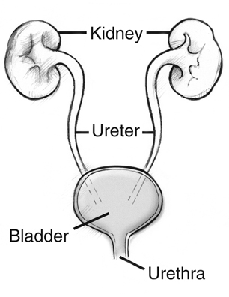
What is a urinary tract infection?
Return to Table of Contents
An infection anywhere in the urinary tract
(urethra,
bladder,
ureters,
or kidneys)

Slide 6
ANATOMY: LOWER VS UPPER UTI
Return to Table of Contents
LOWER UTI = CYSTITIS
Superficial infection of the bladder
Symptoms:
+/- dysuria, urinary frequency, urgency, suprapubic pain, hematuria
Onset often sudden & severe
UPPER UTI = PYELONEPHRITIS
Infection/inflammation of renal parenchyma
Symptoms:
Fever (T>100.4F), chills, flank pain, CVA tenderness, nausea/vomiting, anorexia
With or without symptoms of of cystitis
https://bmjpaedsopen.bmj.com/content/3/1/e000487

Slide 7
UTI: Why so complicatEd?
Return to Table of Contents
Previously, we categorized patients felt to be at higher risk of more serious infection or failing therapy as having complicated UTIs….
COMPLICATED UTIs occurred in patients with the following risk factors:
Urologic abnormalities (i.e. stones, strictures, stents, diversion)
Urinary catheters
Immunocompromising conditions
Poorly controlled diabetes
Male sex
Pregnancy
UNCOMPLICATED UTIs
occurred in:
Non-pregnant, young, healthy females with normal urinary tracts

Slide 8
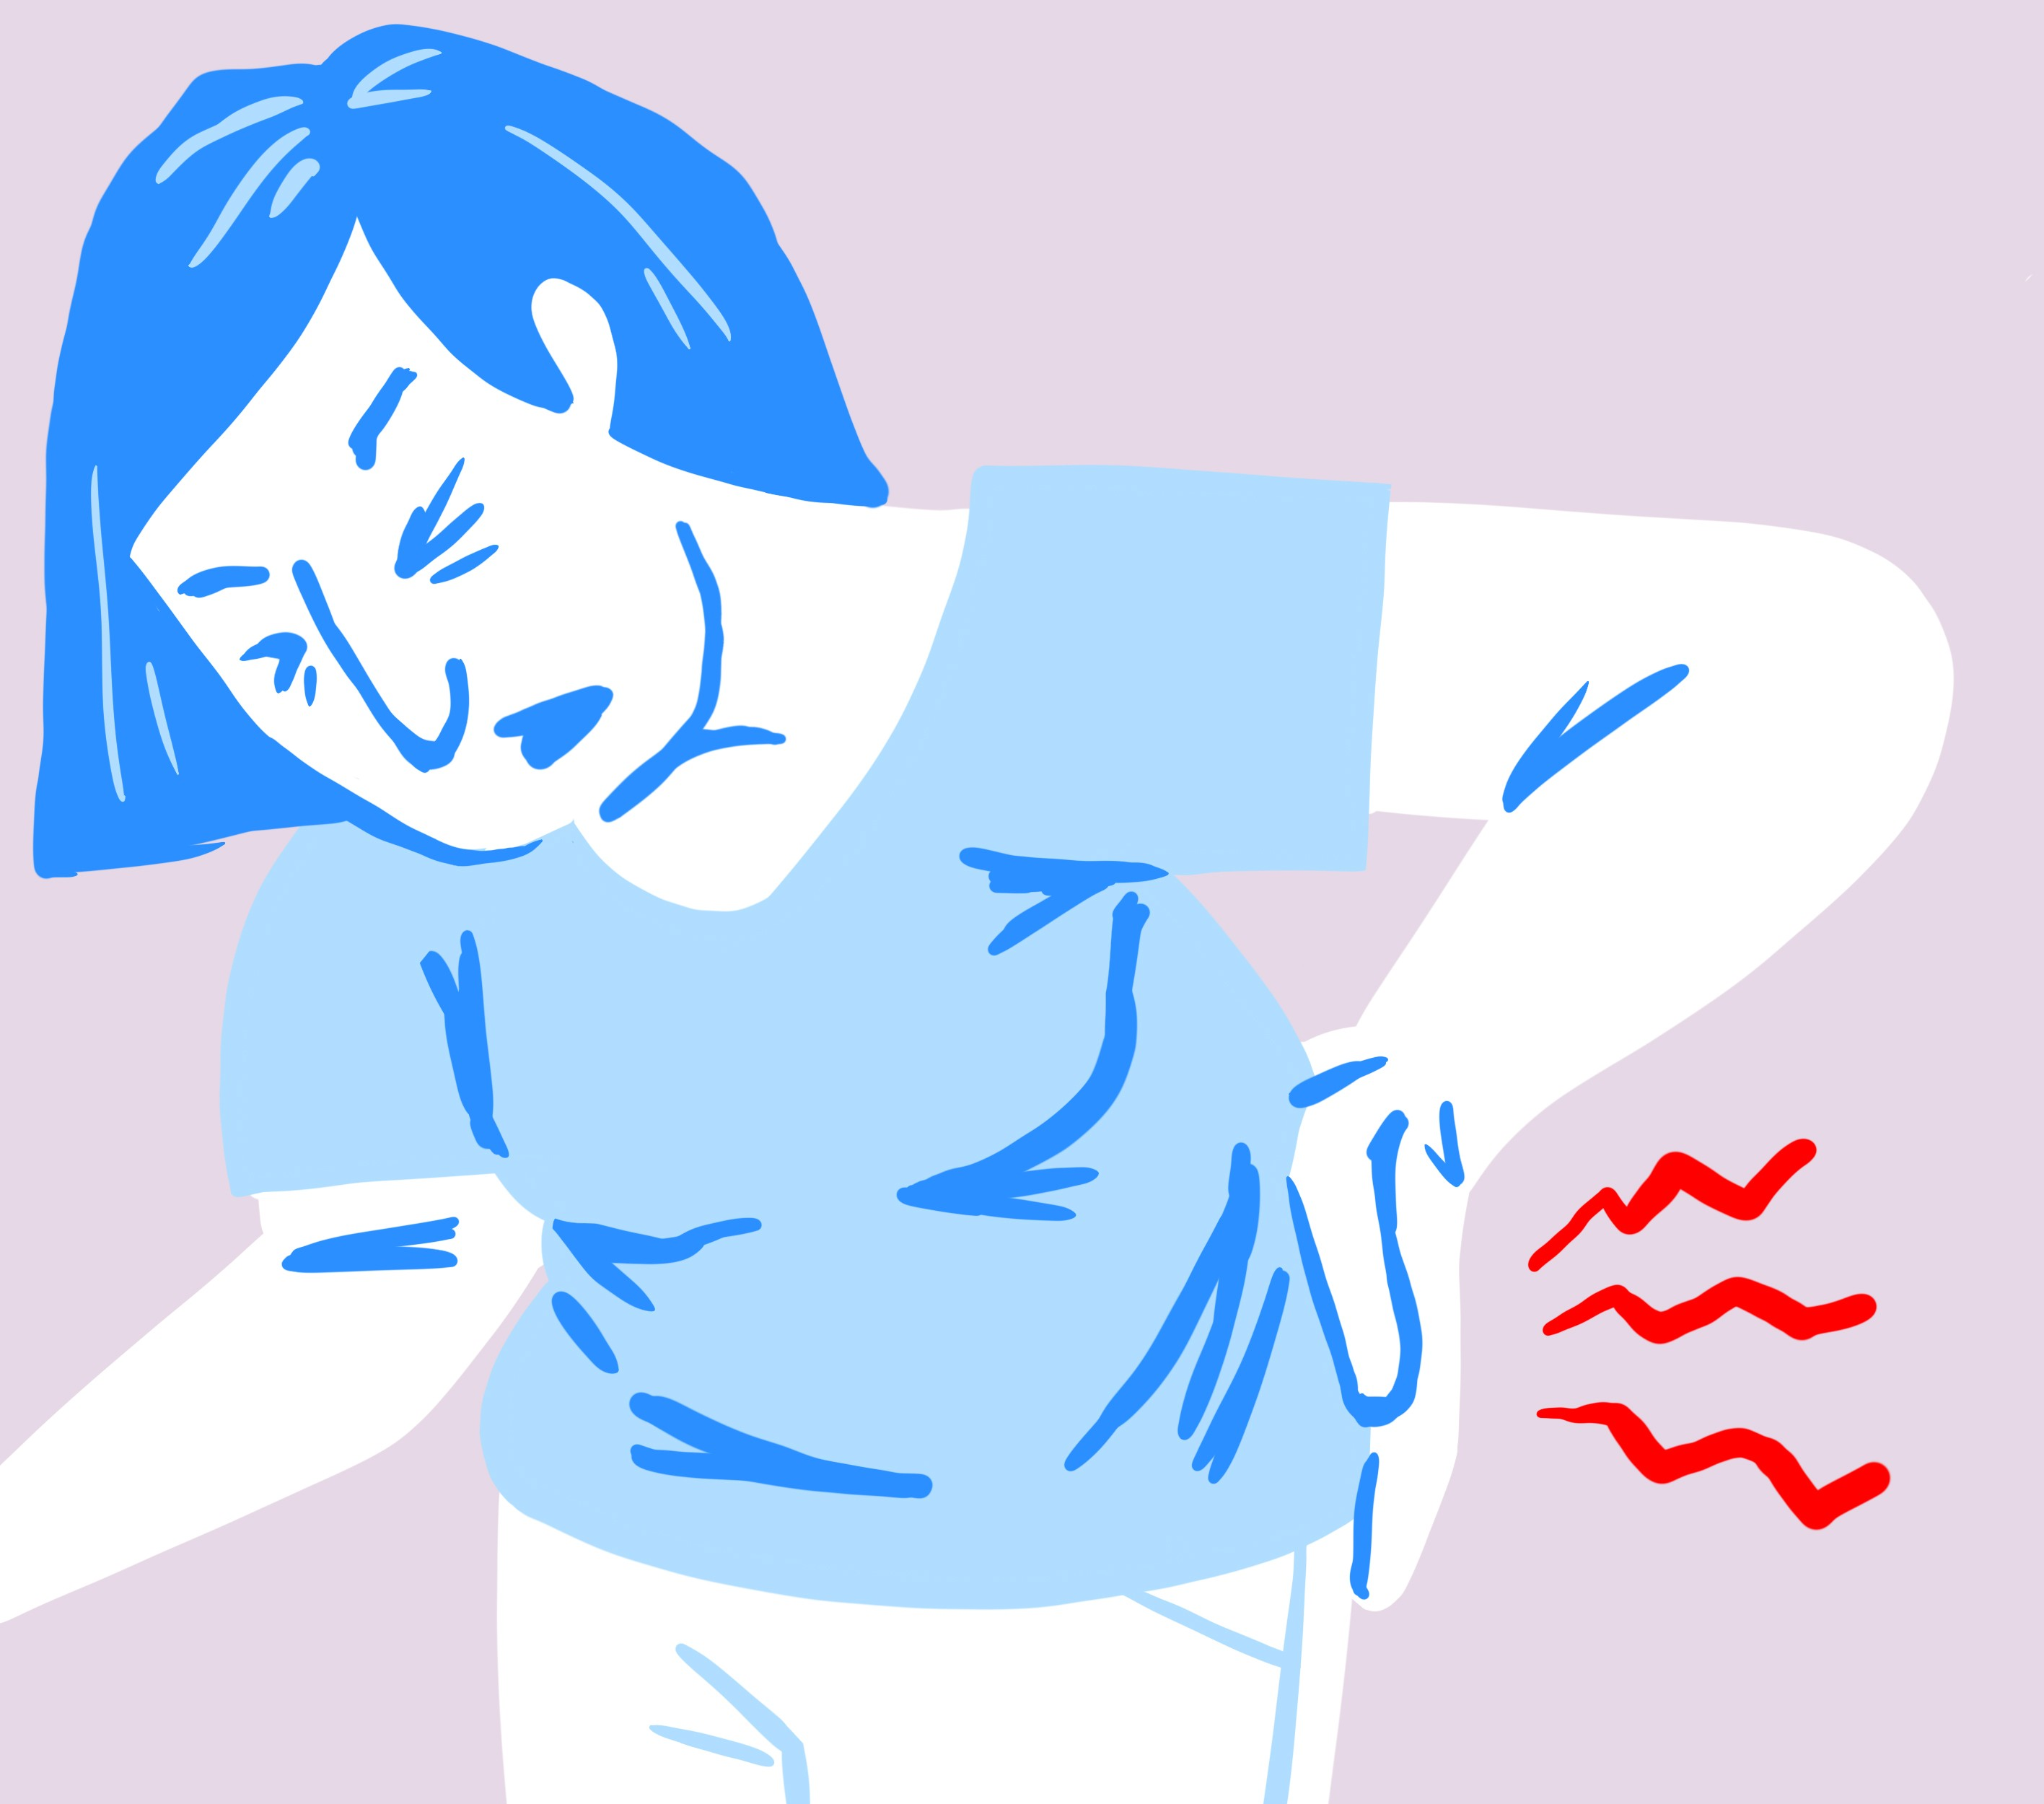
complicated vs Uncomplicated
Return to Table of Contents
Today we categorize UTIs based on extent & severity of infection!
Complicated UTI
Uncomplicated UTI
An acute UTI + signs/symptoms suggestive of extension beyond the bladder
Fever > 99.9ºF
Chills, rigors, or signs/symptoms of systemic infection
Flank pain
Costovertebral angle tenderness
Pelvic or perineal pain in men
Acute “simple” cystitis
Presumed to be confined to the bladder
No signs/symptoms that suggest an upper tract or systemic infection

Slide 9
THE PATHOGENESIS OF A UTI
Return to Table of Contents
Left untreated, tubule obstruction & damage may occur leading to interstitial edema, which may cause interstitial nephritis leading to kidney injury
5. Acute Kidney Injury
Kidneys
Infection of the renal parenchyma leads to pyelonephritis
4. Pyelonephritis
Ureters
*Pyelonephritis can also occur from hematogenous spread
After colonization, bacteria may ascend in the ureter towards the kidney!
Bacterial toxins may inhibit peristalsis (reducing the flow of urine)
3. Ascension
Bladder
Fimbria of bacteria attach to & penetrate bladder epithelial cells → then bacteria replicate & form biofilms
2. Uroepithelium
Penetration
Bacteria from rectum/vagina colonize the periurethral area → ascend through the urethra up towards the bladder
1. Colonization
Urethra
http://www.pathophys.org/uti/

Slide 10
WHICH pathogens CAUSE UTIS?
Return to Table of Contents
UNCOMPLICATED CYSTITIS AND PYELONEPHRITIS
E. Coli is the most frequent cause of UTIs (Czaja et al. 2007)
5-25% due to Enterobacterales (i.e. Klebsiella pneumoniae) & Staphylococcus saprophyticus, Enterococcus faecalis, and Streptococcus agalactiae (GBS) (Hooten 2012)
COMPLICATED CYSTITIS AND PYELONEPHRITIS
Broader pathogen group including above organisms PLUS Pseudomonas, Serratia, enterococci, and staphylococci (Nicolle 2005)
**FYI, in healthy non pregnant women, lactobacilli, enterococci, GBS, and coag-neg staph (except S. saprophyticus) usually represent contamination** (Hooten 2012)

Slide 11
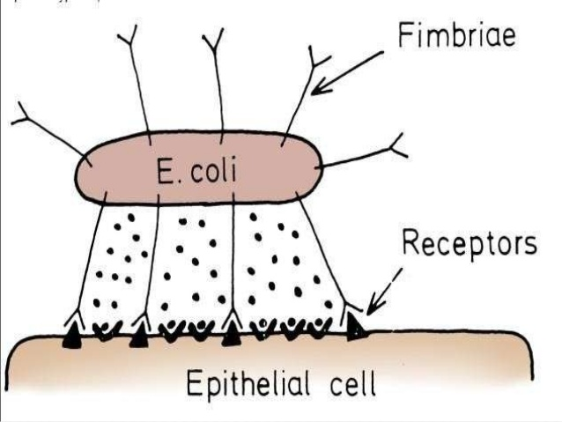
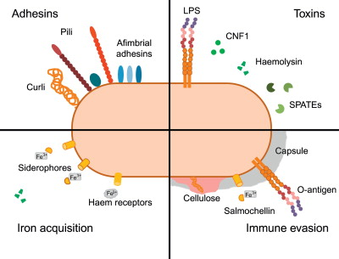
A pathogen’s strategies to infect
Return to Table of Contents
Adhesins:
Hair-like appendages on E. coli bacteria (i.e. fimbriae or pili) bind to & invade bladder uroepithelial cells
E. coli
Iron Acquisition:
Bacteria secrete siderophores (iron-chelating molecules) which load iron & are then taken up for nutrients
E. coli need iron to prosper
https://betterbodychemistry.com/bacteria/avoid-urinary-tract-infections/

Slide 12
A pathogen’s strategies to infect
Return to Table of Contents
Toxins:
- Endotoxin LPS: Large outer membrane molecule that binds immune cells & elicits immune response
- Hemolysin: Forms pores in WBCs, RBCs, & uroepithelial cells causing lysis
E. coli
Immune Evasion:
- O-Antigen of capsule: Helps prevent phagocytosis by macrophages
- Biofilm formation: Bacterial colonies form with an extracellular matrix that evades antibiotics & host immune defense

Slide 13
THE body’s Defense mechanisms: avoiding A uti
Return to Table of Contents
Except for the urethra, the urinary tract is normally sterile due to host defenses against bacterial colonization!
http://www.pathophys.org/uti/uti-hostdefense/

Slide 14
MAKING THE DIAGNOSIS
Return to Table of Contents

Slide 15
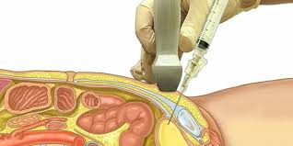
First, one must obtain A SPECIMEN
Return to Table of Contents
The Gold standard
A GOOD SAMPLE
Believe it or not, the gold standard of collecting urine is by suprapubic aspiration
A needle is passed through sterilized suprapubic skin directly into the bladder
A clean-catch voided midstream sample!
Stored in a clean container, in a cool place, tested on immediately
The presence of squamous epithelial cells represents contamination from surrounding skin!
RARELY ever done in clinical practice!

Slide 16
Screening tools: urine dipstick & urine microscopy
Return to Table of Contents
Biochemical Testing:
A white plastic strip with dried reagent pads that react when dipped in urine → tests for glucose, pH, ketones, blood, etc.
Microscopic Examination:
Look at the urine under the microscope to find bacteria, yeast, WBCs, etc.

Slide 17
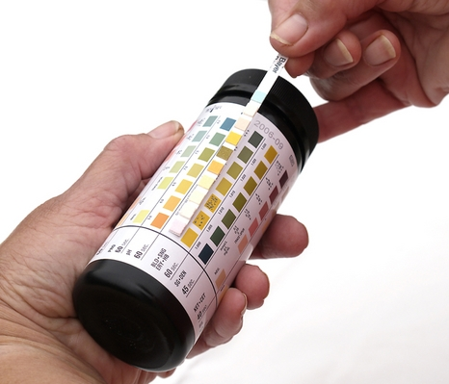
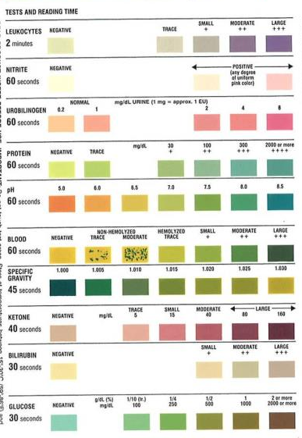
Urine dip results
Return to Table of Contents
Are There Nitrites?
Gram- and some Gram+ bacteria breakdown urinary nitrates to nitrites
Positive test suggests presence of these bacteria
False Positives: prolonged air exposure
False Negatives: <4 hours bladder incubation time, high specific gravity, pH <6
Sensitivity: 45-60%
Specificity: 85-98%
Poor sensitivity, but pretty specific for a UTI!

Slide 18
Urine dip results
Return to Table of Contents
Is There Leukocyte Esterase?
A marker of lysed neutrophils
Positive test suggests pyuria associated with a UTI
Isolated trace positive is of questionable significance
False Positives: contamination with vaginal discharge
False Negatives: high urine glucose
Sensitivity: 48-86%
Specificity: 17-93%
Reasonably sensitive in primary care settings; variable specificity so don’t rely on it alone!

Slide 19
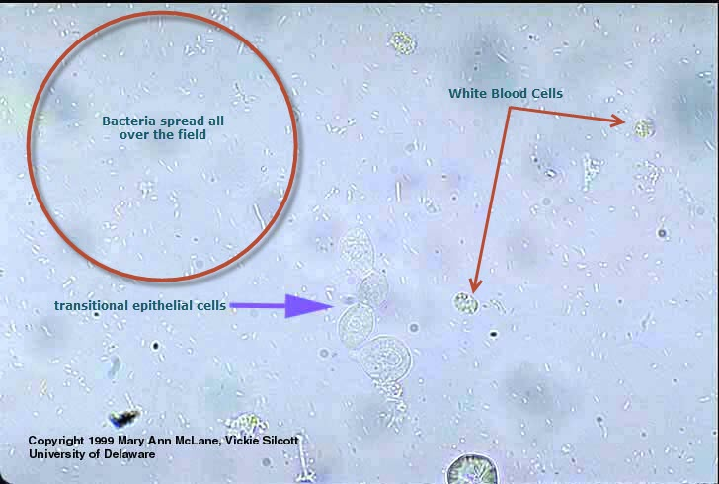
Urine microscopy
Return to Table of Contents
Microscopic Examination of Urine
Are there epithelial cells?
Normal = 0-2 cells
These cells usually indicate contamination by surrounding skin; can indicate urine sample is of poor quality!
Are there white blood cells? (Pyuria)
Normal < 5 cells/microL
Increase in # WBCs and/or positive test for leuk esterase may indicate infection/inflammation in the GU tract
Are there bacteria? (Bacteriuria)
Bacteriuria in the absence of symptoms is usually not of significance
http://www.medical-labs.net/bacteria-transitional-epithelial-cells-and-white-blood-cells-in-urine-sediment-405/

Slide 20
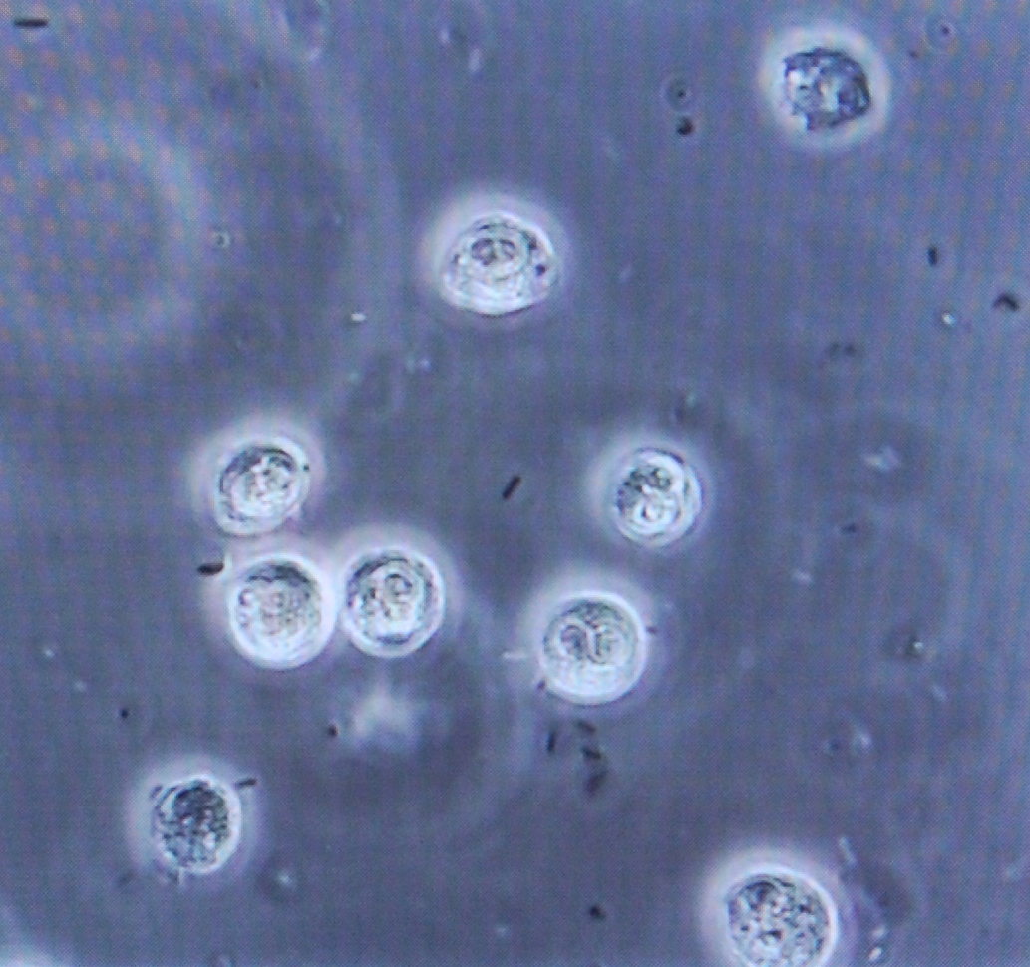
Sterile PYURIA
Return to Table of Contents
Definition: Pyuria that occurs with a negative urine culture
Causes of sterile pyuria include:
Nephrolithiasis (kidney stone)
Contamination of the urine sample with vaginal secretions
Intra-abdominal inflammatory process adjacent to the bladder (i.e. appendicitis, diverticulitis)
Sexually transmitted infections (i.e. chlamydia, gonorrhea)
Prostatitis
Malignancy of kidney, bladder, ureter, etc.
Globally, tuberculosis is a large cause

Slide 21
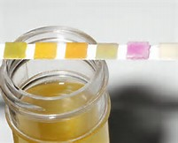
THE Dip stick: how useful IS THIS TOOL?
Return to Table of Contents
REMEMBER, when a patient presents with typical symptoms of a UTI, an office dipstick only gives supplemental information
A negative dipstick for leuk esterase or nitrites DOES NOT rule out infection
For a healthy young woman with TYPICAL symptoms of cystitis → just treat empirically!
REMEMBER, pyuria without symptoms is usually not a UTI
REMEMBER, bacteriuria without symptoms is usually not a UTI
REMEMBER, in a typical patient, do not treat pyuria and bacteriuria without symptoms!
However, consider treating in higher risk populations; i.e. pregnant women, immunocompromised patients

Slide 22
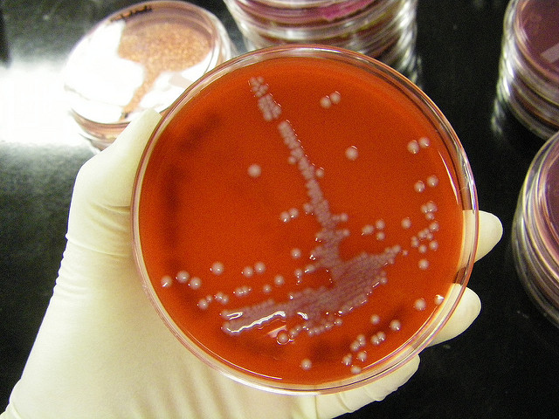
The URINE CULTURE
Return to Table of Contents
Remember!
You do not need to obtain a urine culture for a healthy non-pregnant female with symptoms of cystitis → just empirically treat her!
A positive urine culture = bacterial growth in urine that is reflective of bladder infection
Indications to obtain a culture:
Suspect UPPER TRACT infection (i.e. flank pain, fever)
Failure to respond to therapy
Recurrent UTIs
“Complicated” patient (i.e. male sex, immunocompromised, pregnancy)
For “complicated” or recurrent UTIs, a urine culture should be obtained prior to antibiotics to evaluate for antimicrobial resistance

Slide 23
COLONY COUNTS
Return to Table of Contents
The threshold of >10⁵ colony forming units (CFU) per mL is thought to represent a true infection
Patients with true infection usually have cultures with >10⁵ CFU/mL while contaminated cultures usually have <10³ CFU/mL
However, there are limits to the “>10⁵ per mL rule”
It can still mean bacteriuria is just colonization; symptoms are key!
Patients with pyelonephritis can have lower counts when bacteria are replicating in the kidney and not the bladder

Slide 24
Treatment guidelines
Return to Table of Contents
xxxxxiInfectious Diseases Society of America
Click here for IDSA website link!
Antibiotic regimens next slide!
Notes:
Infectious Diseases Society of America

Slide 25
Uncomplicated/simple cystitis: 1st Line agents
Return to Table of Contents
* Remember to prescribe an antibiotic based on allergy & tolerance profile
* Remember in a young woman, you can empirically treat her; a culture is not necessary!
Prescribe This… | Except…
Nitrofurantoin (Macrobid) 100mg PO BID x 5 days | Avoid if pyelonephritis is suspected or CrCl <30 ml/min
Trimethoprim-sulfamethoxazole (Bactrim) 180/800mg (1 double strength tablet) PO BID x 3 days | Avoid if regional resistance prevalence is known to exceed 20%!
Fosfomycin 3 gm PO single dose | Avoid if early pyelonephritis is suspected

Slide 26
Uncomplicated/simple cystitis: 2nd LINE AGENTS
Return to Table of Contents
* If unable to use first line agent, quinolones are next preferred
*Fluoroquinolones (ciprofloxacin & levofloxacin) should be reserved for important uses other than uncomplicated cystitis!
Prescribe This… | Except…
Ciprofloxacin 250mg PO BID x 3 days | Resistance can be high in some areas, also more $$ and more side effects
Levofloxacin 500mg PO QD x 3 days | Resistance can be high in some areas, similar to cipro
Beta-lactams (amoxicillin-clavulanate, cefpodoxime, cefdinir, cefadroxil, cephalexin) PO x 5-7days | Generally avoid amoxicillin alone given high resistance → B-lactams have lower efficacy than other agents & requires close follow-up. Cephalexin is less well studied.
REMEMBER: Some drugs need dose adjustment in renal dysfunction

Slide 27
Mild complicated uti treatment: OUTPATINET
Return to Table of Contents
* Patients with a mild complicated UTI aka pyelonephritis (i.e. low grade fever, flank pain, able to tolerate PO) with good compliance/follow-up can be treated outpatient!
* A urine culture should always be performed in a complicated infection to confirm that the empiric regimen is appropriate!
Oral Antibiotic Choices
Trimethoprim-sulfamethoxazole (Bactrim) 180/800mg (1 DS tablet) BID x 7-10 days
Ciprofloxacin 500mg BID x 5-7 days
Levofloxacin 750mg QD x 5-7 days
Beta-lactams are an option (amox-clav, cefpodoxime, etc. for 10-14 days) pending culture results & if other agents are not feasible

Slide 28
COMPLICATED UTI Treatment: inpatient
Return to Table of Contents
^ Based on normal renal function
* Patients with moderate-severe pyelonephritis (i.e. high fever, severe pain, sepsis, inability to tolerate PO) need to be managed initially as inpatients!
* Treat moderate illness with:
a 3rd generation cephalosporin OR
a fluoroquinolone
* Treat severe illness (or if resistant organism suspected) with a broader agent:
a 4th generation cephalosporin (i.e. cefepime, ceftazidime)
piperacillin-tazobactam OR
a carbapenem OR
SEVERITY | ANTIMICROBIAL AGENT^
Mild to Moderate | Ceftriaxone 1g IV Q24H
 | Ciprofloxacin 400mg IV/PO Q12H
 | Levofloxacin 750mg IV/PO Q24H
 | Aztreonam 1g IV Q12H use if beta-lactam allergy
Severe | Cefepime 1g IV Q12H
 | Piperacillin-tazobactam (Zosyn) 4.5g IV Q8H
 | Meropenem 500mg IV Q6H
FYI: Aminoglycosides & advanced cephalosporin/carbapenem combinations (i.e. getamicin, ceftaz-avibactam, ceftol-tazobactam, etc. ) are used ONLY for highly resistant organisms (i.e. carbapenemase producing bacteria)

Slide 29
COMPLICATED UTI Treatment: inpatient
Return to Table of Contents
Remember, always obtain blood cultures to evaluate for bacteremia in the septic patient!
REMEMBER, consider obtaining abdominal/pelvic imaging to evaluate for potential urinary tract obstruction (i.e. stone) or renal abscess in the right context
REMEMBER, if there is suspicion for a drug-resistant gram-positive infection (i.e. enterococci, staph.), add one of the following: vancomycin, daptomycin, or linezolid
After clinical improvement is observed, parenteral therapy should be switched to oral therapy using UCx sensitivities as a guide!
A course of therapy is typically 10-14 days!

Slide 30
Multidrug Resistant organisms: Outpatient treatment
Return to Table of Contents
Click here for a great article published in Clin Infect Dis (2016) to learn more!
The prevalence of MDR E. Coli in outpatient isolates is increasing: increased from 9% in 2001 to 17% in 2010 (Sanchez et al. 2014)
Risk Factors = prior use of antibiotics, hospitalized for >48 hours, nursing home residents, receiving hemodialysis in previous 3 months, indwelling catheters, elderly, immunocompromised, diabetics, males
ANTIBIOTIC | RESISTANCE RATES FOR MDROs | SUGGESTED EMPIRIC THERAPY FOR UTI DUE TO MDRO
Fosfomycin | 5-40% | First line
Nitrofurantoin | 2-21% | First line
TMP-SMX | 60-77% | Not recommended
FQs | 49-72% | Not recommended
Beta-lactams | Not well characterized for MDROs; 72-75% in non-MDROs | Not recommended due to poorer clinical outcomes

Slide 31
Want to learn more about antibiotics?
Check out the Antibiotic module on Idmodules.com

Slide 32
RECURRENT UTIs
Return to Table of Contents
After an initial UTI, 20-30% of women will get a second UTI within 6 months and 3% will experience a third UTI within that period!
≥2 infections in six months or ≥3 infections in one year

Slide 33
RISK FACTORS FOR DEVELOPING UTIS
Return to Table of Contents
Hooten et al. NEJM 1996
Scholes et al. J Infect Dis. 2000
Sexual intercourse
Use of spermicides
Previous UTI
New sex partner in the last year
History of UTI in first degree female relative
Female anatomy
Incontinence*
Diabetes*
*Independent risk factors for pyelonephritis

Slide 34
RISK FACTORS FOR DEVELOPING RECURRENT UTIS IN FEMALES
Return to Table of Contents
Biochemical/Genetic Factors:
Uroepithelial cells from “non-secretors” show enhanced adherence of uropathogenic E. coli (Sheinfield et al. 1989, Lomberg et al. 1986, Stapleton et al. 1995)
A ”non-secretor” is someone who carries a gene which prevents them from secreting their ABO blood type antigen in their secretions (15% of the population)
Females whose RBCs display a P1 phenotype (presence of P, P1, & PK antigens on the surface of RBCs) have an increased prevalence of pyelonephritis (Lomberg et al. 1983)
These antigens serve as receptors for P-fimbriated uropathogenic E. Coli
Behavioral Factors:
Spermicide, new sex partner in last year, having a first UTI <15 years old, mother with history of UTIs

Slide 35
RISK FACTORS FOR DEVELOPING RECURRENT UTI IN FEMALES
Return to Table of Contents
Raz et al Clin Infect Dis. 2000
Raz Korean J Urol 2011
Pelvic Anatomy:
Closer proximity of urethra to anus
Postmenopausal Women:
Urine incontinence
Post-voiding residual urine
Decreased estrogen levels
Estrogen stimulates proliferation of Lactobacillus in the vaginal epithelium → decreases pH → helps prevent vaginal colonization of Enterobacterales (i.e. pathogenic E. coli)

Slide 36
Management of recurrent female uti: the evidence
Return to Table of Contents
Eells et al. (CID 2014) performed a systematic literature review of the management of recurrent UTIs & analyzed the effectiveness of 5 strategies to prevent recurrent UTIs
Click for article link
Strategy | Rate of UTIs/year
Antibiotic Prophylaxis | 0.4
Acupuncture | 0.7
Estrogen | 1.1
Cranberry | 1.1
Symptomatic Self-Treatment | 3
RESULTS:
All management strategies showed a reduction in UTI rate except for symptomatic self-treatment (i.e. patient takes antibiotic based on their symptoms/self-diagnosis)
Daily antibiotic prophylaxis was the most efficacious but also the most expensive
Symptomatic self-treatment is less expensive than daily prophylaxis
Acupuncture’s results may be a function of publication bias & is least cost effective in terms of cost per quality of life years gained
Note, controls averaged 3 UTIs/year

Slide 37
Does Increasing water intake prevent recurrent UTIs?
Return to Table of Contents
Hooten et al. 2018 (JAMA) assessed the efficacy of increased daily water intake on frequency of recurrent UTIs in premenopausal women in an RCT of 140 women who had at least 3 UTIs in the prior year & had low-volume fluid intake at baseline (<1.5L daily)
RESULTS:
Women in the intervention arm (who increased their fluid intake by 1.5L) had fewer episodes of UTI (1.7 vs 3.2) over 12 mo. as compared to controls!
Women in the intervention arm required fewer antimicrobial courses for UTI (1.9 vs 3.6) over 12 mo. as compared to controls!
Increase fluid intake by 1.5L
Intervention
Women
n=140
Control
Maintain current fluid intake

Slide 38
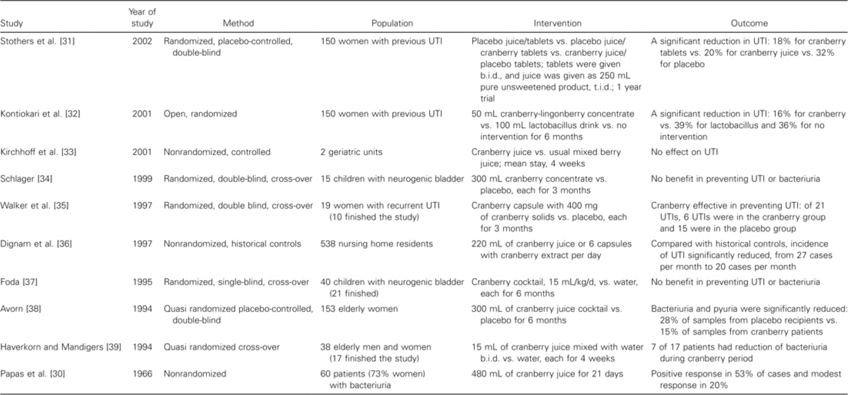
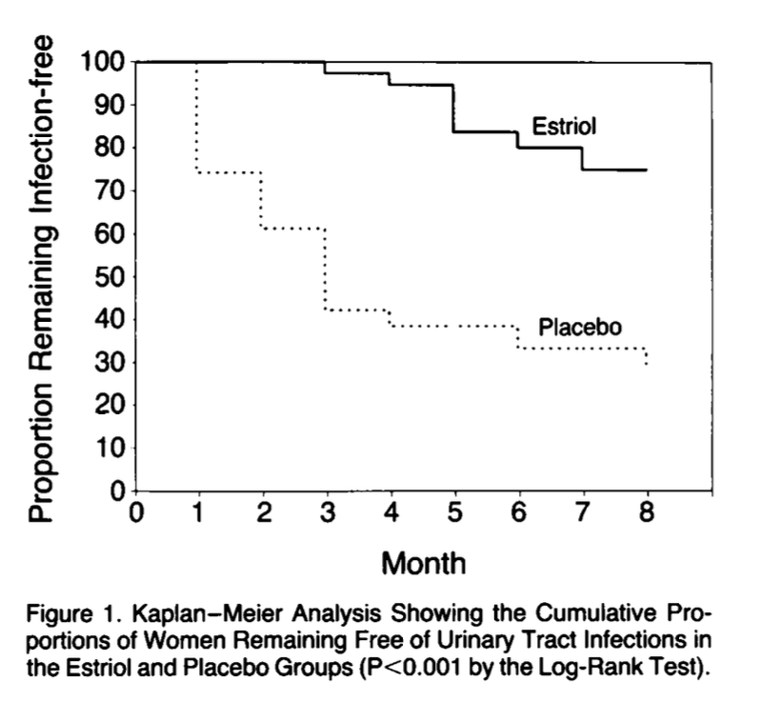
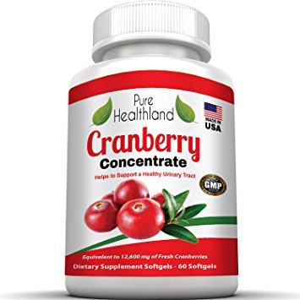
Prevention of recurrent utis: MORE evidence
Return to Table of Contents
From: Cranberry Juice and Urinary Tract Infection
Clin Infect Dis. 2004;38(10):1413-1419. doi:10.1086/386328
Clin Infect Dis | © 2004 by the Infectious Diseases Society of America
Cranberry products:
Estrogen REPLACEMENT:
Cranberries contain 2 compounds (fructose & proanthocyandin) that prevent fimbriaeted E. coli from adhering to uroepithelial cell receptors.
More than a dozen clinical trials have been performed to test the effects of cranberries on the urinary tract. The first clinical study was performed in1966 where subjects who consumed 480mL of juice daily for 3 weeks had a reduction in bacteriuria.
These trials have used many different types of cranberry products: juice concentrate, juice cocktail and cranberry capsules with different dosing regimens
OVERALL: Results suggest a possible clinical benefit of cranberry juice in preventing UTI in some populations, however, further research is needed to clarify the role of cranberries in protecting against UTIs
Estrogen replacement in post menopausal women restores atrophic mucosa, lowers vaginal pH, increases vaginal colonization of lactobacilli and decreases rate of colonization with Enterobacterales!
Raz & Stamm (1993) performed a double blind placebo-controlled trial of intravaginal estrogen cream. The incidence of UTI was 0.5 vs 5.9 episodes for treatment vs placebo group respectively!
Kaplan-Meier analysis showed the cumulative proportion of patients remaining free of UTI was significantly higher in the treatment group
After four months of estrogen treatment, the likelihood of remaining UTI-free was 0.95 in the treatment group versus 0.30 in the placebo group!

Slide 39
urinary tract infections in men
Return to Table of Contents
UTIs are much less common than in women
Why? Men have a longer urethra, prostatic fluid has antibacterial substances, & men have a drier periurethral area
UTIs in men aren’t necessarily COMPLICATED … but men can be at higher risk for more serious infection!!
Why? Majority occur in infants & elderly men, typically associated with urologic abnormalities (i.e. bladder outlet obstruction [urethral stricture, BPH], bladder tumor, instrumentation)
Risk factors for UTIs in young men include lack of circumcision & insertive anal intercourse (Hooten 1997)
Because UTIs in men are less common, it is important to identify the underlying cause!

Slide 40
Evaluation & treatment: male uti
Return to Table of Contents
Harper & Fowlis 2007
Schaeffer & Nicolle NEJM 2016
Male presents with UTI symptoms
IF the patient reporting perineal pain +/- fever, think PROSTATITIS → perform a digital rectal exam AND if tender, empirically treat!
ALWAYS keep a broad differential (i.e. urethritis, cystitis, pyelonephritis, prostatitis)
WHAT ABOUT RECURRENT UTIS IN MALES?
IF the patient appears systemically unwell (i.e. fever, n/v, flank pain) think pyelonephritis, abscess, prostatitis → referral for inpatient management & imaging via ultrasound or CT
REMEMBER,
Low threshold to also test for gonorrhea & chlamydia
Always obtain a urine culture prior to treatment for a male
IF 1st episode in a young, healthy male → just treat, a urologic evaluation is probably not necessary if single episode responds to antibiotics

Slide 41
EVALUATION & TREATMENT: RECURRENT MALE UTIS
Return to Table of Contents
Harper & Fowlis 2007
http://www.auanet.org
Most males with recurrent symptoms will have a structural or functional abnormality leading to impaired bladder emptying & impaired urine flow
Urologic referral is recommended for: 1) more than one UTI 2) ongoing urinary symptoms after treatment 3) positive findings on imaging (i.e. enlarged prostate, large post void residual, bladder/kidney stones)
With recurrent UTIs, THINK CHRONIC PROSTATITIS!
Presentation = recurrent irritative voiding symptoms (dysuria, frequency, urgency, perineal pain) +/- low grade fever +/- recurrent bacteriuria +/- repeat urine culture growing same organism
If DRE is positive, treat with prolonged antibiotic with good prostate penetration (at least 6 weeks!)
Fluoroquinolone > TMP-SMX

Slide 42
Candida In the urine: To treat or not to treat?
Return to Table of Contents
Candiduria (a urine culture growing the yeast Candida) is common in hospitalized patients!
Risk factors include: urinary tract devices, prior antibiotic therapy, diabetes, urinary tract pathology, and malignancy (Kauffman et al. 2000)
Most patients are asymptomatic and it is difficult to differentiate between infection & colonization!
Urine characteristics (i.e. number of yeasts, pyuria) DO NOT help.
Patients with systemic signs & symptoms should be evaluated more closely for disseminated infection with imaging & blood cultures.
Remember: Candiduria in hospitalized patients is almost always contamination and does not require treatment!
(Papas et al. 2016)
WHO NEEDS TREATMENT?
* Asymptomatic Patients: treat with antifungal therapy in the setting of a condition with a high risk of dissemination (i.e. neutropenia, urinary tract manipulation)
* Symptomatic Patients: treat with antifungal therapy based on UCx sensitivities
WHO DOES NOT NEED TREATMENT?
* Asymptomatic Patients because even with treatment, rapid recurrence is common
Other fungi in urine cultures (Cryptococcus, Blastomyces, etc.) require an ID consult
Want to learn more about fungal infection and anti-fungals? Check out that module on IDmodules.com

Slide 43
CATHETER ASSOCIATED URINARY TRACT INFECTIONS:
Return to Table of Contents
Hooten et al 2010
Clinical Definition:
Culture growth of ⩾10³ CFU/ml in the presence of signs/symptoms of UTI w/o other source in a patient with an indwelling urethral, suprapubic, or intermittent catheterization
CAUTI Symptoms:
Fever, rigors, malaise, CVA tenderness, hematuria, pelvic discomfort, altered mental status
Dysuria, urinary frequency/urgency esp. in patients with recent catheter removal!
In patients with a spinal cord injury → symptoms may include increased spasticity or autonomic dysreflexia
How to Reduce the Incidence of CAUTIS:
Make sure there is a clear indication for a catheter! If not, remove the catheter ASAP
Always keep the urinary bag below the level of the patient’s bladder! Use proper hand hygiene before and after handing the catheter
There is no clear recommendation as to whether routine catheter change (i.e. every 2–4 weeks) in patients with chronic catheters will reduce the risk of a CAUTI
Pyuria & bacteria will almost always be seen from patients with catheters!!! A CAUTI ALWAYS has symptoms!

Slide 44
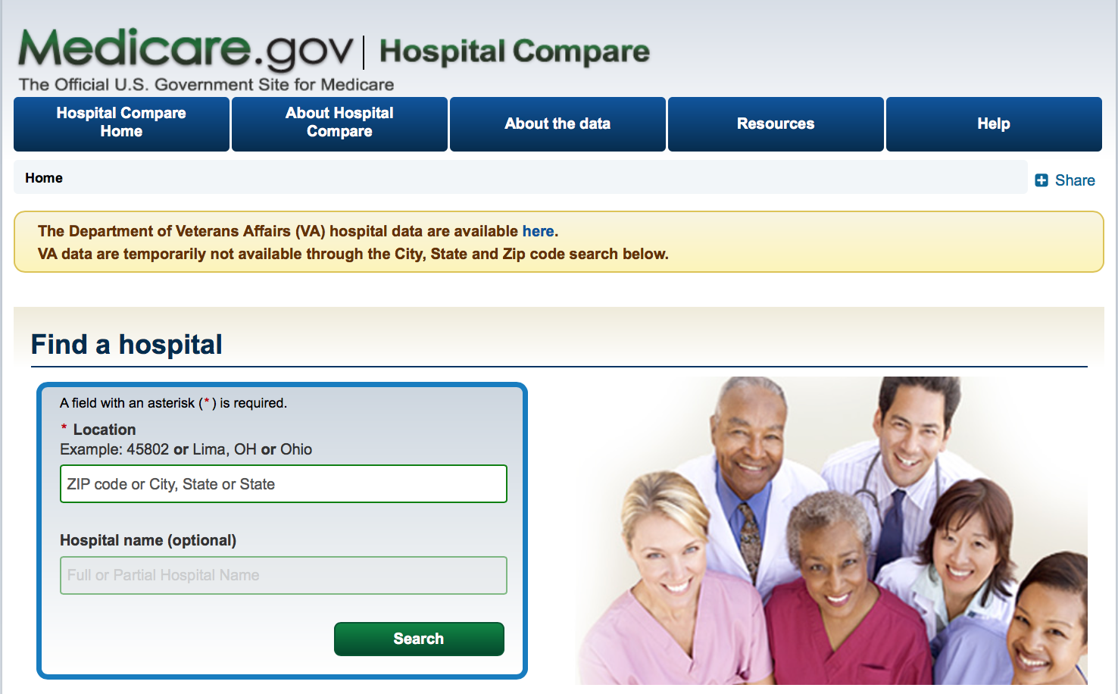
How do hospitals compare: rates of HEALTHCARE-ASSOCIATED INFECTIONS
Return to Table of Contents
Medicare.Gov is the official U.S. Government site for Medicare
Compares the quality of care at >4,000 Medicare-certified hospitals across the country
Hospitals are compared on various quality metrics including the rates of healthcare-associated infections (ex: CAUTIs)

Slide 45
medicare.gov: the data
Return to Table of Contents
Where does the data come from?
Hospitals are required to report data of healthcare-associated infections (HAI) to the CDC’s National Healthcare Safety Network
What kinds of infections are reported?
Incidence of central line-associated blood stream infections, CAUTIs, surgical site infections, MRSA bacteremia, and C. difficile
How are hospitals compared?
Hospitals are compared using the Standardized Infection Ratio (SIR) → the primary summary measure used to track HAIs and adjusts for various facility and patient level factors that contribute to HAI risk within each facility
The SIR compares the actual # of HAIs reported to the # that would be predicted, given the standard population (i.e. NHSN baseline) adjusting for several risk factors that are significantly associated with differences in infection incidence
An SIR > 1.0 indicates that more fewer CAUTIs (or other HAI) were observed than predicted
An SIR < 1.0 indicates fewer CAUTIs (or other HAI) were observed than predicted

Slide 46
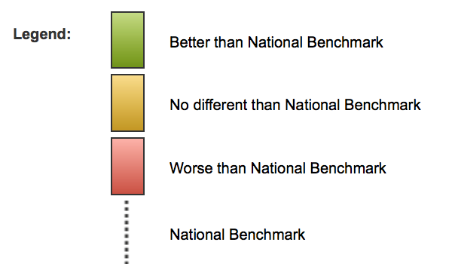
How does your hospital compare?
Return to Table of Contents
INSTRUCTIONS:
Click HERE or type “https://www.medicare.gov/hospitalcompare/search.html” into your browser
Type in zip code & hospital name
Click on the “Complications & deaths” tab
Click on the “Infections” tab
Click “Show Graphs”
Interpret the Data

Slide 47
LET’S DO SOME CASES
Return to Table of Contents

Slide 48
Case 1
Return to Table of Contents
You are the on call doctor covering the primary care clinic for the weekend. A 23 year old woman calls you urgently at 11pm on a Friday evening complaining of burning with urination and frequent urination since she woke up that morning. She denies fever, side or back pain, or other symptoms. She has no past medical history or allergies. She tells you she has an IUD for birth control. She tells you she thinks she has a urinary tract infection because she had one a few years ago. There are some available appointments in the Saturday clinic tomorrow morning. What is the most appropriate next step?
A) Tell her you cannot help her over the phone and refer her to ED for evaluation
B) Empirically treat her with 5 days of Nitrofurantoin & tell her to schedule a clinic visit if symptoms do not improve by Monday
C) Empirically treat her with 3 days of Ciprofloxacin & tell her to schedule a clinic visit if symptoms do not improve by Monday
D) Tell her she needs to come in for a urinalysis & urine culture on Saturday

Slide 49
Explanation case 1
Return to Table of Contents
This woman has typical symptoms of acute simple cystitis, a lower urinary tract infection. She has no symptoms to suggest early pyelonephritis, or an upper tract or systemic infection. You do not need a urine analysis for this patient as her symptoms are typical for a urinary infection. You do not need a urine culture for this patient as you have little reason to suspect bacterial resistance. It is correct management to empirically treat her with antibiotics. Nitrofurantoin (Macrobid) is a first line choice for treatment along with TMP-SMX (Bactrim) or Fosfomycin. Typically fluoroquinolones like ciprofloxacin are reserved for important uses other than uncomplicated/simple cystitis. If her symptoms do not improve within 48-72 hours, or she develops recurrent symptoms within a few weeks of treatment, she should have an evaluation and a urine culture should be obtained.

Slide 50
Case 2
Return to Table of Contents
You are the on call doctor covering the primary care clinic for the weekend. A 35 year old woman calls you urgently at 11pm on a Friday evening complaining of burning with urination and frequent urination since she woke up that morning. She sounds really frustrated because this is her fourth episode in 6 months! She tells you she is always prescribed Bactrim, and her symptoms get better, but then they come right back! She denies fever, side or back pain, or other symptoms. She has no allergies and she is not pregnant. There are some available appointments in the Saturday clinic tomorrow morning. What is the most appropriate next step?
Tell her you cannot help her over the phone, and refer her to ED for evaluation
Empirically treat her with 3 days of Ciprofloxacin since a first line agent like Bactrim isn’t working & tell her to schedule a clinic visit if symptoms do not improve by Monday
Empirically treat her with 5 days of Nitrofurantoin since a first line agent like Bactrim isn’t working & tell her to schedule a clinic visit if symptoms do not improve by Monday
Tell her she needs to schedule an office visit Saturday to obtain a urine culture as you are worried she might have a resistant bacteria

Slide 51
Explanation case 2
Chew & Finh 1999
Johnson et al. 1992
Fairchild et al. 1982
Return to Table of Contents
This woman has typical symptoms of cystitis. However, what is not typical about this case is that this sounds like her 4th episode in 6 months. She could be developing recurrent UTIs or she could be suffering from an improperly treated UTI as her symptoms improve while on Bactrim but then quickly return. The definition of having recurrent UTIs is >2 infections in 6 months or >3 infections in one year. For this patient, you definitely need to obtain a urine culture and see her in clinic for an evaluation! It is likely that her urine culture will grow an organism that is resistant to Bactrim. You should tailor her antibiotic therapy based on this culture. Referral to urology and evaluation of the urinary tract to evaluate the etiology of recurrent UTIs is generally not needed. Cystoscopy and imaging at this point will likely be low yield. However, it is recommended that women be referred to urology after two recurrences of pyelonephritis or if there is high suspicion for a functional or structural abnormality. CT or renal ultrasound could later be obtained to rule out nephrolithiasis or obstructive uropathy.

Slide 52
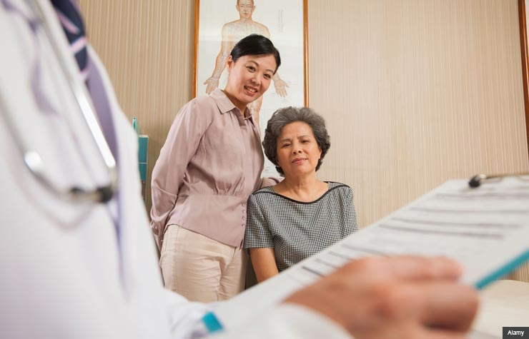
Case 3
Return to Table of Contents
A 76 year old woman, Ms. Chen, with history of diabetes (last HbA1c 9.1%), comes to see you for an acute visit in your primary care clinic. She is Mandarin speaking only and has brought her English speaking daughter with her for translation. Unfortunately the translator phone software isn't working today, so you have to rely on her daughter for interpretation. Ms. Chen at baseline is incontinent and for the past 2-3 days her daughter has noted Ms. Chen has had more episodes of urinary incontinence and has been complaining of bladder discomfort. In the office, Ms. Chen's vital signs are normal & her physical exam is unremarkable. A urine analysis shows: mod leuks, positive nitrite, positive glucose, 3 RBCs, 48 WBCs, few bacteria, 9 epithelial cells. What is the most appropriate empiric therapy and why?
A) Prescribe TMP-SMX (Bactrim) 1 DS tablet BID x 7 days for a complicated urinary tract infection
B) Prescribe Nitrofurantoin (Macrobid) 100mg BID x 5 days for an uncomplicated urinary tract infection
C) Defer antibiotic therapy given high number of epithelial cells, you cannot trust this urine analysis. Refer to urology for management of urinary incontinence.

Slide 53
Explanation case 3
Return to Table of Contents
Previously UTIs were categorized as being complicated in patients with risk factors for treatment failure or more serious infection (i.e. pregnancy, male sex, poorly controlled diabetes, anatomic abnormalities, etc. Today we categorize UTIs based on extent and severity of infection. Complicated UTIs are defined as UTIs with signs and symptoms suggestive of extension beyond the bladder (fever, chills, CVAT) while uncomplicated UTIs are confined to the bladder. Based on her symptoms and physical exam, Ms. Chen has a simple, uncomplicated cystitis. Being elderly and having poorly controlled diabetes does not automatically make her UTI “complicated”. It is important to note, symptoms of cystitis in elderly patients can include the classic symptoms of urgency, frequency, dysuria but may also include the development, or worsening, of urinary incontinence. Epithelial cells can indicate contamination by surrounding skin flora however given the patient's classic symptoms of cystitis and urine analysis with leukocyte esterase, nitrites and bacteria, this sample is adequate to support the diagnosis. Appropriate oral regimens for simple cystitis include: Macrobid, TMP-SMX, or Fosfomycin.

Slide 54
Case 4
Return to Table of Contents
A 65 year old man with a history of benign prostatic hypertrophy (BPH) on tamsulosin and finasteride & chronic lower back pain presents to the ED. He appears unwell, febrile to 102.8F and with a HR of 115. He is complaining of chills, malaise, and nausea that started last night. He has noted burning with urination, urinary frequency and a sensation that he is not completely emptying his bladder for a few days. At first he thought this was his “BPH acting up” but he reports it has been painful to sit. He is reporting lower back pain but doesn’t think its worse than normal. A CBC is notable for WBC 15.6K. A urine analysis is notable for large leukocyte esterase, nitrites, bacteria with 30 WBCs and 18 RBCs. What is the next appropriate step in management?
Empirically start IV Ceftriaxone for suspected pyelonephritis given fever, back pain, leukocytosis. Admit to the Medicine service.
Consult Urology & perform a CT Urography to evaluate for kidney stones given presence of RBCS and back pain; infected nephrolithiasis is a urologic emergency!
Perform a digital rectal exam; if tender, he likely has acute prostatitis. Start IV Ceftriaxone and admit to medicine given severe sepsis.
Place a foley and obtain CT A/P to evaluate for pyelonephritis or perinephric abscess

Slide 55
Explanation case 4
Return to Table of Contents
Brede & Shoskes 2011
This patient has the classic symptoms of prostatitis including irritative voiding symptoms, fevers, chills, malaise, and perineal pain. A digital rectal exam should be performed on this patient to help make the diagnosis. On exam, the prostate is exquisitely tender, firm and edematous. BPH is an anatomical anomaly that predisposes the patient to this condition. Other predisposing factors include genitourinary instrumentation (i.e. catheterization) and urethral strictures. Entry of bacteria into the prostate gland almost always occurs via the urethra. The pathogens that cause acute prostatitis include E. Coli, Proteus, Klebsiella, Enterobacter, Serratia, and Pseudomonas. Treatment of acute bacterial prostatitis is typically at least 4 weeks with an antibiotic with good prostate penetration. A urine culture should be obtained as the pathogen in the urine culture is often the pathogen infecting the prostate and antibiotics should be tailored to this culture. TMP-SMX & the fluoroquinolones have good prostate penetration. The patient should have imaging studies to rule out complications of prostatitis (i.e. abscess) via transrectal US or CT pelvis if no improvement is observed following initiation of medical therapy. If this patient did not have a tender prostate on exam, he should be empirically managed as having a complicated upper tract infection.

Slide 56
Case 5
Return to Table of Contents
A 25 year old healthy woman comes to your primary care clinic. Her vitals documented by the medical assistant are: T99.8 HR101 BP104/65 99%RA. She appears fatigued and is sitting on the exam table holding her left side. She states she was camping a little over a week ago and started having burning with urination and frequent urination. She decided to make an appointment to see you after she developed left back pain last night. She has been feeling feverish with some nausea at home. This is the first time she has experience anything like this. She has a sulfa allergy. A urine analysis is notable for positive leuk esterase & nitrites. Urine pregnancy is negative. She has left costovertebral tenderness. What is the next appropriate step?
Refer her to the ED, as she has pyelonephritis and requires IV antibiotics for the first 48 hours until urine culture returns
Send her urine for culture, prescribe a 7 day course of ciprofloxacin for pyelonephritis
Refer her to the ED, as she has pyelonephritis and requires imaging with ultrasound or CT to evaluate for complications (i.e abscess, renal stones)
Prescribe a 10 day course of ciprofloxacin for pyelonephritis, but there is no need to obtain a urine culture since this is an infection in an otherwise healthy young female

Slide 57
EXPLANATION CASE 5
Return to Table of Contents
Gupta et al. 2011
This young healthy woman has acute pyelonephritis, an upper urinary tract infection, given her flank pain and fever, in addition to her cystitis symptoms. The diagnosis is supported by the urine analysis and her physical exam. A urine analysis and urine culture is always sent for patients with suspected pyelonephritis or complicated UTI. Outpatient management is appropriate for a patient with mild-moderate symptoms who can tolerate oral antibiotics and who have close follow up. Inpatient management is warranted when the illness is severe (i.e. high fever, severe pain, inability to take oral medications or tolerate PO, pregnancy, when there are concerns about compliance, etc.). Fluoroquinolones and TMP-SMX are recommended for empiric treatment of pyelonephritis, but the patient in this case is allergic to sulfa. Follow up cultures are not needed for patients’ whose symptoms resolve after treatment. Most patients with acute complicated UTI or pyelonephritis do not need imaging studies unless they are severely ill, have persistent clinical symptoms despite 48-72 hours of appropriate antibiotic therapy, or there is concern for urinary tract obstruction. The goal of imaging is to evaluate for a process that would warrant intervention (i.e. stone) or to diagnose a complication of infection (i.e. renal abscess).

Slide 58
Case 6
Return to Table of Contents
A 61 year old woman comes to your primary care clinic for her annual physical exam. She is generally healthy and her medication list includes only over the counter vitamins. As you review her past medical history, you note she has been treated for five urinary tract infections over the last three years. She is postmenopausal. Her last urinary tract infection was two months ago. She wants to know what she can do to try to reduce her chance of developing another infection. For this specific patient, which intervention has been shown to significantly reduce the development of recurrent UTIs AND is safe to prescribe for her?
Cranberry supplementation
There is no evidenced-based intervention for reducing this patient’s risk of UTIs
Intravaginal estrogen
Oral estrogen

Slide 59
EXPLANATION CASE 6
Return to Table of Contents
Raz 2011
UTIs are the most common bacterial infection in postmenopausal women. Postmenopausal women develop more UTIs because the lack of estrogen leads to atrophic mucosa, a higher vaginal PH, and increased colonization with Enterobacterales including E. Coli. Intravaginal estrogen has been shown to reduce the incidence of UTIs in this specific population. Other benefits of estrogen in this population include improving symptoms related to atrophic vaginitis and improving urge incontinence. This patient is generally healthy and has no contraindications to estrogen therapy. Contraindications to estrogen therapy include endometrial or breast cancer, thromboembolic disease, and liver disease. It is worth noting that estrogen doses used vaginally are significantly lower than those used for oral estrogen replacement therapy. Although studies have shown potentially beneficial evidence of cranberries in reducing UTIs, there is no conclusive evidence that cranberries are useful in the prevention of UTIs in postmenopausal women.

Slide 60
Case 7
Return to Table of Contents
You are taking care of Mr. Jones who is currently hospitalized in the ICU with respiratory failure from influenza and while reviewing his microbiology data, you noticed that his urine culture is growing Candida albicans. Mr. Jones initially brought into the ED when his family found him having difficulty breathing with high fevers. His initial VS were T102.1 HR108 BP86/43 79%RA. He was intubated on arrival given hypoxia and dyspnea and a urinary catheter was placed. Blood cultures, a urine culture, and a respiratory culture were all sent on admission to the ICU. A CXR shows multifocal infiltrates. You are asked while on rounds whether or not you want to start an antifungal to treat his positive urine culture. What should you do?
Start empiric liposomal amphotericin B. Mr. Jones is critically ill and normally you would start fluconazole but there is a high rate of resistance of C. albicans to fluconazole.
Do not treat this urine culture as candida in the urinary tract is likely a colonizer
Start fluconazole for a fungal UTI
Re-culture his urine as candida is known to be a contaminant. If found a second time, start antifungal therapy

Slide 61
EXPLANATION CASE 7
Return to Table of Contents
Candida is extremely common to find in the urine of hospitalized patients and Candida is often a colonizer of the urinary tract. It is very difficult to differentiate between an infection versus colonization with Candida, though ALMOST ALL candiduria represents contamination. This patient’s risk factor for candiduria is his urinary catheter. You do not need to treat this patient with an anti-fungal; he is likely systemically ill from his influenza pneumonia given the clinical context. Patients who need treatment and whose urine cultures are likely to represent a true infection with Candida are: 1) patients with symptoms of a urinary tract infection and 2) asymptomatic patients with a very high risk of dissemination (i.e. neutropenia, patients undergoing urinary tract manipulation). The oral choice of treatment is fluconazole; the other azoles are not recommended as they are not as active in the urine. Amphotericin B is an antifungal alternative for treatment though less desirable but at times used when the Candida is fluconazole-resistant. (see IDmodules.com anti-fungal module for more details)

Slide 62
Congratulations on finishing the UTI module!
Return to Table of Contents
Please take this brief post-module quiz
https://goo.gl/forms/LbQwIqxnrsTeRR3i1

Slide 63
REFERENCES
Return to Table of Contents
Schappert SM, Rechtsteiner EA. Ambulatory medical care utilization estimates for 2007. Vital Health Stat. 2011;13:1–38.
May L, Mullins P, Pines J. Demographic and treatment patterns for infections in ambulatory settings in the United States, 2006-2010. Acad Emerg Med. 2014 Jan;21(1):17-24. 2. Czaja CA, Scholes D, Hooton TM, Stamm WE. Population-based epidemiologic analysis of acute pyelonephritis. Clin Infect Dis. 2007;45(3):273.
Nicolle LE. Catheter-related urinary tract infection: practical management in the elderly. Drugs Aging. 2014 Jan;31(1):1-10
Hooton TM. Clinical practice. Uncomplicated urinary tract infection. N Engl J Med. 2012 Mar 15;366(11):1028-37
Sanchez GV, Baird AM, Karlowsky JA, Master RN, Bordon JM. Nitrofurantoin retains antimicrobial activity against multidrug-resistant urinary Escherichia coli from US outpatients. J Antimicrob Chemother. 2014 Dec;69(12):3259-62.
Walker E, Lyman A, Gupta K, Mahoney MV, Snyder GM, Hirsch EB. Clinical Management of an Increasing Threat: Outpatient Urinary Tract Infections Due to Multidrug-Resistant Uropathogens. Clin Infect Dis (2016) 63 (7): 960-965.
Sheinfeld J, Schaeffer AJ, Cordon-Cardo C, Rogatko A, Fair WR. Association of the Lewis blood-group phenotype with recurrent urinary tract infections in women. N Engl J Med. 1989 Mar 23;320(12):773-7.
Lomberg H, Cedergren B, Leffler H, Nilsson B, Carlström AS, Svanborg-Edén C. Influence of blood group on the availability of receptors for attachment of uropathogenic escherichia coli. Infect Immun. 1986 Mar;51(3):919-26.
Stapleton A1, Hooton TM, Fennell C, Roberts PL, Stamm WE. Effect of secretor status on vaginal and rectal colonization with fimbriated Escherichia coli in women with and without recurrenturinary tract infection. J Infect Dis. 1995 Mar;171(3):717-20.
Devillé WL, Yzermans JC, van Duijn NP, Bezemer PD, van der Windt DA, Bouter LM. The urine dipstick test useful to rule out infections. A meta-analysis of the accuracy. BMC Urol. 2004 Jun 2;4:4. doi: 10.1186/1471-2490-4-4. PMID: 15175113; PMCID: PMC434513.
Foxman B. Recurring urinary tract infection: incidence and risk factors. Am J Public Health. 1990;80(3):331-333.

Slide 64
REFERENCES
Return to Table of Contents
Scholes D, Hooton TM, Roberts PL, Stapleton AE, Gupta K, Stamm WE. Risk factors for recurrent urinary tract infection in young women. J Infect Dis. 2000;182(4):1177-1182.
Hooton TM, Scholes D, Hughes JP, et al. A prospective study of risk factors for symptomatic urinary tract infection in young women. N Engl J Med. 1996;335(7):468-474.
Lomberg H, Edén CS. Influence of P blood group phenotype on susceptibility to urinary tract infection. FEMS Microbiol Immunol. 1989 Jun;1(6-7):363-70.
Kinane DF, Blackwell CC, Brettle RP, Weir DM, Winstanley FP, Elton RA. ABO blood group, secretor state, and susceptibility to recurrent urinary tract infection in women. Br Med J (Clin Res Ed). 1982 Jul 3;285(6334):7-9.
Lomberg H, Hanson LA, Jacobsson B, Jodal U, Leffler H, Edén CS. Correlation of P blood group, vesicoureteral reflux, and bacterial attachment in patients with recurrent pyelonephritis. N Engl J Med. 1983 May 19;308(20):1189-92.
Raz R, Gennesin Y, Wasser J, et al. Recurrent urinary tract infections in postmenopausal women. Clin Infect Dis. 2000;30(1):152-156.
Paul Raz. Urinary Tract Infection in Postmenopausal Women. Korean J Urol. 2011 Dec; 52(12): 801–808.
Eels SJ, Bharadwa K, McKinnell JA, Miller LG. Recurrent Urinary Tract Infections Among Women: Comparative Effectiveness of 5 Prevention and Management Strategies Using a Markov Chain Monte Carlo Model. Clin Infect Dis (2014) 58 (2): 147-160.
Raz R, Chazan B, Dan M. Cranberry Juice and Urinary Tract Infection. Clin Infect Dis (2004) 38 (10): 1413-1419.
Raz R1, Stamm WE. A controlled trial of intravaginal estriol in postmenopausal women with recurrent urinary tract infections. N Engl J Med. 1993 Sep 9;329(11):753-6.
Hooton TM, Stamm WE. Diagnosis and treatment of uncomplicated urinary tract infection. Infect Dis Clin North Am. 1997;11(3):551.
Harper M, Fowlis G. Management of urinary tract infections in men. Trends Urology, Gynecol. Sexual Health. 2007;12: 30–35.

Slide 65
REFERENCES
Return to Table of Contents
Schaeffer AJ, Nicolle LE. Urinary Tract Infections in Older Men. N Engl J Med 2016; 374:562-571
Hooton TM, Bradley SF, Cardenas DD, Colgan R, Geerlings SE, Rice JC, Saint S, Schaeffer AJ, Tambayh PA, Tenke P, Nicolle LE; Infectious Diseases Society of America.Diagnosis, prevention, and treatment of catheter-associated urinary tract infection in adults: 2009 International Clinical Practice Guidelines from the Infectious Diseases Society of America. Clin Infect Dis. 2010 Mar 1;50(5):625-63.
Kauffman CA, Vazquez JA, Sobel JD, Gallis HA, McKinsey DS, Karchmer AW, Sugar AM, Sharkey PK, Wise GJ, Mangi R, Mosher A, Lee JY, Dismukes WE. Prospective multicenter surveillance study of funguria in hospitalized patients. The National Institute for Allergy and Infectious Diseases (NIAID) Mycoses Study Group. Clin Infect Dis. 2000 Jan;30(1):14-8.
Pappas PG, Kauffman CA, Andes DR, Clancy CJ, Marr KA, Ostrosky-Zeichner L, Reboli AC, Schuster MG, Vazquez JA, Walsh TJ, Zaoutis TE, Sobel JD. Executive Summary: Clinical Practice Guideline for the Management of Candidiasis: 2016Update by the Infectious Diseases Society of America. Clin Infect Dis. 2016 Feb 15;62(4):409-17
Johnson JR, Vincent LM, Wang K, Roberts PL, Stamm WE. Renal ultrasonographic correlates of acute pyelonephritis. Clin Infect Dis. 1992 Jan;14(1):15-22.
Fairchild TN, Shuman W, Berger RE. Radiographic studies for women with recurrent urinary tract infections. J Urol. 1982 Aug;128(2):344-5.
Chew LD, Fihn SD. Recurrent cystitis in nonpregnant women. West J Med. 1999 May;170(5):274-7.
Brede CM, Shoskes DA. The etiology and management of acute prostatitis. Nat Rev Urol. 2011 Apr;8(4):207-12.

Slide 66
REFERENCES
Return to Table of Contents
Gupta K, Hooton TM, Naber KG, Wullt B, Colgan R, Miller LG, Moran GJ, Nicolle LE, Raz R, Schaeffer AJ, Soper DE; Infectious Diseases Society of America; European Society for Microbiology and Infectious Diseases. International clinical practice guidelines for the treatment of acute uncomplicated cystitis and pyelonephritis in women: A 2010 update by the Infectious Diseases Society of America and the European Society for Microbiology and Infectious Diseases. Clin Infect Dis. 2011 Mar 1;52(5):e103-20.
Luthje & Brauner. Chapter Seveen – Virulence Factors of Uropathogenic E. coli and Their Interactions with the Host. Advances in Microbial Physiology. Volume 65, 2014, p 337-372
Sobel JD, Fisher JF, Kauffman CA, Newman CA. Candida urinary tract infections--epidemiology. Clin Infect Dis. 2011;52 Suppl 6:S433-S436.
http://www.idsociety.org/organ_system/#genitourinary
http://www.pathophys.org/uti/
http://www.auanet.org/education/educational-programs/medical-student-education/medical-student-curriculum/adult-uti
https://labtestsonline.org/understanding/analytes/urinalysis/ui-exams/start/2/
http://www.surgeryencyclopedia.com/st-wr/urinalysis.html
http://www.microbiologybook.org/infectious%20disease/urinary%20tract%20infections.htm

