Slide 1
Mycobacterium Tuberculosis

Slide 2
Welcome to the module on Tuberculosis
Please take this brief pre-module quiz
https://goo.gl/forms/jnK6G4Z5wF1wO1KE2

Slide 3

This module works a lot better in “presentation” mode

Slide 4
Table of contents
Part 1: Epidemiology
Part 2: Pathogenesis
Part 3: Diagnosis
Part 4: Treatment
Part 5: MDR and XDR TB
HINT: click on any of the links to short-cut directly to that section of the presentation!

Slide 5
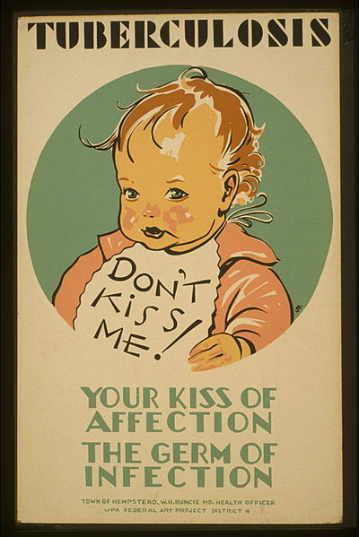
Part 1: Epidemiology
ToC
HINT: this button will take you back to the table of contents
Let’s start with some basic facts about how common tuberculosis is, where it’s found, and other epidemiologic facts
Notes:
https://commons.wikimedia.org/wiki/File:Tuberculosis_LCCN98516354.jpg

Slide 6

About 2 billion people world-wide have TB

Slide 7
That’s almost 1/3 of the world’s population

Slide 8
In some countries in Asia/Africa, it’s almost 80%!

Slide 9
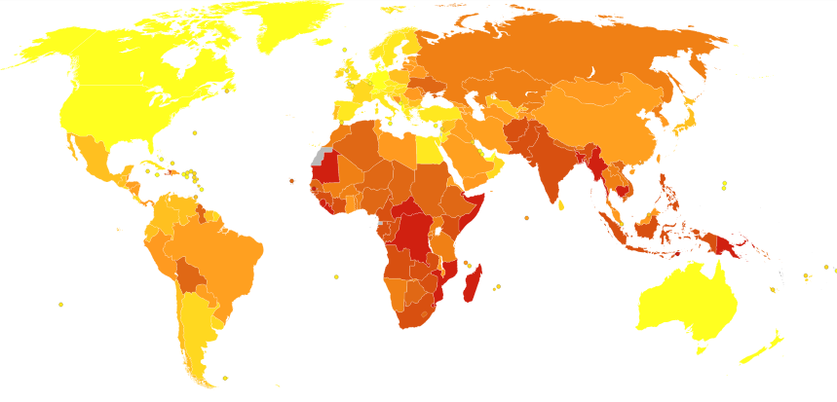
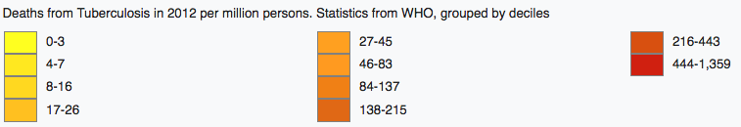
ToC
Deaths from Tuberculosis in 2012 per million persons by country
Data from the WHO
Notes:
https://commons.wikimedia.org/wiki/File:Tuberculosis_world_map-Deaths_per_million_persons-WHO2012.svg

Slide 10
Tuberculosis is also:
ToC
• The number one cause of death from infectious disease in the world
• The number one killer of people with HIV
Side note on HIV and TB
HINT: Click the button to learn a little more about TB and HIV

Slide 11
Side note on TB and HIV
There is synergy between TB and HIV:
• The risk of contracting TB doubles within the first year of developing HIV; the risk then continues to increase as the HIV progresses.
• People with HIV are at high risk of reactivating latent TB and of becoming re-infected with TB after treatment. TB can also develop at an accelerated rate in people with HIV.
• Just as HIV makes TB worse, TB can make HIV worse. Having had TB (even after successful treatment for it) is associated with an increased risk of progression to AIDS or death.
This is because HIV targets CD4+ T cells, which are critical for control of TB (we’ll talk more about the role of T cells in TB later)
The reason for this is not known but may also be due to the importance of T cells in clearing TB. The inflammatory T cell response may increase the number of CD4+ T cell targets for HIV to infect and even causes an increase in the expression of the CXCR4 and CCR5 receptors HIV targets.

Slide 12
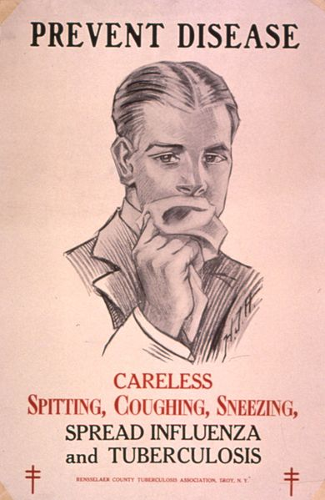
Part 2: Pathogenesis
ToC
Now let’s talk a little bit about how TB spreads and what happens during infection
Notes:
https://commons.wikimedia.org/wiki/File:TB_poster.jpg

Slide 13
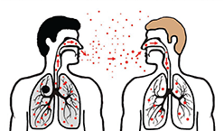
TB is spread through aerosolized droplets
ToC
This means someone with active, pulmonary TB needs to
1) cough on you. You must then
2) breath droplets containing mycobacterium tuberculosis into your lungs.
3) The TB bacilli then travel to alveoli and proliferate.
Notes:
https://commons.wikimedia.org/wiki/File:Disease_transmission_sneezing.png

Slide 14
TB is spread through aerosolized droplets
ToC
For infection to occur, only about 10 TB bacilli need to reach the lungs
Once in the lungs, the bacilli are phagocytosed by macrophages in the lung
Instead of being killed, the TB bacilli proliferate in the macrophages for 2-12 weeks until there are thousands of them
This is very low! Infectious dose of other pathogens:
E. coli: 10⁶ – 10⁸
Vibrio cholera: 10⁴ – 10⁶
Campylobacter: 500
Francisella tularensis: 10-50
Tuberculosis: 10
Entamoeba coli: 1(!)
Macrophage
Notes:
https://commons.wikimedia.org/wiki/File:Disease_transmission_sneezing.png

Slide 15
TB is spread through aerosolized droplets
ToC
At this point, enough antigen has been produced to stimulate a cellular immune response
Cellular immune response = CD4 and CD8 T cells attempt to contain the infection and/or kill infected cells
(REMINDER: this is in contrast to a humoral immune response in which B cells produce antibodies as a means of neutralizing invaders or indirectly stimulating their death)
Macrophage
T cell
Notes:
https://commons.wikimedia.org/wiki/File:Disease_transmission_sneezing.png

Slide 16
At this point, one of two things can happen.
Do you know what they are?
  #1: Latent TB: The immune system is able to successfully contain the infection (but not eliminate it). Macrophages and T cells wall off areas of infection, thereby preventing the infection from spreading. These walled off areas of infection are called granulomas.
OR
  #2: Active TB: The immune system is not able to contain the infection within granulomas and it spreads throughout the body

Slide 17
Latent infection
ToC
QUIZ: People with latent infection will generally report which symptom(s)?
A: Lymphadenopathy
B: Weight loss
C: Fevers
D: Hemoptysis
E: All of the above
F: None of the above
Latent infection is asymptomatic. It is also not contagious. By definition, latent infection is successfully contained, not able to spread within the host or from one host to another.
F: None of the above

Slide 18
Latent tuberculosis infection (LTBI)
ToC
• 90% of the time, primary infection results in latent infection
• The hallmark of latent infection – the reason it is “latent” and not “active” infection – is that the TB is continually kept in check by the immune system.
• The primary mechanism the immune system has for controlling TB is walling it off in granulomas, primarily because of a healthy CD4 and CD8 T-cell response. As long the immune system keeps the TB inside granulomas, the infected person is, for all intents and purposes, healthy. This control can continue for decades – for the entirety of a person’s lifetime!
So although 2 billion people have TB in the world, the vast majority have LTBI and are not even aware!

Slide 19
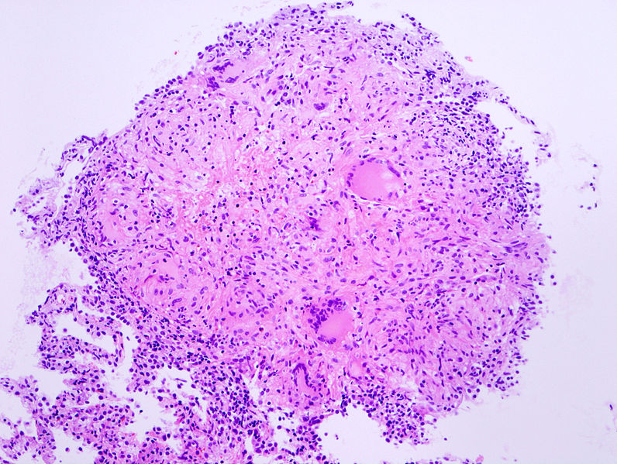
Granulomas!
ToC
This is a caseating granuloma!
These areas of caseation are areas of necrosis with complete loss of tissue architecture
Caseum = soft, dead cell mush
The graunuloma: a rim of healthy
macrophages and T cells
that are walling off:
- infected macrophages
- dead and dying infected cells
- free bacteria
- matrix
Lung tissues
Notes:
https://commons.wikimedia.org/wiki/File:Tuberculous_caseous_granuloma_(1)_TBLB.jpg

Slide 20
Latent infection
ToC
Question: Why do we care about latent infection?
Answer: Latent TB can progress to Active TB. This is called reactivation.
The lifetime risk of progression to active disease is approximately 10%.
5% in the first 1.5 years after infection
5% over the remaining lifetime
Reactivation is more likely to occur in immunosuppressed individuals (think HIV: 10% risk per year if untreated!) or can occur as immunity wanes with age

Slide 21
Active infection
ToC
Active infection can be a result of primary infection not successfully contained by the immune system or reactivation of latent disease
In active TB, you’ll more often see the classic symptoms you associate with tuberculosis:
Fever
Night sweats
Weight loss
Hemoptysis
These are caused by the immune response to the TB. Specifically, macrophages (and T cells to a lesser extent) produce tumor necrosis factor (TNF). TNF causes a massive inflammatory response including fever and cachexia.
Why does the body do this to itself? TNF also promotes activation of immune cells, apoptosis of pathogenic cells, and inhibits viral replication.
What about hemoptysis? Why is that such a hallmark of TB?

Slide 22
Active infection
ToC
Active infection can be a result of primary infection not successfully contained by the immune system or reactivation of latent disease
In active TB, you’ll more often see the classic symptoms you associate with tuberculosis:
Fever
Night sweats
Weight loss
Hemoptysis
When TB is well contained in a granuloma (latent TB), factors released from immune cells – TNF, reactive oxygen species, and cytotoxic agents (granzymes and perforin) – kill some of the tissue and TB inside the granulomas, creating necrosis and tissue destruction.
When TB is not well contained (active TB), this same process happens outside the confines of the granuloma. When this tissue destruction leads to erosion of a blood vessel wall, hemoptysis occurs.

Slide 23
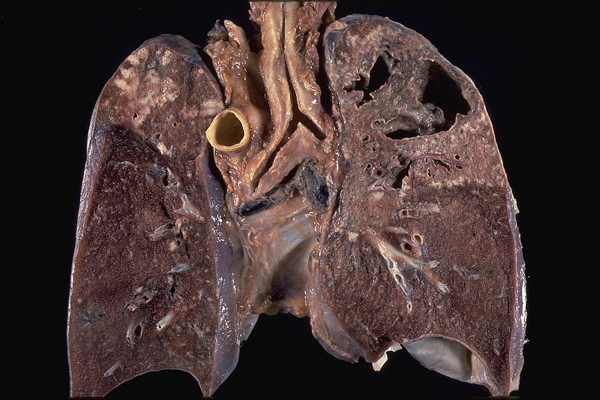
Cavitary tuberculosis
ToC
Cell necrosis leads to destruction of lung tissue and cavitations
This lung destruction is what leads to hemoptysis
Notes:
https://commons.wikimedia.org/wiki/File:Cavitary_tuberculosis.jpg

Slide 24
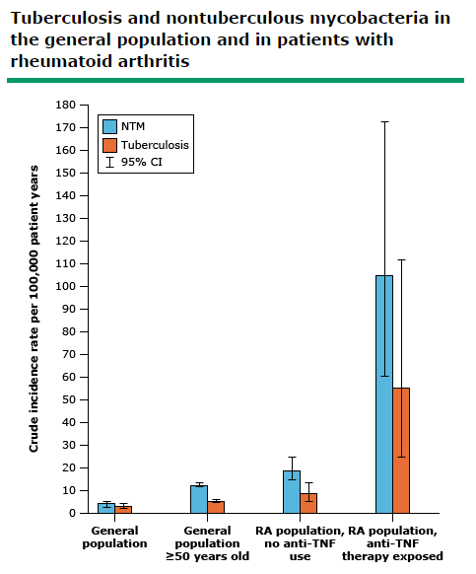

Food for thought
ToC
If many of the symptoms (fevers, weight loss, cachexia) from active tuberculosis are from over-abundance of TNFa, can we help the patient by giving TNFa-blockers?
What do you think?
Answer: you potentially could decrease some symptoms, but TNFa is being used by the immune system to fight the infection. In fact, TNFa-inhibitors are a potent way to case latent TB to become active TB! Better to kill the bacteria than to decrease TNFa

Slide 25
Active infection
ToC
What about other symptoms of active tuberculosis?
Could be just about anything!
Don’t forget about extrapulmonary TB: occurs in 15-20% of cases, especially in children or the immunocompromised (50% of cases in people with HIV!):
- Spine (Pott’s disease)
- CNS
- Lymph nodes (Scrofula when it involves the neck)
- Pericardium
- Pleura
- Joints
- Intestines
- GU system
- Pretty much anywhere
- Or everywhere – miliary TB (hemotagenously disseminated TB)

Slide 26
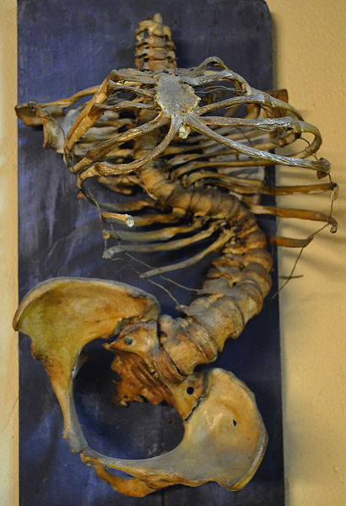
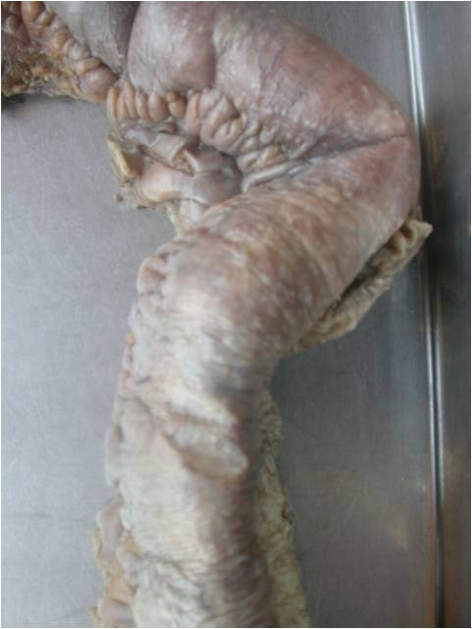
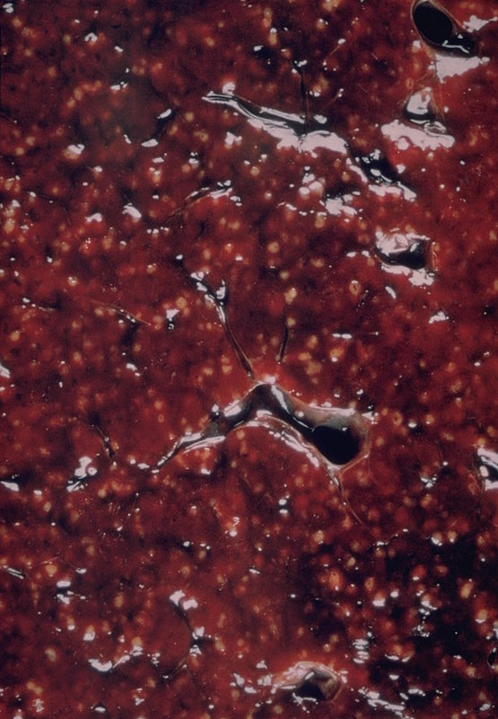
TB in the ileum
Effect of Pott’s disease on the spine
of a child
Miliary TB in the spleen
Notes:
https://commons.wikimedia.org/wiki/File:Mal_de_Pott_au_mus%C3%A9e_Testut-Latarjet.JPG
https://commons.wikimedia.org/wiki/File:Tuberculosis_of_ileum.jpg
https://commons.wikimedia.org/wiki/File:Miliary_tuberculosis_involving_spleen_(6539941557).jpg

Slide 27
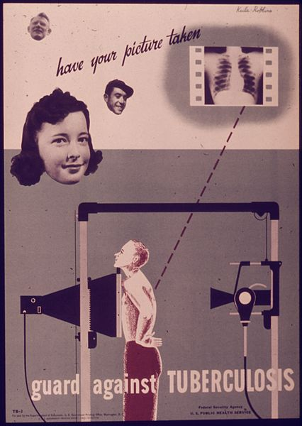
Part 3: Diagnosis
ToC
Now let’s talk about how TB is diagnosed and who should be tested for it
Notes:
https://commons.wikimedia.org/wiki/File:%22Guard_Against_Tuberculosis%22_-_NARA_-_514425.jpg

Slide 28
Part 3: Diagnosis
ToC
Whom would you test?
Has hemoptysis, night sweats, and weight loss
Feels just fine
?
✔
Test?
Test?

Slide 29
Diagnosis: whom to test
Feels just fine
• Is he from somewhere where TB is endemic?
• Is risk of reactivation high?
- Does he have HIV?
- Otherwise (or about to be) immunosuppressed?
(e.g. on chemotherapy, on TNF inhibitors,
getting HD)
If yes: TEST

Slide 30
Part 3: Diagnosis
ToC
How to test?
Feels just fine
In this guy, you’re looking for Latent TB.
You have 2 main options:
1. Tuberculin skin test
2. Interferon gamma release assay

Slide 31
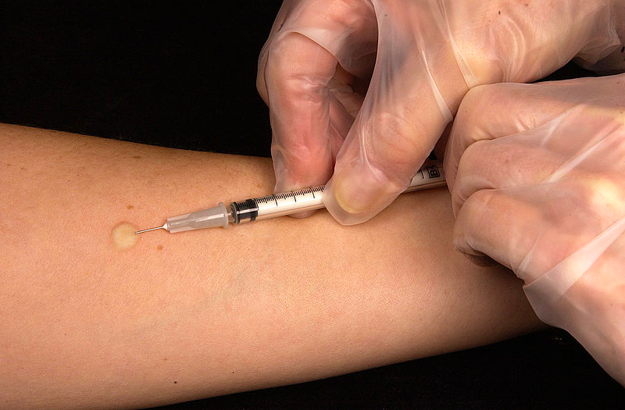
Tuberculin skin test (TST)
ToC
• TST is performed by injecting 0.1 ml of tuberculin purified protein derivative (PPD) intradermally into the inner surface of the forearm.
• 48-72 hours later, the diameter of induration (NOT erythema) is measured:
- 5 mm is positive for: HIV+, organ transplant, other immunosuppressed people
- 10 mm is positive for: recent immigrants from areas with high
TB incidence, health care workers, the homeless, and people
with hematologic or head/neck malignancies, renal failure,
or diabetes
- 15 mm is positive for: people with no known risk factors
Notes:
https://commons.wikimedia.org/wiki/File:Mantoux_tuberculin_skin_test.jpg

Slide 32
Tuberculin skin test (TST)
ToC
How it works: TB antigens are injected into the skin. If you have memory cells from a prior TB exposure, those immune cells will react to the antigens by producing a lot of cytokines and lot of inflammation.
That inflammation causes the induration which is measured
• False negatives can occur due to being immunosuppressed:
if you’re immune system can’t mount an inflammatory response, the test will be negative
• False positives can occur due to BCG vaccination (especially if recent)
and non-tuberculous mycobacterial infections
And remember: decreasing the size of your cutoff for a positive result
(10 mm vs 15 mm, for example) will increase sensitivity and decrease
specificity. Increasing the cutoff will do the reverse.
Notes:
https://commons.wikimedia.org/wiki/File:Mantoux_tuberculin_skin_test.jpg

Slide 33
Interferon gamma release assay (IGRA)
ToC
Two types: Quantiferon and T spot.
In both tests, T cells in a patient’s blood sample are stimulated with tuberculosis-specific peptides and the activity of the T cells is approximated by measuring interferon gamma.
Here’s the principle:
Everyone, even people who have never been exposed to TB, have T cells capable of recognizing TB. BUT: in unexposed people there are very few of those T cells, they’re mostly hanging out in lymph nodes, and they’re naïve (meaning once they encounter TB antigens, it’ll take them at least a week to become activated into effector cells that can make interferon gamma).
If a person has already been exposed to TB (because they’re latently infected with it, for instance), their naïve T cells will have undergone this initial encounter with TB a long time ago and turned into effector cells that circulate through the blood. When those effector T cells encounter TB, they’ll start producing lots of interferon gamma.

Slide 34
IGRA: inside the test tube of someone without latent TB
+
+
T cell
TB antigens
Antigen presenting cells
REMEMBER: T cells only bind to antigens presented by antigen presenting cells

Slide 35
IGRA: inside the test tube of someone without latent TB
+
NOTHING happens.
There won’t be any effector T cells in the blood specific for TB in this person who hasn’t been exposed to it before.

Slide 36
IGRA: inside the test tube of someone with latent TB
+
+
Effector T cell
(these T cells have seen TB before)
TB antigens
Antigen presenting cells
REMEMBER: T cells only bind to antigens presented by antigen presenting cells

Slide 37
IGRA: inside the test tube of someone with latent TB
Interferon gamma production!
Effector T cell re-encountering TB antigen

Slide 38
Interferon gamma release assay (IGRA)
ToC
So, in both tests, a patient’s blood is drawn and the T cells in the blood are exposed to TB proteins. If the patient has never been exposed to TB before, he won’t have any TB-specific effector cells in the blood and you won’t be able to measure any interferon gamma.
BUT, if he has been exposed to TB, the TB-specific effector cells will start making interferon gamma in response to the TB antigens you put in the test tube.
The main difference between quantiferon and T spot? Quantiferon measures the total concentration of interferon gamma made, while T spot measures the number of interferon gamma-producing T cells. Pretty much the same thing.

Slide 39
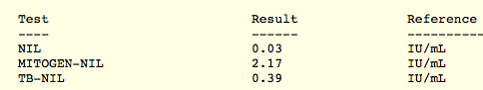
How to interpret an IGRA
ToC
Amount of interferon
gamma
Nil = the negative control. This is a tube with the patient’s blood not stimulated with any antigens. It should be < 8.0 IU/ml. A reading higher than 8 indicates that the patient has an underlying inflammatory/immune condition that may cause a false positive. Because the Nil represents background inflammation, it is subtracted from the other values.
Mitogen = the positive control. This is a tube with the patient’s blood stimulated with a substance (the mitogen) that causes nonspecific activation of T cells and interferon gamma production. It should be ≥ 0.5 IU/ml. A reading less than 0.5 indicates that the patient has an underlying condition inhibiting activation of T cells nonspecifically (such as HIV or immunosuppressant use). This can cause a false negative.
TB = the tube we’re interested in. Finally! In this tube the patient’s blood is stimulated with TB antigens. For a positive test, the TB tube (minus the background Nil tube) must be ≥ 0.35 IU/ml.

Slide 40
How to interpret an IGRA
ToC
Negative
Indeterminate
Positive
The negative and positive controls worked well, and no excessive interferon found
Negative test! (within limits of sensitivity and negative predictive value)

Slide 41
How to interpret an IGRA
ToC
Negative
Indeterminate
Positive
The negative and positive controls worked well, and excessive interferon found
Positive test! (within limits of specificity and positive predictive value)

Slide 42
How to interpret an IGRA
ToC
Negative
Indeterminate
Positive
Indeterminate does NOT mean “sort of positive”
Either the negative or positive control failed.
  Negative control is positive: something is causing non-specific inflammation
  Positive control is negative: patient is too immunosuppressed to produce interferon no matter what
  Meaning: the test didn’t work! It has no value
It just means the test failed and you can’t say anything based on it

Slide 43
Which test to choose?
ToC
Interferon gamma release assay
VS
Tuberculin skin test
- History of BCG vaccination or BCG cancer therapy
- Patients with difficulty returning for a follow up read of a TST
- Potentially immunosuppressed (because you have a negative control built in)
- Children under age 5
- Can do either for most other indications
- Both can give false positive results with other mycobacteria (kansasii, bovis, marinum, etc)
- Both have similar sensitivity/specificity profiles (~75% sensitive, 98% specific for LTBI)
- Consider doing both in cases where you get an initial negative or indeterminant result but have high pre-test probability for latent TB

Slide 44
Part 3: Diagnosis
ToC
How to test?
Has hemoptysis, night sweats, and weight loss
You’re worried this guy has active tuberculosis.
TST and IGRA screen for latent TB.
Do not use them to test for active TB.
YES you can have active TB and a negative TST or IGRA
They only provide collateral information in this setting

Slide 45
Part 3: Diagnosis
ToC
How to test?
Sputum:
AFB stain
Culture for M. Tb
Nucleic acid amplication (PCR) for M. Tb
Has hemoptysis, night sweats, and weight loss
Imaging:
Chest X ray or CT

Slide 46
What tests to send to work-up active TB?
ToC
 | Detectable Concentration of TB (bacilli per mL) | Approximate time for result to be available | Approximate Sens/Spec for “smear positive” | Approximate Sens/Spec for “smear negative”
Acid-Fast Bacilli Smear x3 | 5,000-10,000 | A few hours | 45-80/98 | N/A
Acid-Fast Bacilli Culture | 10-100 | 2-6 weeks | 80/98 | 60/98
MTB DNA probe | 1-10 | 2 hours (though often a send-out lab) | 88/98 | 68/98
MTB DNA probe can also rapidly predict rifampin and isoniazid resistance (by looking for causative genes)

Slide 47
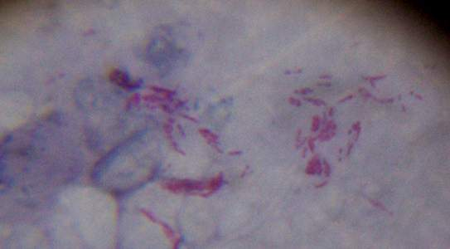
Acid fast bacilli stain
• Typically collect 3 smears, 8 hours apart. Ideally one smear is first thing in the morning.
• False positives can be caused by non-tuberculous mycobacterium. Also some bacteria can stain positive with AFB stains (e.g. nocardia)
• Of positive smears: the majority of cases are diagnosed with the first
smear (86%). The second smear produces only
incremental improvement in yield (~9%). The third
smear gives you only about 2-5% increased yield.
Notes:
https://commons.wikimedia.org/wiki/File:M_tuberculosis_sputum.jpg

Slide 48
When to get a bronchoscopy?
Question: wouldn’t a nice deep specimen from a bronchoscopy be better than 3 induced sputums (which patients often have trouble producing)?
Answer:
No! Bronch x1 has somewhat lower sensitivity than sputum x3
Pursue bronchoscopy when:
Attempts at induced sputum fail
Sputum AFB smear x3 is negative, but high clinical suspicion for MTB remains high
If a bronch is needed for other reasons

Slide 49
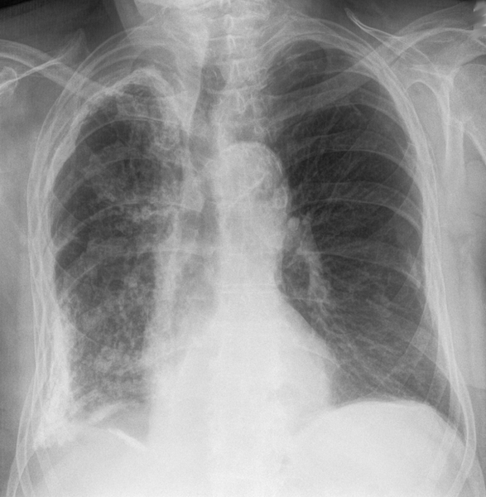
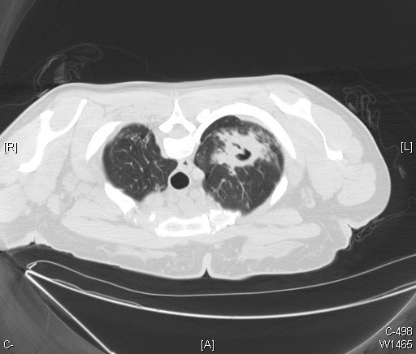
Imaging
CXR and Chest CT are highly sensitive (95⁺%) for active TB (CT slightly more so), though of course specificity is relatively low (~60-70%).
However: 20% of HIV patient will have a negative CXR!
Notes:
https://commons.wikimedia.org/wiki/File:43-01-Pleuraschwielen_Tbc.png
https://commons.wikimedia.org/wiki/File:Cavitary_tuberculosis_-_CT_scan_(6984891687).jpg

Slide 50
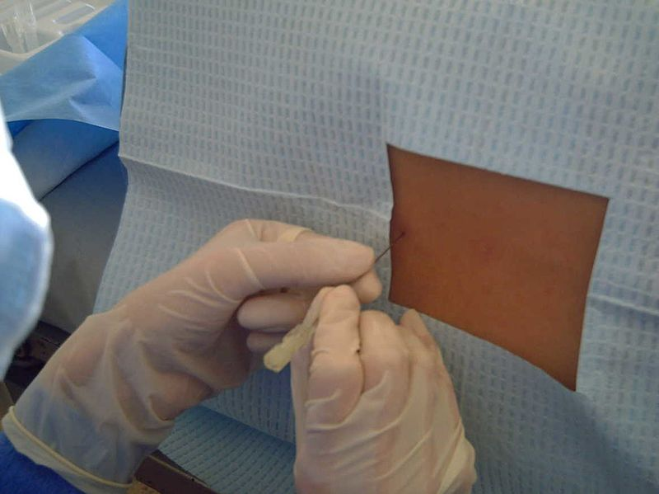
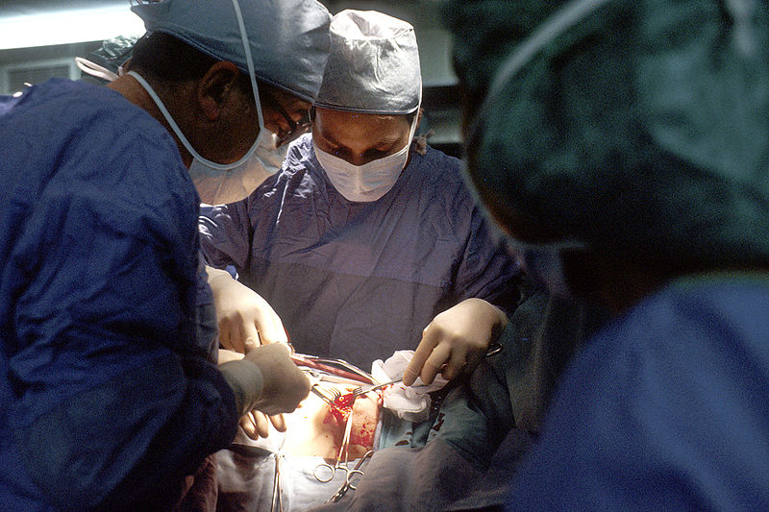
Wait, what if there is concern that the patient has extrapulmonary TB?
The principles of diagnosis are the same: get tissue – biopsy, get CSF, tissue, fluid, etc and send AFB smear(s), culture, and PCR on the sample
Notes:
https://commons.wikimedia.org/wiki/File:Puncion_lumbar.jpg
https://commons.wikimedia.org/wiki/File:Surgical_breast_biopsy.jpg

Slide 51
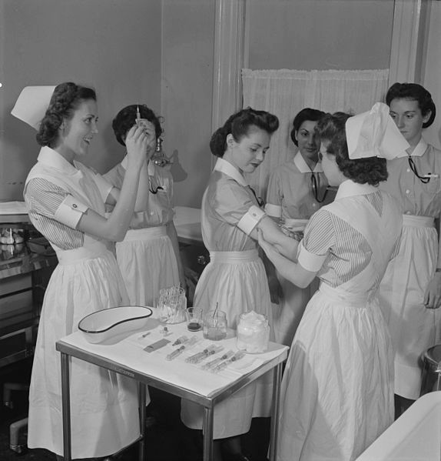
Part 4: Treatment
ToC
Now let’s talk about the different treatment options for TB
Notes:
https://commons.wikimedia.org/wiki/File:Epidemics_are_a_latent_possiblity_8b07712v.jpg

Slide 52
Patient # 1
ToC
42 year old man, recently emigrated from Vietnam and found to have a positive screening TST. He denies weight loss, night sweats, cough/hemoptysis, or any other symptoms of illness. Your exam and a chest X ray are normal. He does mention that prior to moving to the US, he was living with his grandfather who had active, pulmonary TB. He is otherwise healthy.

Slide 53
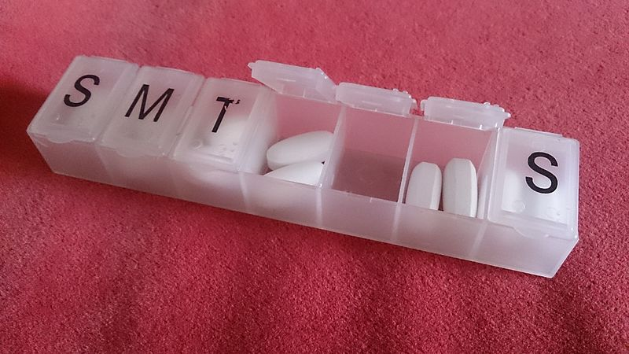
How would you treat patient #1?
ToC
Latent TB
What are you treating?
Anything special to consider about this host?
How do you treat Latent TB?
Doesn’t sound like it! Would screen him for HBV too though!
Notes:
https://commons.wikimedia.org/wiki/File:Daily_pills.jpg

Slide 54
Latent TB treatment
ToC
OPTIONS:
1. Isoniazid (INH) x 9 months
2. Rifampin x 4 months
3. Isoniazid and rifapentin x 3 months
REMEMBER: always rule out active TB before starting treatment for latent TB. If you give a latent TB regimen (monotherapy) to someone with active TB, you risk development of drug resistant TB
Get a CXR before starting
9 months is a long time – do you really have to treat that long with INH?
Notes:
Bull World Health Organ. 1982;60(4):555-64.
Efficacy of various durations of isoniazid preventive therapy for tuberculosis: five years of follow-up in the IUAT trial. International Union Against Tuberculosis Committee on Prophylaxis.

Slide 55
Latent TB treatment
ToC
A study by the International Union Against TB (IUAT) compared 3 months, 6 months, and 12
months of treatment with INH. In the intention-to-treat analysis:
When just looking at people who completed therapy, the 12 month efficacy increases to 93% while the other numbers are about the same (31% and 69%). BUT since it’s hard to get people to take INH for 12 months, we aim for 9 months.
 | 3 months | 6 months | 12 months
Percent cured of LTBI | 21% | 65% | 75%
Notes:
Bull World Health Organ. 1982;60(4):555-64.
Efficacy of various durations of isoniazid preventive therapy for tuberculosis: five years of follow-up in the IUAT trial. International Union Against Tuberculosis Committee on Prophylaxis.

Slide 56
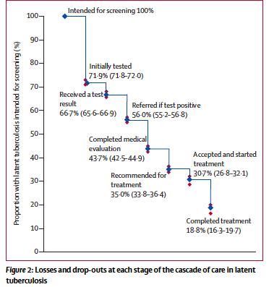
Taking INH for 9 months can be hard
ToC
In this study looking at cascade of care, only ~19% of people completed 9 months of INH!
Alsdurf Lancet ID 2016

Slide 57
Latent TB treatment
ToC
OPTIONS:
1. Isoniazid (INH) x 9 months (and don’t forget B6)
2. Rifampin x 4 months
3. Isoniazid and rifapentin x 3 months
If a healthy adult with minimal other medical issues (and minimal other meds), rifampin x4 months can be a nice choice. Otherwise, INHx9 months is typical
So, why would anyone pick INH over the shorter options?
1. Cost: INH is cheap, rifampin costs a bit more, and rifapentin is noticeably more expensive
2. Rifampin is a cytochrome P450 3A inducer – it interacts with a lot of medications
3. INH/rifapentin is a directly observed therapy (DOT), which is difficult to coordinate

Slide 58
Monitoring on
LTBI Therapy
ToC
Monthly follow up suggested
Ask re: nausea, anorexia, icterus, rash, parasthesias
Monitor ALT, AST, Total Bilirubin (INH and rifampin can cause hepatitis)
Stop if
  Asymptomatic >5 fold increase above upper-limit of normal (ULN) AST
  Symptomatic >3 fold increase above ULN AST
  Baseline abnormal >3 fold increase above ULN AST
Saukkonen AJRCCM 2006

Slide 59
Patient # 2
ToC
64 year old woman, recently emigrated from Bolivia, presents with 2 months of night sweats and weight loss. In the last month she has developed hemoptysis. Her sputum is positive for M. Tb.

Slide 60

How would you treat patient #2?
ToC
Active pulmonary TB
What are you treating?
Anything special to consider about this host?
How do you treat active TB?
Not that we know of. Screen for HIV
Notes:
https://commons.wikimedia.org/wiki/File:Prescription_medication_being_dispensed.tiff

Slide 61
Active TB treatment
ToC
R - Rifampin
I - Isoniazid
P - Pyrazinamide
E - Ethambutol
2 months = intensive phase
(if drug susceptibilites return before 2 months
confirming pan-sensitivity, can stop ethambutol early)
Exceptions:
- extend continuation phase (7 months) in patients with cavitary pulmonary TB and ongoing M. Tb in sputum samples at 2 months
- in extrapulmonary TB, continuation phase is 9-12 months
Continuation phase
4 months of isoniazide and rifampin alone

Slide 62
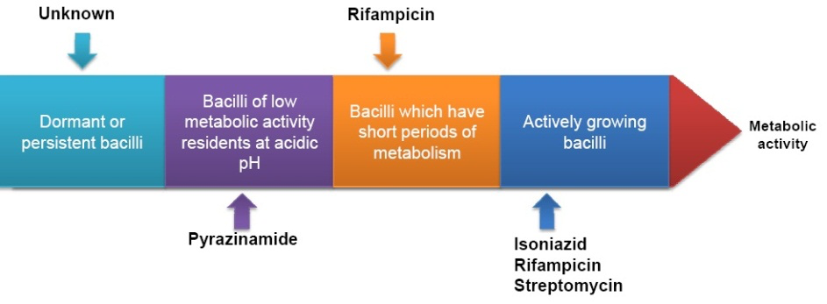
TB Drug Action
ToC
Early Bactericidal Activity – INH > EMB > RIF > PZA
Longiterm Sterilizing – RIF > PZA > INH > EMB
Resistance prevention – INH > RIF > EMB > PZA
Guzman 2013, Chapter in Tuberculosis- Current Issues in Diagnosis and Management
Mitchison Tubercle 1985

Slide 63
Patient # 3
ToC
64 year old woman, recently emigrated from Bolivia, presents with 2 months of night sweats and weight loss. In the last month she has developed hemoptysis. Her sputum is positive for M. Tb. She is also HIV positive, non-adherent to HAART.

Slide 64
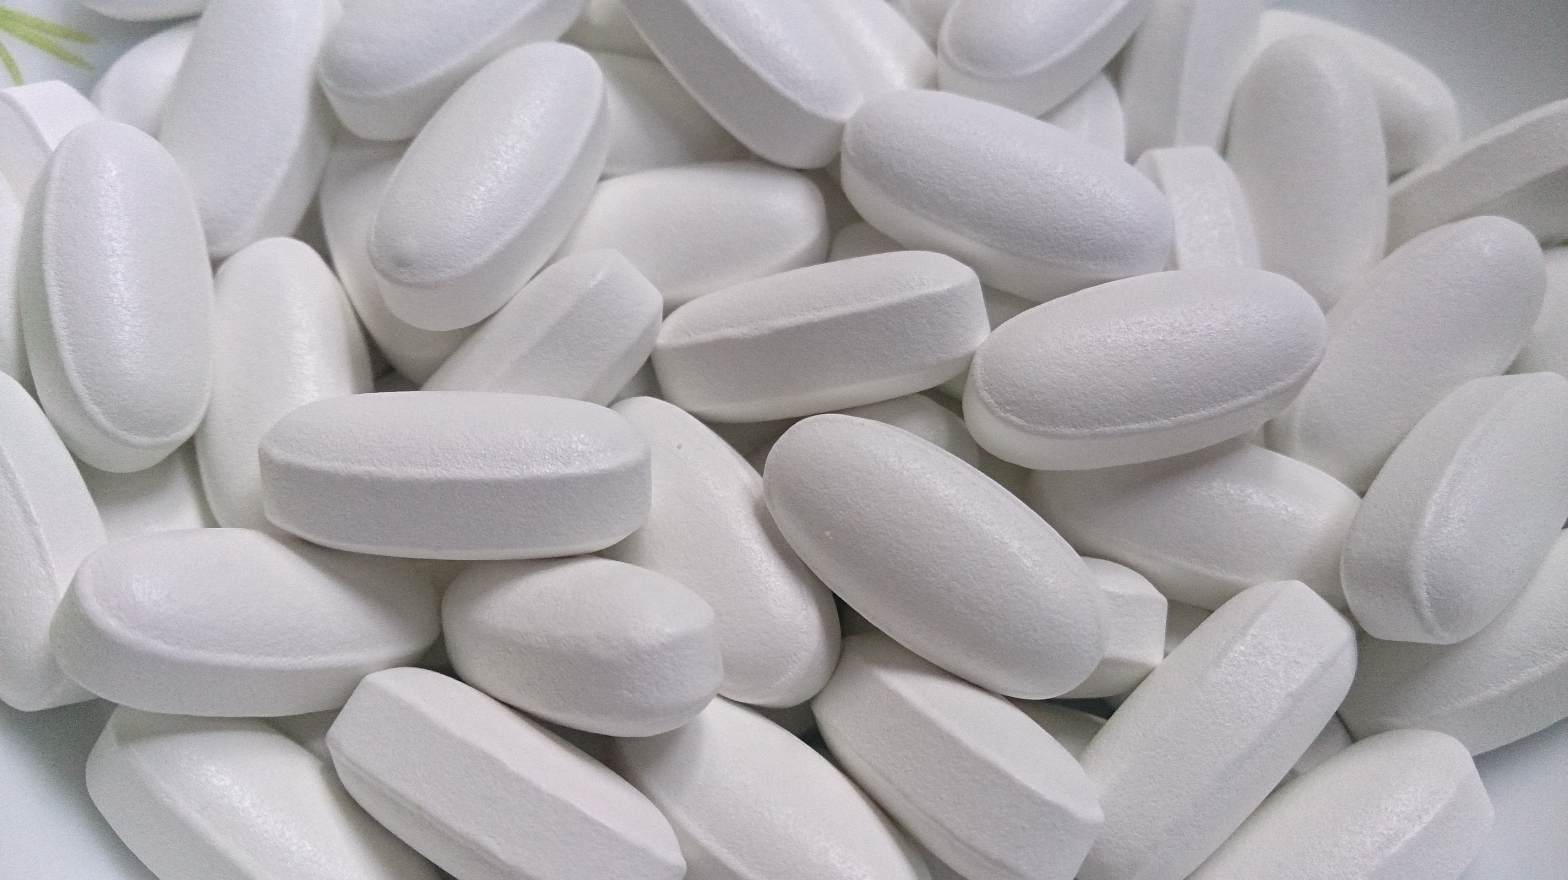
How would you treat patient #3?
ToC
Active pulmonary TB
What are you treating?
Anything special to consider about this host?
How do you treat active TB in HIV+ hosts?
Yes, HIV positive
Notes:
https://commons.wikimedia.org/wiki/File:Pills_2.jpg

Slide 65
TB treatment in patients with HIV
ToC
Treatment regimen is the same but a few important things to consider:
1. There are often drug-drug interactions between TB medications and antiretrovirals – check before prescribing
2. Duration of treatment is longer for patients with HIV not on HAART (the continuation phase is extended to 7 months)
3. Remember that TB can look different in HIV: extrapulmonary and CNS TB are much more common and symptoms can progress more quickly

Slide 66
TB treatment in patients with HIV
ToC
Would you start this patient on HAART?
The short answer is YES!
BUT, starting patients with TB and HIV on HAART can lead to a paradoxical worsening of the TB: this is due to IRIS (immune reconstitution inflammatory syndrome).
What happens: About 1-4 weeks after starting HAART, patients can develop fevers, worsening lymphadenopathy, and new infiltrates. Essentially this is due to comparative recovery of the immune system on HAART and a robust inflammatory response as the recovering immune system tries to respond to the TB.
The lower someone’s CD4 count is to start, the greater the risk.
What to do about it: IRIS is usually self-limited and treated with supportive care. In severe cases, steroids can be considered, although there isn’t much data to support their use (except in TB meningitis)

Slide 67
TB treatment in patients with HIV
ToC
So…. would you start this patient on HAART?
Still, yes.
If the CD4 count is low, the initiation of HAART is sometimes delayed for a few weeks after the start of TB treatment
Anywhere from 2-12 weeks depending on the CD4 count and where the TB is (IRIS from TB meningitis can be particularly dangerous; waiting a few weeks recommended)
It is not recommended to wait until completion of TB treatment to start HAART.
And finally: if someone is already on HAART, do not interrupt therapy for TB treatment (though HIV regimen may need to be modified). IRIS occurs during the initiation of HAART.

Slide 68
A note on treatment: drug side effects
ToC
This TB drug can cause optic neuritis, usually reversible with
discontinuation of the drug:
This drug can cause peripheral neuropathy:
This drug can cause gout flares:
This drug turns bodily fluids orange:
This drug can cause a Lupus like syndrome:
This drug can cause thrombocytopenia:
This drug can cause polyarthralgias:
This drug has a LOT of drug-drug interactions:
Ethambutol
Isoniazid
Start patients on pyridoxine (vitamin B6) to prevent this side effect while on INH
Pyrazinamide
Rifampin
Isoniazid
Rifampin
Rifampin AND pyrazinamide
Rifampin

Slide 69
Drug side effects: continued
ToC
all of them
These drugs can cause LFT abnormalities:
Pyrazinamide > isoniazide > rifampin >> ethambutol
20% of people have an increase in LFTs with RIPE therapy
Stop treatment if:
  • Asymptomatic and AST > 5X increase above upper limit of normal
  • Symptomatic and AST > 3X increase above upper limit of normal
  • Baseline abnormal LFTS and AST > 3X increase above upper limit of normal
After improvement in LFTs, can restart medications. Reintroduce rifampin first (+/- ethambutol). Then INH. May avoid pyrazinamide.

Slide 70
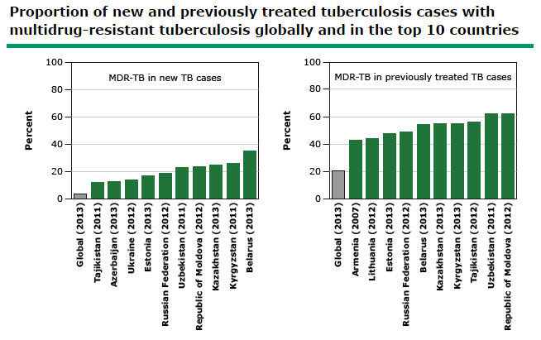
A word on multi-drug resistant TB
(MDR TB)
ToC
When MTB is resistant to INH and Rifampin, it is said to be multi-drug resistant (MDR)
Increasingly common
Treatment is now with at least 4 or 5 second line drugs (plus PZA) for 9-24 months

Slide 71
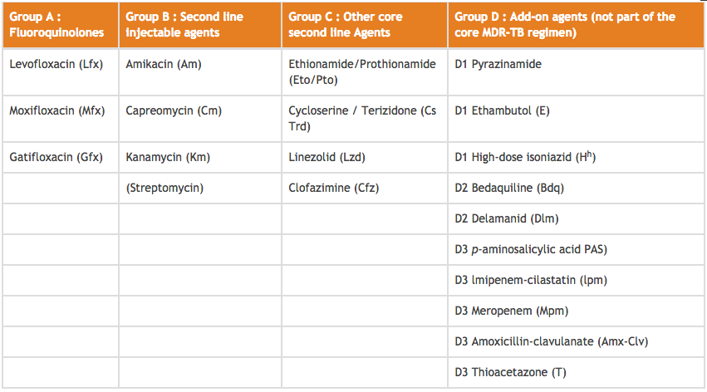
MDR-TB Therapy: 2nd line drugs
ToC
WHO Guidelines for Programmatic Management of MDR TB 2016 update

Slide 72
MDR-TB Therapy: 2nd line drugs
ToC
Curry Center
DR-TB guidelines,
3rd edition

Slide 73
A word on extensively-drug resistant TB (XDR TB)
ToC
When MTB is resistant to INH, rifampin, fluoroquinolones, and aminoglycosides, it is called extensively drug resistant (XDR TB)
First reported in 2006, now in > 100 countries (including the USA, though still quite rare)
Multiple 2nd and 3rd line agents used for months, often with significant drug toxicity
Sometimes, no effective therapy is available
XDR TB is a significant threat to global health. Please watch this short video: https://www.ted.com/talks/james_nachtwey_fights_xdrtb

Slide 74
Congratulations!
ToC
Please take the post-module quiz here
https://goo.gl/forms/gv9RpcZAGpMwReO03

