Slide 1
Infectious Endocarditis

Slide 2
Welcome to the module on Infectious Endocarditis!!
Please take this brief pre-module quiz
https://docs.google.com/forms/d/10ZW70g7buH0R7vky6v6BlEoBLsh959LtSyUngkUJQCc/viewform?usp=send_form

Slide 3
This module works a lot better in “presentation” mode

Slide 4
Infectious Endocarditis Overview
An infection of one or more of the heart’s four valves that causes a bulky and friable vegetation
An important and very serious infection, affecting thousands of patients annually in the United States, with high rates of morbidity and mortality
It can present acutely (over days to weeks), or sub-acutely (over weeks to months), with a wide variety of clinical manifestations related to diverse embolic, immunologic, and infectious complications
Diagnosing endocarditis requires an astute clinician with excellent physical exam skills and in-depth knowledge of pathophysiology

Slide 5
Outline (click to jump to a section)
Pathophysiology and immune response
Microbiology
Physical Exam findings
Diagnosis
Complications
Treatment
Special cases (culture negative, fungal, marantic, and prosthetic valve endocarditis)

Slide 6
Outline (click to jump to a section)
Pathophysiology and immune response
Microbiology
Physical Exam findings
Diagnosis
Complications
Treatment
Special cases

Slide 7
Pathophysiology of Infectious Endocarditis
Normal heart valves are resistant to clot and infection
Covered in endothelial cells that prevent platelet aggregation
For infection to set up on a valve, the outer surface (endothelial cells) needs to be damaged first, exposing sub-endothelial collagen

Slide 8
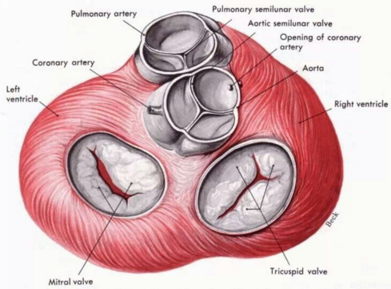
Injury

Slide 9
Platelet
Exposed collagen
Damaged Heart Valve surface

Slide 10
Platelet
Exposed collagen
Damaged Heart Valve surface

Slide 11
Platelet
Exposed collagen
Damaged Heart Valve surface

Slide 12
Platelet activation at the damaged site
Adapted from Jason Freed, MD
Fibrinogen
GP IIb IIIa
Shape
Change
Aggregation
Platelet
Dense
Granule
TxA2
Synth
Platelet Activation
TxA2
Receptor
GPVI
ADP Receptor
TxA2
Exposed sub-endothelial Collagen
ADP
Notes:
Slide adapted from Jason Freed, MD

Slide 13
Fibrin
Platelet
Exposed collagen
Damaged Heart Valve surface

Slide 14
Fibrin
Platelet
Exposed collagen
Damaged Heart Valve surface

Slide 15
Fibrin
Platelet
Exposed collagen
Damaged Heart Valve surface

Slide 16
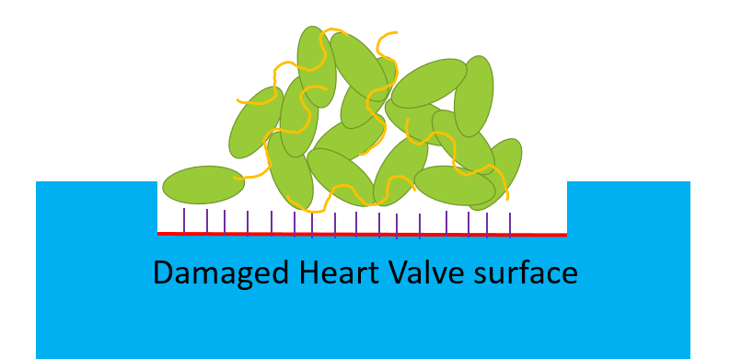
Seeded vegetation
Bacteremia
Healing
Fibrosis/Scar

Slide 17
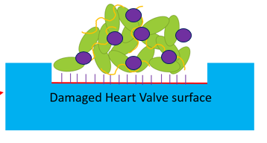
Vegetation proliferation

Slide 18
Bacteria contribute to vegetation proliferation
For instance, Staphylococcus aureus has certain virulence factors that directly contribute to platelet activation and aggregation
Example virulence factor: Coagulase leads to more fibrin formation

Slide 19
Bacteria contribute to vegetation proliferation

Slide 20
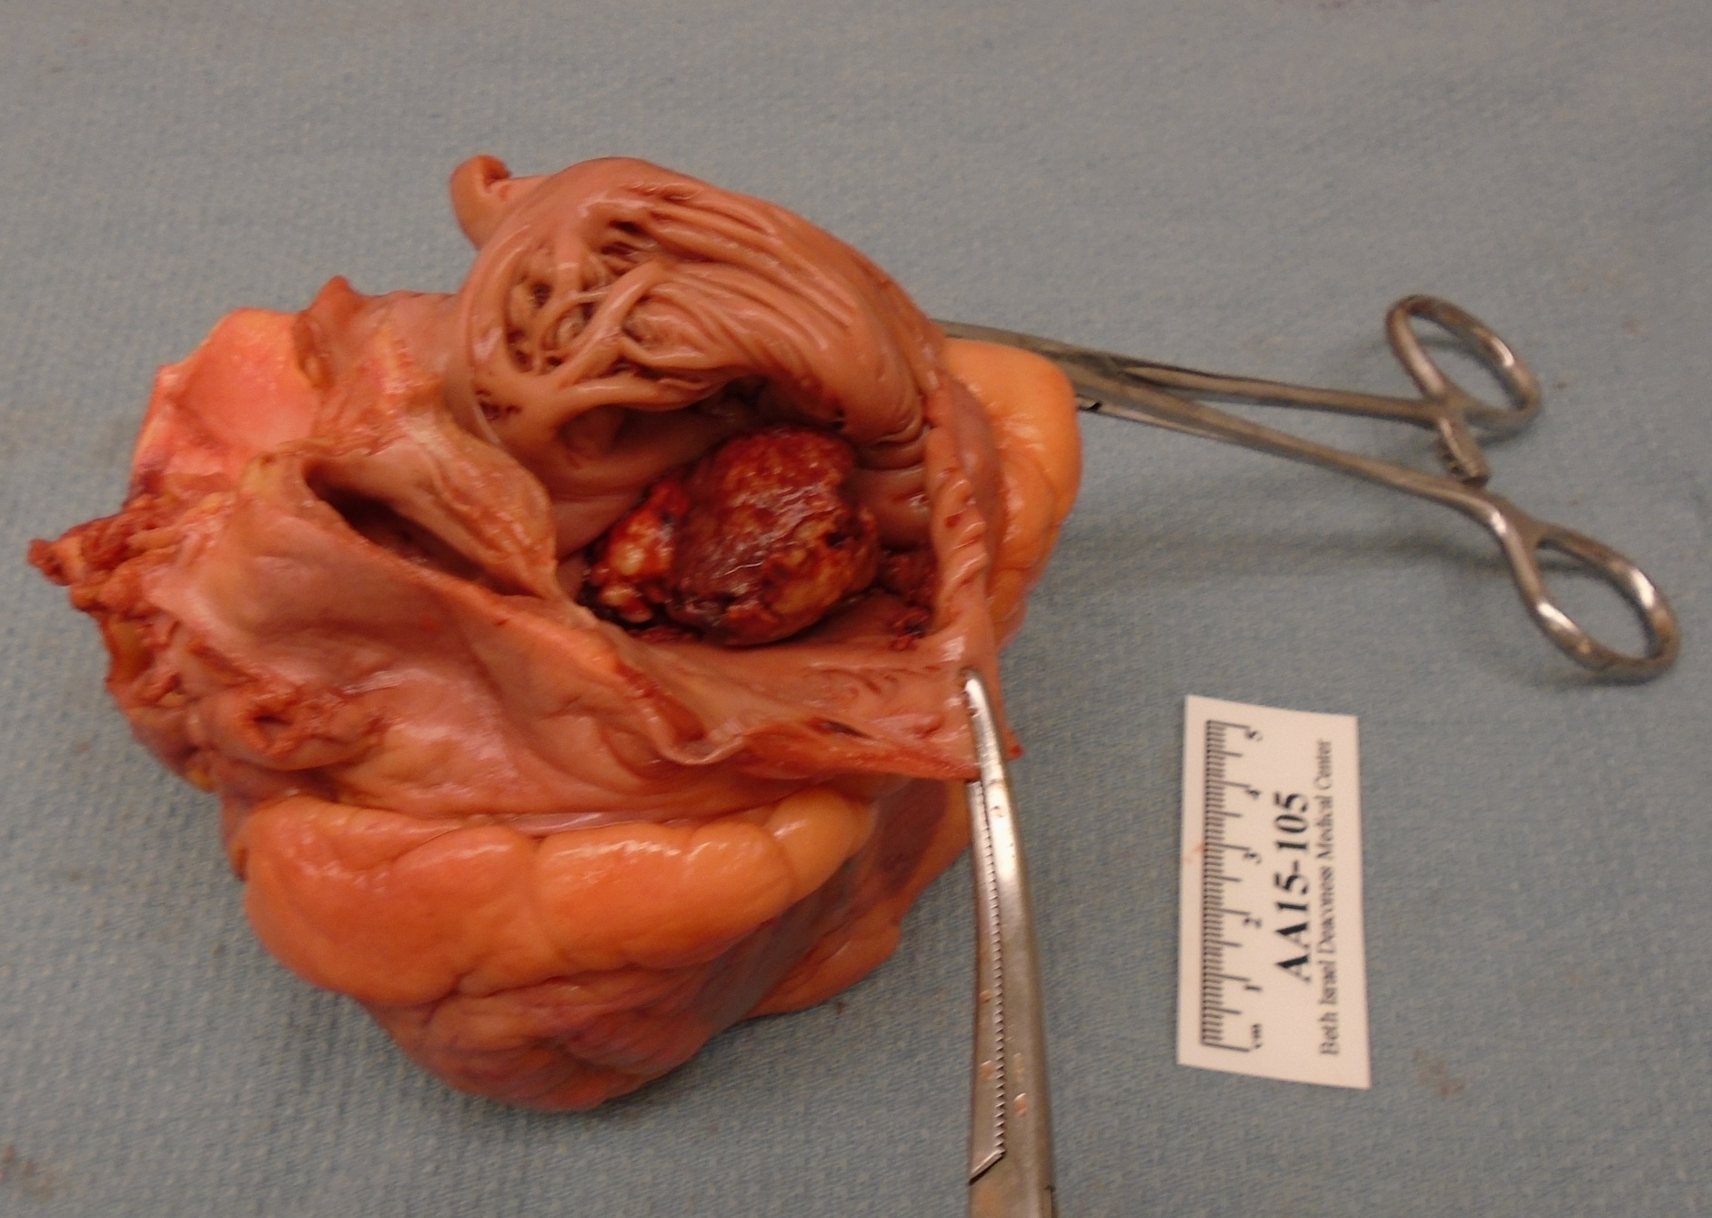
A massive (3.5cm) tricuspid valve vegetation from Streptococcus viridans in a 26 year old woman who died of infectious endocarditis
Tricuspid valve vegetation
Source: Jonathan Hecht, MD and Andrew Hale, MD

Slide 21
Injury
But what causes the injury?

Slide 22
Causes of injury to heart valves
Injury
Intrinsic injury to valves
Congenital heart disease
Prior episode of endocarditis
Rheumatic heart disease
Turbulent flow
Extrinsic injury to valves
Intravenous drug use
Other
Prosthetic valve material

Slide 23
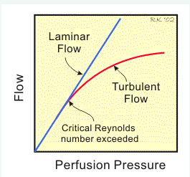
Reynold’s number
(velocity) x (diameter) x (density)
~
viscosity
The higher Reynold’s number (R), the more likely turbulent flow becomes. Turbulent flow damages valves and predisposes to endocarditis.
- Per the above equation, when there is a tightening (like aortic stenosis), AFTER the tightening the R will increase, thus you get turbulence
Notes:
And can make comment about infected aortic aneurysm

Slide 24
Some bacteria cause endocarditis more easily than others because they directly contribute to valve damage
Staphylococcus aureus secretes enzymes that make it easier to cause infectious endocarditis
Hyaluronidase: breaks down proteoglycans in connective tissue
Proteases: destroy tissue proteins

Slide 25
Immunologic response to endocarditis
The vegetation is highly inflammatory
The white blood cell count (WBC), Erythrocyte Sedimentation Rate (ESR) , C-Reactive Protein, and other acute phase reactants will be high
The immune system is highly activated
Rheumatoid Factor often elevated
Polyclonal immunoglobulin population creates immune complex deposition throughout the body
Osler Nodes
Glomerulonephritis

Slide 26
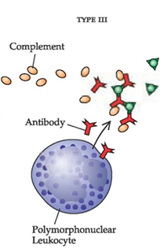
Immune-complex mediated damage
Antigen
Immune-complex creation and deposition in small vessels
Injury
PMN and complement
activation

Slide 27
Question
A 46-year-old man with history of recent intravenous drug abuse presents with fever and is found to have infectious endocarditis. He states that the heroin he injects is not always pure.
What cardiac valve do you think he is most likely to have an infectious endocarditis vegetation on? Why that one?

Slide 28
Answer
Tricuspid valve. Intravenous drug users have a higher incidence of tricuspid valve involvement. This is from impurities (such as talc) within the injected drugs that directly damage the valves, and are mostly filtered out by the lungs.

Slide 29
Question
He is found to have evidence of glomerulonephritis. Does this mean he must have left-sided (mitral or aortic valve) endocarditis? Why or why not?

Slide 30
Answer
No, it could be right or left sided infectious endocarditis. Immune complexes can get through the pulmonary circulation and deposit systemically.

Slide 31
Question
What would you expect the effect of aspirin to be on endocarditis vegetation size?

Slide 32
Answer
You would expect aspirin to decrease the size of vegetations or prevent enlargement of vegetations by decreasing platelet activation (via inhibition of thromboxane A2). This was looked at in large trials: unfortunately, it doesn’t work well and causes increased hemorrhagic stroke, so is not done in clinical practice

Slide 33
Outline (click to jump to a section)
Pathophysiology and immune response
Microbiology
Physical Exam findings
Diagnosis
Complications
Treatment
Special cases

Slide 34
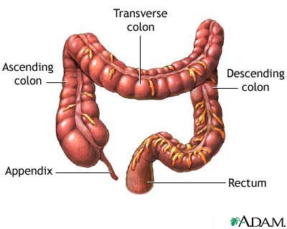
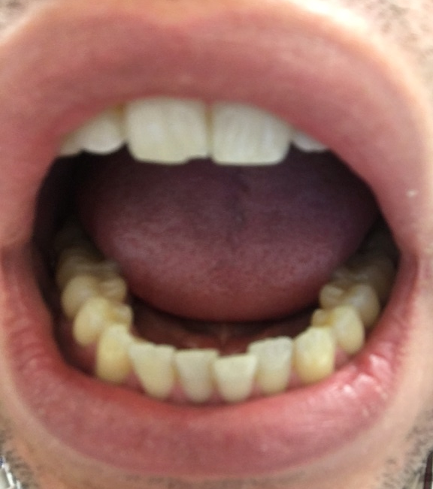
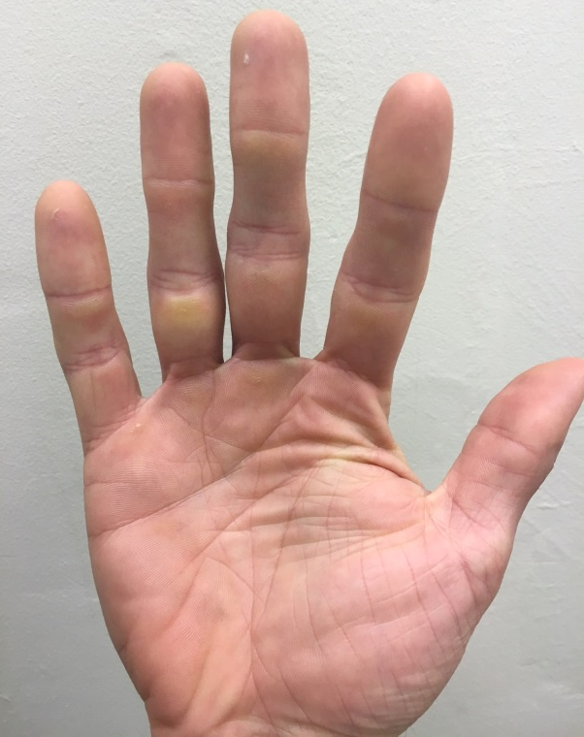
Microbiology of Infectious Endocarditis: commons sources
Mouth flora
Strep. viridans
Skin flora
Staph. aureus
Coagulase-negative Staph
Gastrointestinal flora
Strep. bovis
Enterococcus
Andrew Hale, MD
Andrew Hale, MD
www.nlm.nih.gov

Slide 35
Adapted from Murdoch et al, Arch Intern Med, 2009

Slide 36
HACEK Group (not worth memorizing specific names)
A group of rare gram-negative organisms than can cause infectious endocarditis
Haemophilus aphrophilus
Actinobacillus actinomycetemcomitans
Cardiobacterium hominis
Eikenella corrodens
Kingella kingae
Fun to Say!

Slide 37
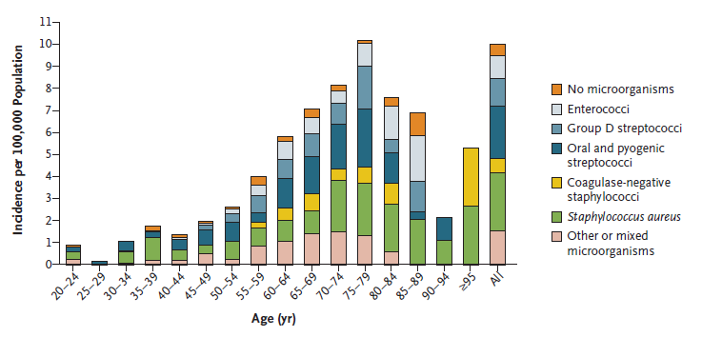
Hoen B et al. Infectious Endocarditis. NEJM 2013;368:1425-33

Slide 38
Question
Which of the following is NOT a significant risk-factor for endocarditis?
A) Congenital valve disease
B) Intravenous heroin use
C) Recent dental cleaning
D) Prosthetic heart valve
E) Infectious endocarditis 5 years ago
F) Rheumatic heart disease as a child
G) Pneumonia in the last 30 days
H) Recent colonoscopy

Slide 39
Answer
Which of the following is NOT a significant risk-factor for endocarditis?
A) Congenital valve disease: intrinsic damage to the valve
B) Intravenous heroin use: extrinsic damage to the valve
C) Recent dental cleaning: transient bacteremia from oral flora
D) Prosthetic heart valve: easier for bacteria to stick to a foreign body
E) Infectious endocarditis 5 years ago: intrinsic damage to the valve
F) Rheumatic heart disease as a child: intrinsic damage to the valve
G) Pneumonia in the last 30 days: not a risk factor
H) Recent colonoscopy: transient bacteremia from GI flora

Slide 40
Outline (click to jump to a section)
Pathophysiology and immune response
Microbiology
Physical Exam findings
Diagnosis
Complications
Treatment
Special cases

Slide 41
Exam findings in Infectious Endocarditis
Several classic exam findings are seen in Infectious Endocarditis
They result from a combination of direct valve damage, vegetation break off and embolization, and immune-complex deposition

Slide 42
1) New heart murmurs (or worsening of old murmurs)
The infection tends to destroy the valve, thus the valve becomes insufficient (starts to regurgitate)
If a patient had infectious endocarditis of the aortic valve, what would you expect to hear upon heart auscultation?
Aortic regurgitation: a diastolic rumble, best heard at the left 3rd intercostal space. An example can be listened to here: http://www.wilkes.med.ucla.edu/ARMain.htm

Slide 43
2) Embolic phenomena seen on exam
Splinter hemorrhages
Janeway lesions
Roth spots

Slide 44
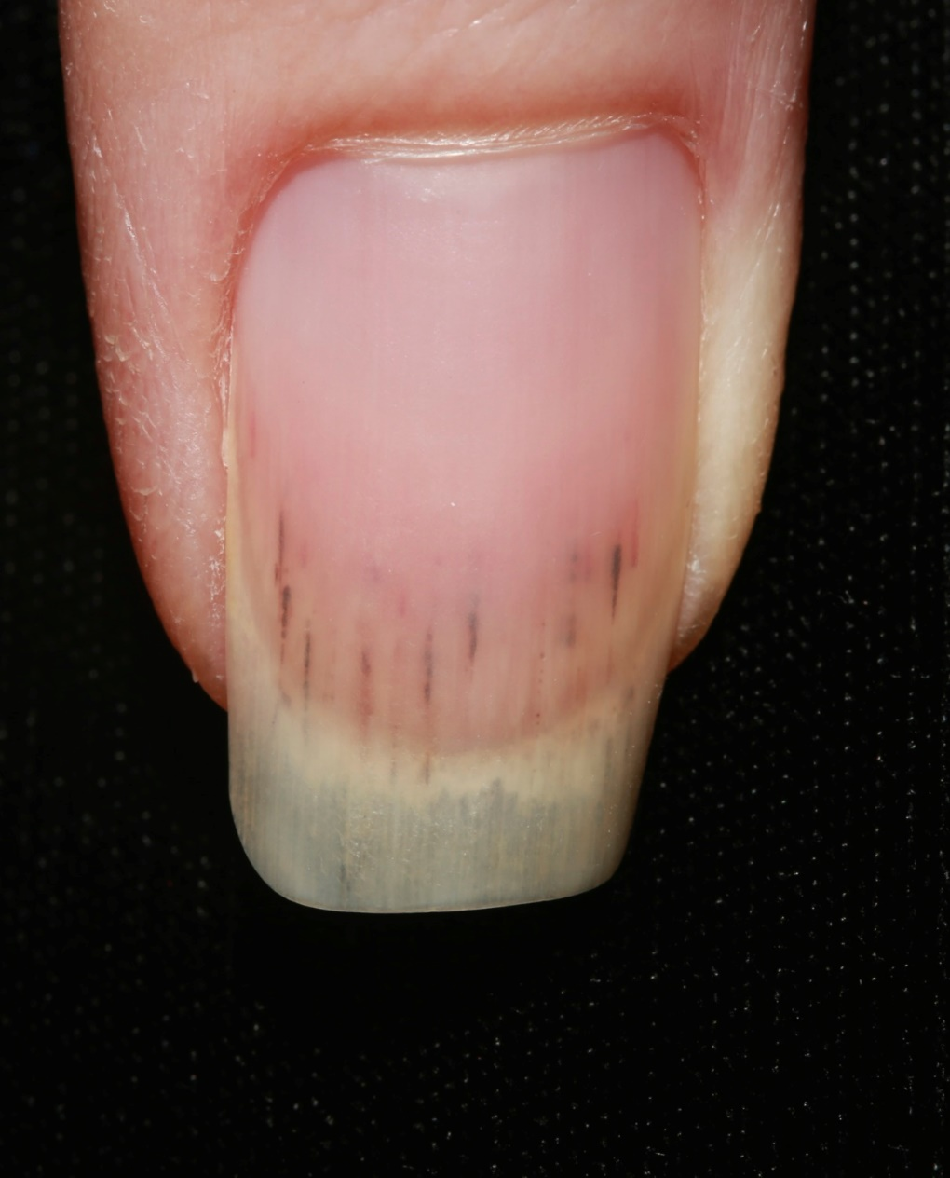
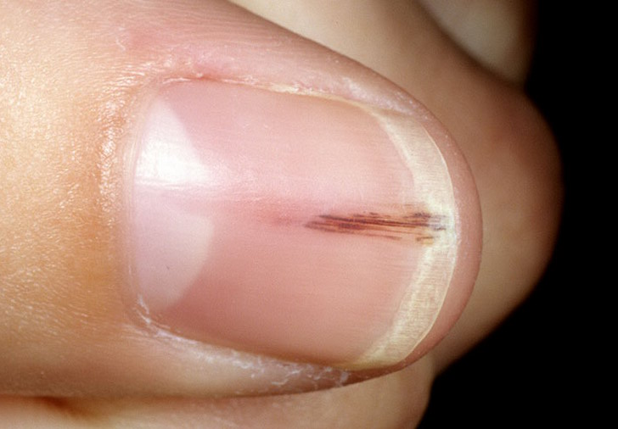
Embolic phenomena: Splinter Hemorrhages Micro-emboli to the nail bed
www.regionalderm.com

Slide 45
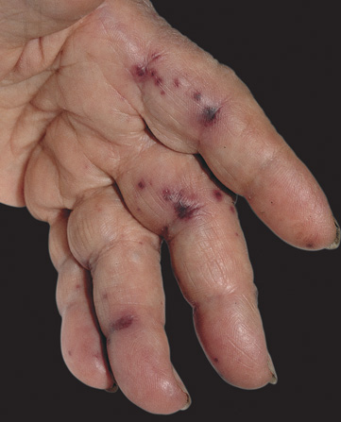
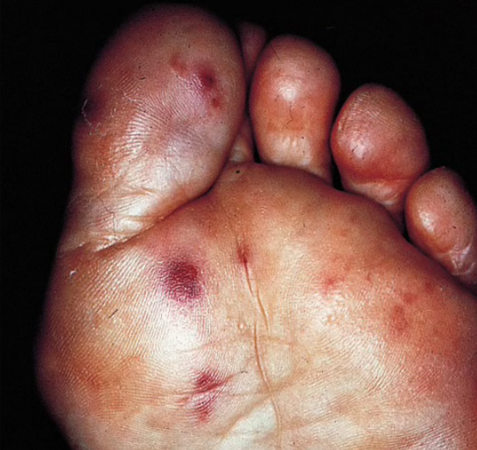
Embolic phenomena: Janeway lesions Erythematous, non-tender, non-blanching macules on palms or soles
Fitzpatrick’s Color Atlas and Synopsis of Clinical Dermatology, 6th Edition
www.studyblue.com

Slide 46
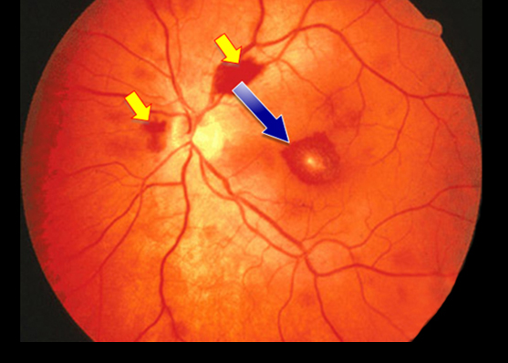
Embolic phenomena: Roth spots Retinal hemorrhage with pale-white center, seen on funduscopic exam
Reference.Medscape.com

Slide 47
3) Immune-complex deposition phenomena seen on exam
Osler nodes
Splenomegaly

Slide 48
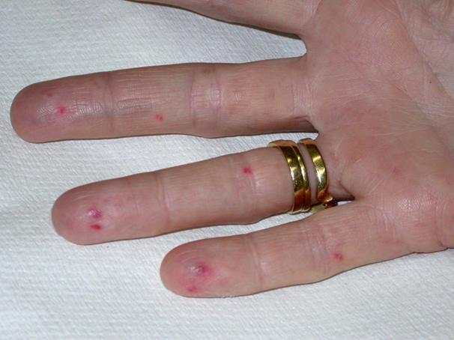
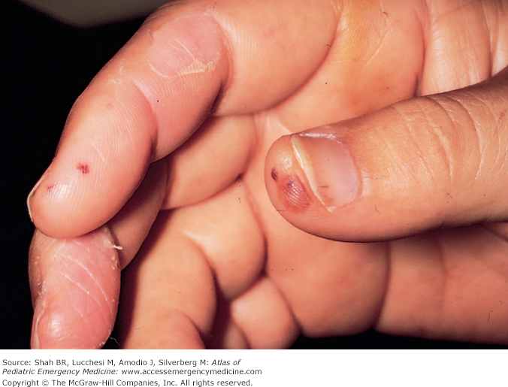
Immune-complex deposition phenomena: Osler Nodes Tender, erythematous nodules on the finger tips
intranet.tdmu.edu.ua
Atlas of Pediatric Emergency Medicine

Slide 49
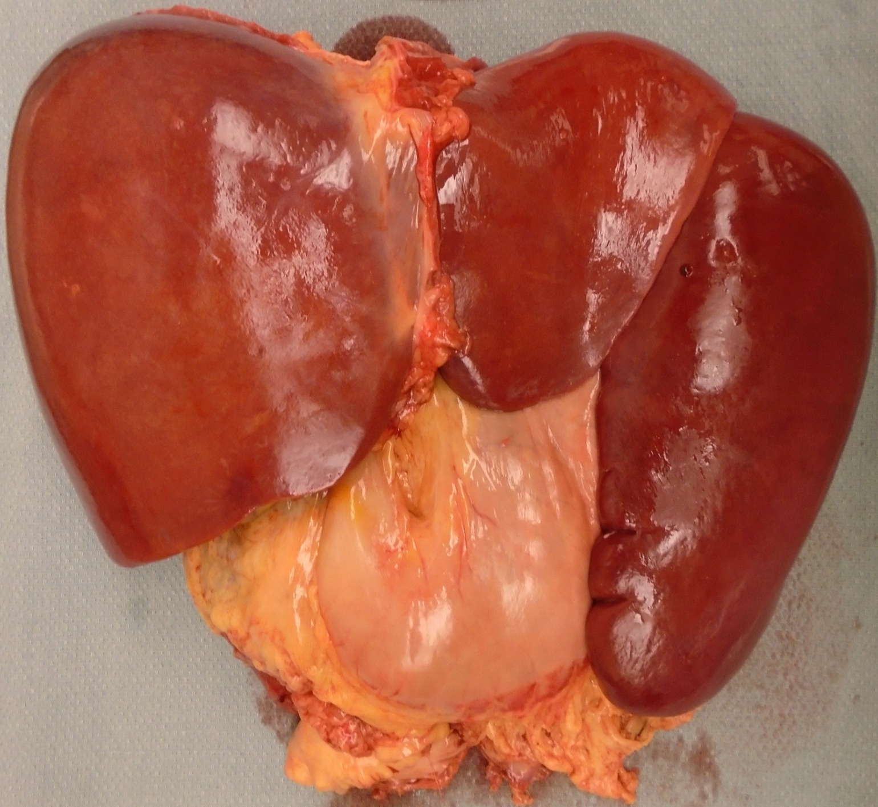
Immune-complex deposition phenomena: splenomegaly Massive splenomegaly in a 26 year old woman who died of infectious endocarditis
Approximate normal size
Liver and Spleen
Source: Jonathan Hecht, MD and Andrew Hale, MD

Slide 50
Question
You are the intern rounding on a 59-year-old patient with congenital bicuspid aortic valve and Strep viridans bacteremia. The issue of endocarditis is raised. Your Attending thoroughly examines the patient and finds no evidence of Janeway Lesions, Splinter hemorrhages, Roth Spots, or Osler nodes. He says:
“I am very reassured by the lack of these findings that the patient does not have endocarditis”
What is your response?

Slide 51
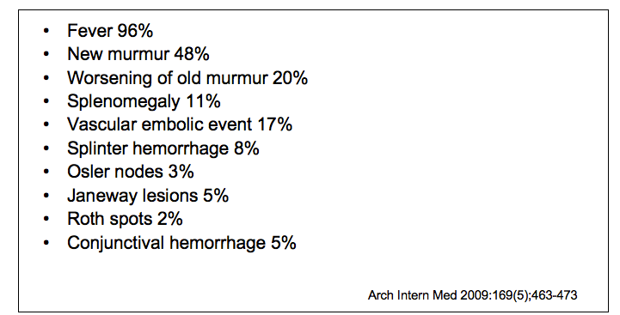
Answer: these “classic” findings are seen in the minority of endocarditis cases

Slide 52
Question
Osler nodes can be seen in both left and ride sided endocarditis, but splinter hemorrhages tend to be seen only in left sided endocarditis. What is the best explanation for this?

Slide 53
Answer
Osler nodes are an immune-complex mediated finding. Splinter hemorrhages are embolic phenomena. Thus unless a patient has a patent foramen ovale (PFO), you will not see splinter hemorrhages in right-sided (tricuspid or pulmonic valve) infectious endocarditis. Osler nodes can be seen in either because the immune-complexes are able to pass through the pulmonary circulation.

Slide 54
Outline (click to jump to a section)
Pathophysiology and immune response
Microbiology
Physical Exam findings
Diagnosis
Complications
Treatment
Special cases

Slide 55
How does one diagnose infectious endocarditis?
A combination of clinical, physical exam, imaging, and microbiologic findings
These are combined into the modified Duke Criteria

Slide 56
Two separate positive blood cultures from typical endocarditis organisms
- Staph, Strep, enterococcus, or HACEK
Modified Duke Criteria
Major Criteria #1
Or single positive blood culture or serology for Q-fever (Coxiella: loves valves)
Heart valve involvement
- Vegetation or valve abscess seen on echocardiogram OR
- New valvular regurgitation
- By auscultation or echocardiography
Major Criteria #2
Predisposing condition
- IV drug use, congenital valve defect, rheumatic heart disease, etc…
Minor Criteria #1
Minor Criteria #2
Fever
Minor Criteria #3
Embolic phenomena
- Splinter hemorrhages, Janeway lesions, Roth spots, arterial emboli
Immunologic phenomena
- Osler nodes, Rheumatoid Factor, glomerulonephritis
Minor Criteria #4
Positive blood cultures for an organism not typical of causing endocarditis
- Gram negatives, fungi, others
Minor Criteria #5

Slide 57
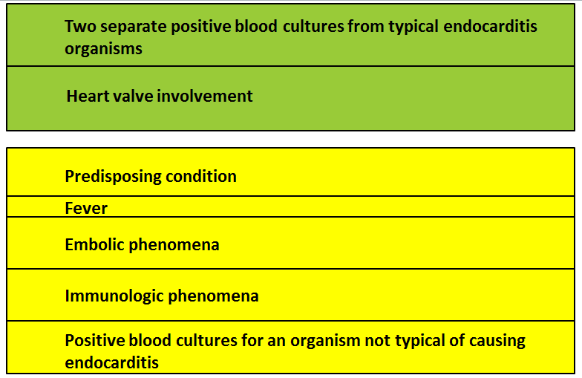
Modified Duke Criteria
To diagnosis infectious endocarditis, need [2 major], or [1 major and 3 minor], or [5 minor criteria]

Slide 58
A large tricuspid valve vegetation in a patient with infectious endocarditis
Source: Andrew Hale, MD

Slide 59
Question
A 72-year-old woman with history of aortic valve replacement because of aortic stenosis is admitted with Enterococcus blood stream infection. She has no evidence of heart failure, and is normotensive. You wonder if she may have infectious endocarditis
Which of the following would you obtain?
1) TTE, if negative then TEE
2) Straight to TEE
3) TTE, if negative then no need for invasive and expensive testing

Slide 60
Benefits and Costs of TTE vs TEE
Trans-thoracic
Trans-esophageal
30-60% sensitive for finding vegetations
Non-invasive
Cheaper
90 % sensitive
Much better at finding peri-valvular complications (Ex: root abscess)
Much better at detecting prosthetic valve endocarditis (mechanical or biologic)
Invasive, patients need sedation and cannot have neck or airway instability or significant esophageal pathology (Ex: esophageal varices)
More expensive

Slide 61
When to use TTE/TEE
1) TTE, if negative then get a TEE
Negative or inadequate TTE with high suspicion for endocarditis
High-risk organism like Staphylococcus aureus
Positive TTE with concern for intra-cardiac complications (such as root abscess)
2) Straight to TEE (skip the TTE)
Prosthetic valves
Poor TTE windows (obesity, chest wall deformity, mechanical ventilation)
3) TTE, if negative then no need for invasive / expensive testing
Want to rule out endocarditis, but not a high-risk organism or high-risk patient
Note: there is some controversy to this, and it depends on pre-test probability
If you want to go into the details, see the American Heart Association guidelines

Slide 62
Answer
A 72-year-old woman with history of aortic valve replacement because of aortic stenosis is admitted with Enterococcus blood stream infection. She has no evidence of heart failure, and is normotensive. You are concerned about infectious endocarditis
Which of the following would you obtain?
1) TTE, if negative then TEE
2) Straight to TEE: she has a high risk organism (enterococcus) and a prosthetic valve. It would be very reasonable to proceed straight to TEE
3) TTE, if negative then no need for invasive and expensive testing

Slide 63
Outline (click to jump to a section)
Pathophysiology and immune response
Microbiology
Physical Exam findings
Diagnosis
Complications
Treatment
Special cases

Slide 64
What are the possible complications of infectious endocarditis?
Sepsis
Embolic events as pieces of vegetation break off
If “left-sided” (aortic or mitral) will get septic emboli systemically
Stroke
Epidural abscess
Splenic infarcts
If “right-sided” (tricuspid or pulmonic) will embolize to the lungs
Pulmonary septic emboli
Local destruction
Valves can be completely destroyed
Heart failure
Root abscess causing conduction block

Slide 65
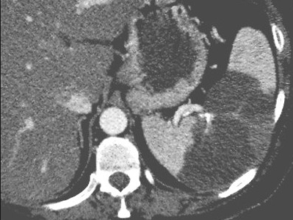
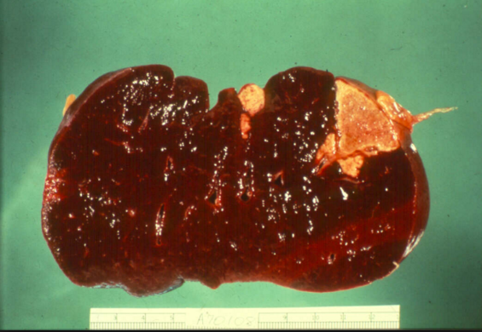
Complications of endocarditis: Splenic infarcts from vegetation embolizing
radiopaedia.org
ect.downstate.edu

Slide 66
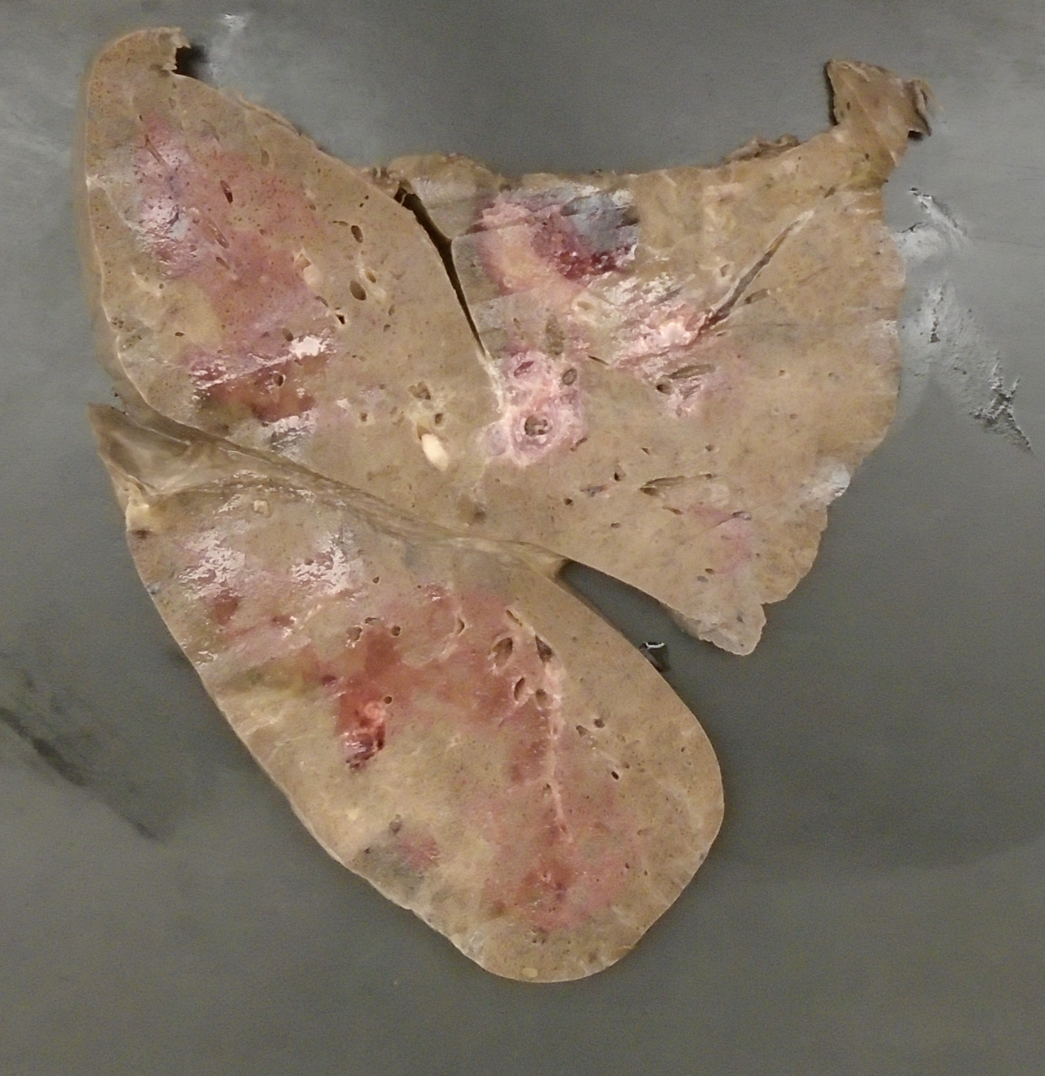
Complications of endocarditis: Fatal pulmonary septic emboli in a young patient with tricuspid endocarditis
Source: Andrew Hale, MD
Pulmonary emboli & infarcts

Slide 67
Vegetation size | Number of patients | Deaths
< 1.0 cm | 19 | 0 (0%)
1.1 to 2.0 cm | 61 | 2 (3%)
> 2.0 cm | 18 | 6 (33%)
Bigger the vegetation, the more likely pulmonary embolism and death

Slide 68
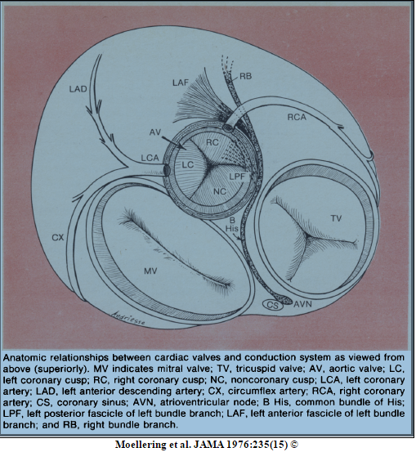
Complications of endocarditis: para-valvular abscess causing heart block
Prolonged PR interval: 1st degree heart block
The aortic valve is in close proximity to the conduction system. If a para-valvular abscess forms, it can compress the conduction fibers and cause heart block (from 1st degree to 3rd degree)

Slide 69
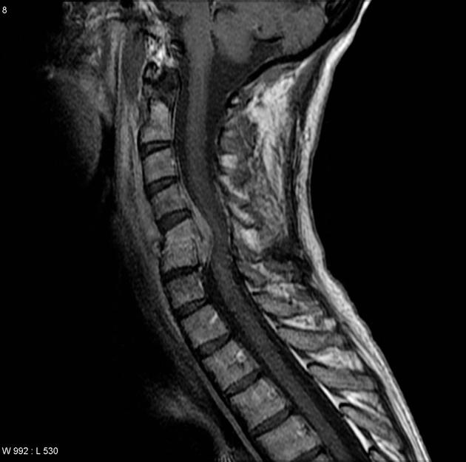
Complications of endocarditis: epidural abscess
Infection has spread next to the spinal cord via hematogenous spread
Epidural abscess causing spinal cord compression, which leads to paralysis

Slide 70
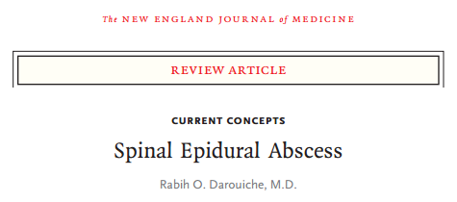
Complications of endocarditis: epidural abscess
If you want to learn more about epidural abscess, check out this review:
Click HERE to link to it

Slide 71
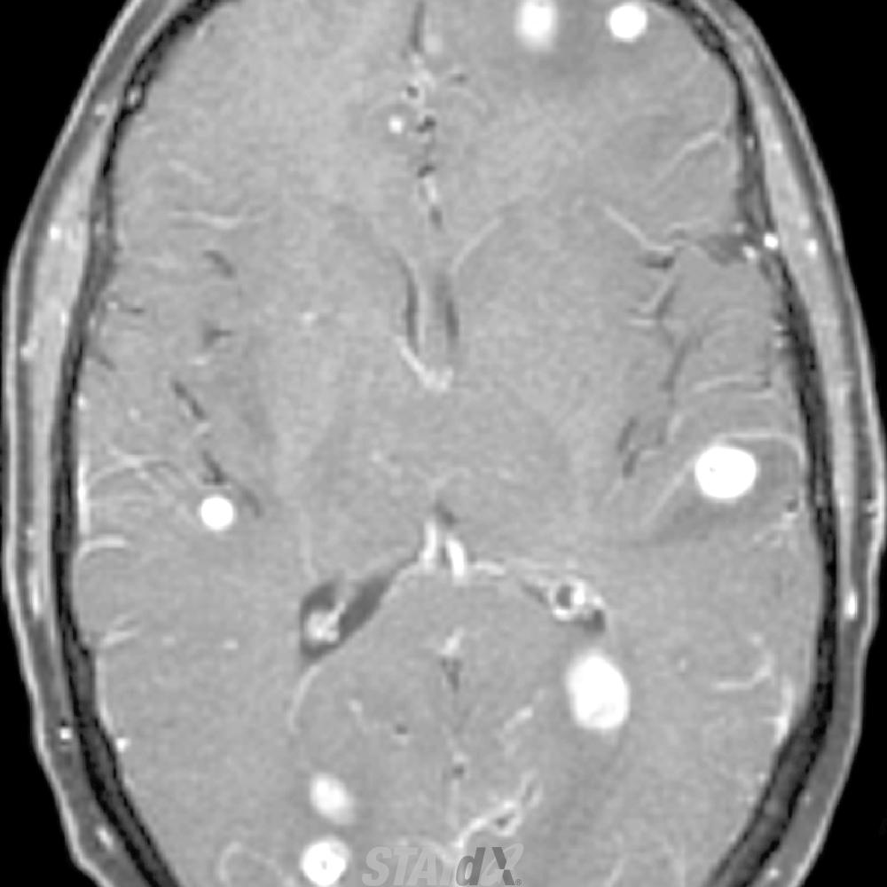
Complications of endocarditis: septic emboli to the brain (stroke)
Pieces of vegetation embolize to the brain
Multiple pieces tend to embolize, “showering” the brain with emboli
Clinically relevant in 20-35% of patients with left-sided infectious endocarditis, though up to 80% of these patients will have some evidence of micro-emboli on brain MRI
Click HERE if you want to learn more about this
Adapted from Statdx.com

Slide 72
Outline (click to jump to a section)
Pathophysiology and immune response
Microbiology
Physical Exam findings
Diagnosis
Complications
Treatment
Special cases

Slide 73
How to treat infectious endocarditis
Intravenous antibiotics
Typically for at least 6 weeks
Directed at the causative pathogen
Consider the need for surgery
Typically involves open heart surgery for valve replacement
If the valve is too damaged to function (IE, heart failure symptoms)
If the vegetation is very large
If there have already been serious embolic events and there is more vegetation that could break off
ID should ALWAYS be consulted

Slide 74
When to add aminoglycosides (gentamicin)
Enterococcus endocarditis
Add 6 weeks of gent onto primary agent (typically ampicillin, vancomycin, or daptomycin, depending on resistance profile)
Some enterococcus may only need short-course gent, or double B-lactam therapy. AHA guidelines (page 22)
Staph aureus PROSTHETIC VALVE endocarditis
Only for the first 2 weeks of the 6 week course
Giving gentamicin in native valve Staph aureus endocarditis just hurts the kidneys
Streptococcus endocarditis
In the right situation and if native valve, you can treat for 2 weeks TOTAL with a B-lactam and gentamicin, but this isn’t done much clinically
Sometimes with Strep prosthetic valve involvement

Slide 75
When to add rifampin
Prosthetic valve endocarditis from Staph species (Staph aureus as well as coagulase-negative Staph (CoNS))
And that’s it!

Slide 76
Who needs Cardiac Surgery consultation?
Valve destruction is causing heart failure
Severe valve regurgitation (even if asymptomatic)
Complicated infection
Persistent positive blood cultures, despite appropriate antibiotics
Para-valvular complications (root abscess, conduction abnormalities, leaflet perforation)
Recurrent embolization events
Large vegetation size (> 1cm is a risk factor for embolization)
Difficult organisms (sometimes with pseudomonas, candida, etc…)

Slide 77
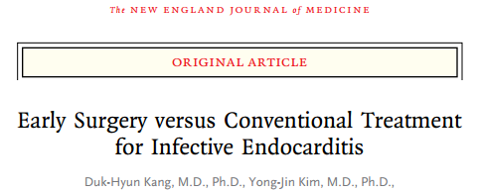
The EASE trial was an RCT looking at the benefits of early surgical intervention in patients with left-sided native-valve endocarditis with valve dysfunction and vegetation size > 1.0cm
Patients who got “early” surgery got it within 48 hours
Control group was treated based on AHA guidelines and got surgery only if required
No significant mortality benefit at 6 months
HOWEVER, embolic events, recurrence of endocarditis, or re-hospitalization because of heart failure was 3% in the early-surgery group vs 28% in the control-group

Slide 78
Question
A 33-year-old female patient who uses intravenous heroin is found to have a 1.5cm vegetation on her mitral valve. The primary team is worried about the risk of stroke
How soon can we expect antibiotics to decrease her stroke risk?

Slide 79
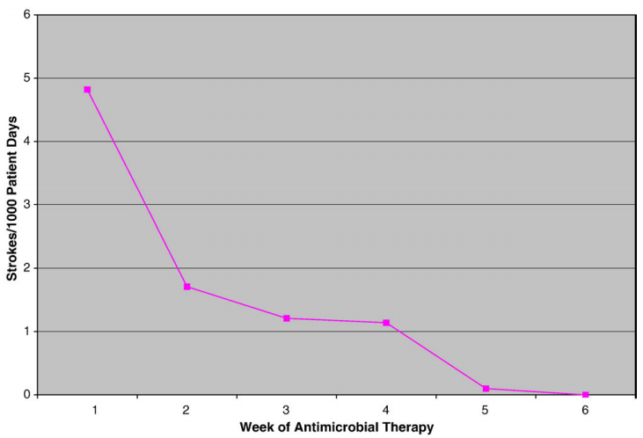
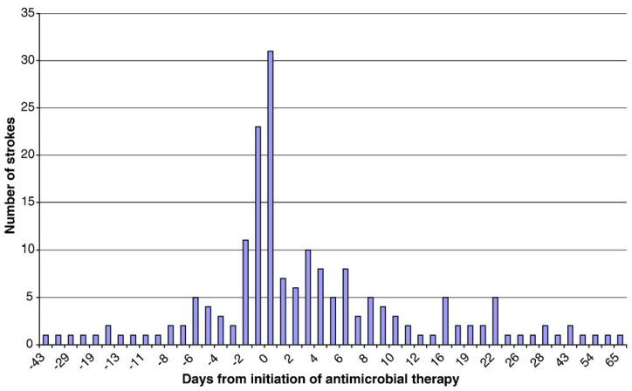

Slide 80
Answer
It takes at least a couple weeks for antibiotics to really decrease stroke risk. That is why large vegetations are an indication for surgery: because the risk of embolization is high and antibiotics won’t decrease risk for a while

Slide 81
What happens to the vegetation AFTER appropriate antibiotic therapy?
Case series of 41 vegetations in 32 patients
AFTER appropriate treatment:
30 % of vegetations were gone
30 % were present but smaller
40% were present and the same size
Thus, it is NOT ABNORMAL that a vegetation will still be present after treatment

Slide 82
Question
A 27-year-old female patient is in the hospital with infectious endocarditis of the aortic valve. On electrocardiogram, you notice that she has Wenkebach phenomenon (2nd degree heart block)
Is her infection likely to respond to 6 weeks of antibiotics alone? Why or why not?

Slide 83
Answer
No, antibiotics are unlikely to be enough. She has evidence of heart block. This implies she has a para-valvular abscess as a complication of her aortic valve endocarditis, compressing the His-Purkinje system. Antibiotics have trouble penetrating abscesses. This is also an indication for surgery to drain the abscess.

Slide 84
Outline (click to jump to a section)
Pathophysiology and immune response
Microbiology
Physical Exam findings
Diagnosis
Complications
Treatment
Special cases (culture negative, fungal, marantic, and prosthetic valve endocarditis)

Slide 85
Question
A 78-year-old woman with advanced lung adenocarcinoma has an obvious aortic valve vegetation on echocardiography. She is not known to have prior heart disease. She has no positive blood cultures, no fever, and no physical exam findings that suggest endocarditis.
1) Is this infectious endocarditis?
2) If not, what else could it be?

Slide 86
Answer
1) No, she does not meet the modified Duke Criteria, thus at this point we cannot diagnose infectious endocarditis
2) What else could it be? The differential for valvular mass includes:
- Prior bacterial endocarditis that resolved but with persistent, sterile vegetation. Treatment of endocarditis does not mean the vegetations always goes away
- Sterile valve thrombosis
- Rarely, valve neoplasms such as fibroelastoma
- Rarely, metastatic cancer
- Murantic endocarditis: certain inflammatory conditions, such as systemic lupus erythematosus and certain cancers cause sterile vegetations to form on heart valves

Slide 87
Culture Negative Endocarditis
Comes in two forms
“Normal” bacterial endocarditis but already given antibiotics so cultures sterilized
Endocarditis from an organism that is not readily cultured
Coxiella burnetii (Q-fever)
Much more common
Brucella
Bartonella (henselae or quintana)
Note that HACEK organisms readily grow in normal blood cultures and are NOT on this list
Legionella
Whipple’s Disease

Slide 88
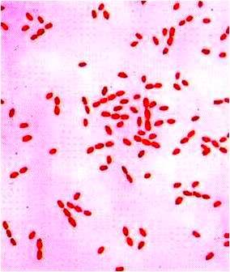
Culture Negative Endocarditis
Endocarditis from an organism that is not readily cultured
Note these are ALL intracellular organisms, hence they don’t grow well in cultures. Diagnosis usually made by serologies or by PCR
Coxiella burnetii (Q-fever)
Contact with farm animals or products of conception, unpasteurized milk
Brucella
Contact with farm animals or products of conception, unpasteurized milk
Bartonella henselae: quintana:
From cat exposure
From louse exposure, more commonly causes endocarditis than B. henselae. Often in homeless, chronic alcoholics
Legionella
An environmental hazard, common cause of pneumonia
Whipple’s Disease
From Trophyerma whipplei. Often seen with arthralgia, weight loss from malabsorption, abdominal pain, more common in men

Slide 89
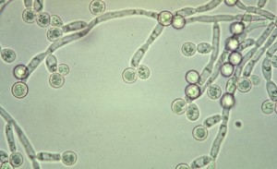
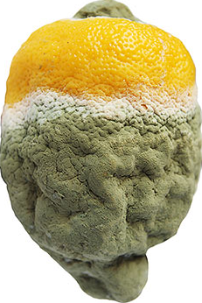
Fungal Endocarditis
Candida species are by far the most common
Aspergillus, Histoplasma, trichosporon, and others are more rare causes
Risk factors include IV drug use, prosthetic valves, and central venous catheters
Heroin often needs an acid to dissolve the powder into an injectable liquid. Lemon juice is often used
Lemons have a lot of Candida on them
Dramatization

Slide 90
Candida Endocarditis
Treatment:
Initially with amphotericin and flucytosine
Can narrow to fluconazole if sensitive
Vegetations are larger:
Risk of embolism is higher
Surgery is usually needed for cure
If surgery not done, often need lifelong suppressive antifungals
Popular misconception:
ALL patients with positive blood culture for candida need an echo
Not true! Only patients at high risk for endocarditis (IE: prosthetic valve) or with high-suspicion for endocarditis need one
They DO need an ID consult and an Ophthalmologic examination

Slide 91
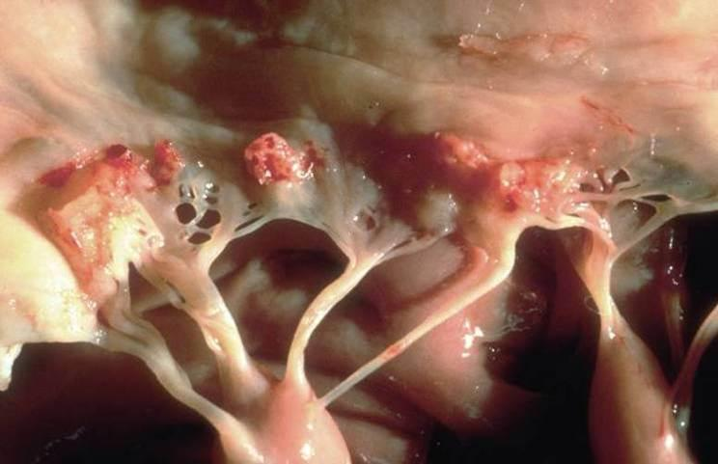
Non-Bacterial Thrombotic Endocarditis (IE: Marantic endocarditis)
Sterile deposition of platelet thrombi on heart valves
Seen mostly in patients with advanced adenocarcinoma, systemic lupus erythematosus, and antiphospholipid antibody syndrome
Hypercoagulable state is the common underlying cause
“Marantic” refers to a Greek term for “wasting away”, highlighting the association with advanced malignancy
Typically asymptomatic until embolization occurs. Fever is uncommon. There is usually no valve destruction, so no heart failure symptoms.
Treatment is anticoagulation
Valvular thrombi with minimal valve destruction in non-bacterial thrombotic endocarditis in a patient with advanced adenocarcinoma
Picture from studyblue.com

Slide 92
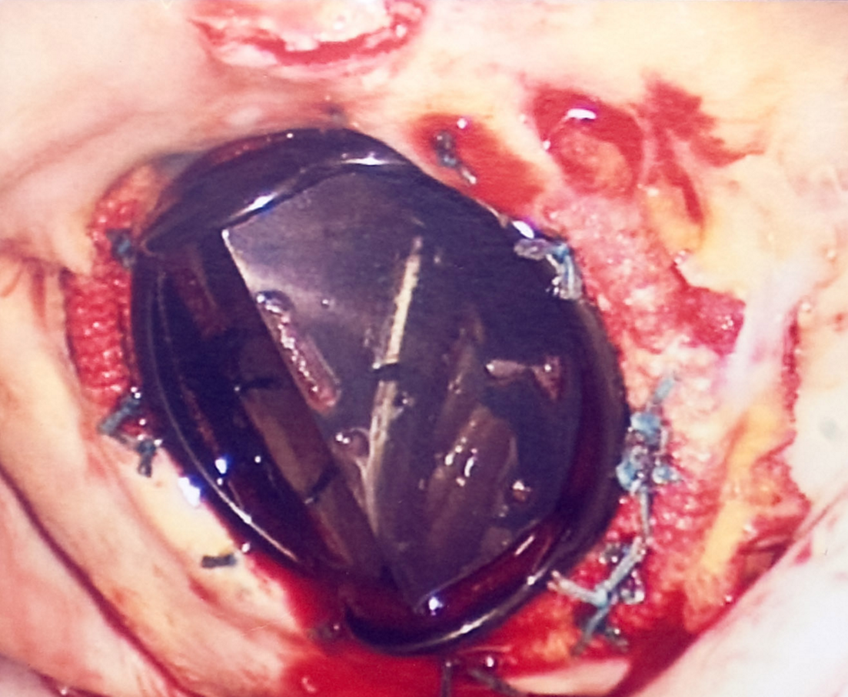
Prosthetic Valve Endocarditis
Site of infection tends to be para-valvular, NOT on the actual mechanical prosthesis (although this can certainly happen)
This causes more abscesses and valve dehiscence
Which is one reason TEE is much more sensitive
Higher rates of morbidity and mortality than native-valve endocarditis
More likely to need surgery
Picture from themitralvalve.org

Slide 93
Question
A 31-year-old man with history of congenital heart disease s/p mechanical mitral valve replacement presents with Staph aureus (MSSA) bacteremia and TEE findings suggestive of prosthetic valve endocarditis.
What antibiotic regimen would you give this patient?

Slide 94
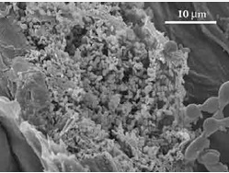
Prosthetic Valve Endocarditis
Biofilms are established more readily on foreign material, and are harder to eradicate
Hence, for prosthetic valve endocarditis from biofilm forming bacteria such as Staph epidermidis or Staph aureus, rifampin is added to the regimen
Because rifampin penetrates biofilms more readily than drugs like vancomycin or nafcillin
Rifampin has a low-barrier to resistance, hence gentamicin for 2 weeks is added to be “rif-protective”, until bacterial load is low

Slide 95
Answer
A 31-year-old man with history of congenital heart disease s/p mechanical mitral valve replacement presents with Staph aureus (MSSA) bacteremia and TEE findings suggestive of prosthetic valve endocarditis
What antibiotic regimen would you give this patient?
A regimen of nafcillin and rifampin for 6 weeks, with gentamicin for 2 weeks, would be reasonable

Slide 96
Infectious Endocarditis: Conclusions
An infection of one or more of the heart’s four valves that can cause a bulky and friable vegetation
An important and very serious infection, affecting thousands of patients annually in the United States, with high rates of morbidity and mortality
It can present acutely (over days to weeks), or sub-acutely (over weeks to months), with a wide variety of clinical manifestations related to diverse embolic, immunologic, and infectious complications
Diagnosing endocarditis requires an astute clinician with excellent physical exam skills and in-depth knowledge of pathophysiology

Slide 97
Congratulations!
Please take the post-module quiz here
https://docs.google.com/forms/d/1TRJvIkDluspNB8TZ38L_wLvlARbR5fz2287uIQakhPI/viewform?usp=send_form

Slide 98
References
Taha et al. Aspirin to prevent growth of vegetations and cerebral emboli in infective endocarditis. J Intern Med. 1992 May;231(5):543-6.
Hoen B, Duval X. Infective endocarditis. N Engl J Med 2013; 369:785.
Mansur AJ, Grinberg M, da Luz PL, Bellotti G. The complications of infective endocarditis. A reappraisal in the 1980s. Arch Intern Med 1992; 152:2428.
Bayer AS. Infective endocarditis. Clin Infect Dis 1993; 17:313.
Hutter A, Moellering R. Assessment of the patient with suspected endocarditis. JAMA. 1976 Apr 12;235(15):1603-5.
Ruttmann E, Willeit J, Ulmer H, et al. Neurological outcome of septic cardioembolic stroke after infective endocarditis. Stroke 2006; 37:2094.
Speechly-Dick ME, Swanton RH. Osteomyelitis and infective endocarditis. Postgrad Med J 1994; 70:885.
Pant S, Patel NJ, Deshmukh A, et al. Trends in infective endocarditis incidence, microbiology, and valve replacement in the United States from 2000 to 2011. J Am Coll Cardiol 2015; 65:2070.
Fowler VG Jr, Miro JM, Hoen B, et al. Staphylococcus aureus endocarditis: a consequence of medical progress. JAMA 2005; 293:3012.
Murdoch et al. Clinical presentation, etiology, and outcome of infective endocarditis in the 21st century: the International Collaboration on Endocarditis-Prospective Cohort Study. Arch Intern Med. 2009;169(5):463.
Baddour et al. Circulation. 2005; 111: 394-434
Heidenreich et al. Am Jour Med 1999; 107: 198-208
And as listed on each individual slide

