Slide 1
Hospital and Ventilator Associated Pneumonia (HAP/VAP)

Slide 2
Welcome to the module on HAP/VAP
Please take this brief pre-module quiz
https://goo.gl/forms/EpqlgYcj73DIgtun2

Slide 3
This module works a lot better in “presentation” mode
Start presentation mode now

Slide 4
Disclaimer:
We recommend going through the Community Acquired Pneumonia (CAP) module on www.idmodules.com prior to the HAP/VAP module
We will build off concepts developed in the CAP module here
Also note that for a more detailed approach to the management of HAP/VAP, IDSA guidelines were updated in 2016

Slide 5
Outline (click to jump to a section)
Overview, pathogenesis, and prevention
Microbiology
Diagnosis
Treatment
Practice cases

Slide 6
Outline (click to jump to a section)
Overview, pathogenesis, and prevention
Microbiology
Diagnosis
Treatment
Practice cases

Slide 7
HAP/VAP: serious diseases with high morbidity and mortality

Slide 8
Hospital-Acquired PNA (HAP) Ventilator-Associated PNA (VAP)
Definitions:
Hospital-Acquired Pneumonia (HAP): occurs after at least 48 hours of hospitalization
Ventilator-Associated Pneumonia (VAP): occurs after 48-72 hours of endotracheal intubation

Slide 9
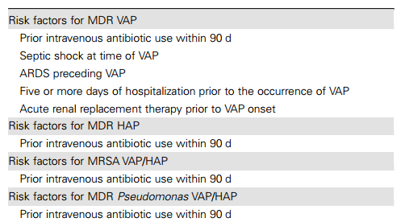
What happened to HCAP???
Prior IDSA guidelines included a category called Health-Care Associated Pneumonia (HCAP)
This referred to patients with increased exposure to the health care setting, and had strict definitions for who fit into HCAP
Dialysis, hospitalization > 48 hours in the last 90 days, living in a nursing home, etc…
The 2016 IDSA guidelines GOT RID of HCAP
Now, they recommend an assessment of “risk for multi-drug resistant organisms”, using these criteria:
And recommending antibiotic choice be based on local antibiograms
The hope was to decrease reflexive “Vancopime” [vanco/cefepime] with HCAP’s strict definition, and allow more nuance
This has been somewhat confusing for many providers

Slide 10
Effects of HAP/VAP
Pneumonia is the 2nd most common nosocomial infection (after UTI’s)
Top cause of nosocomial infectious death
Increases length of hospitalization 7-9 days on average
At a cost of $12,000-$40,000 extra per hospitalization, on average
Muscedere JG, Day A, Heyland DK. Mortality, attributable mortality, and clinical events as end points for clinical trials of ventilator-associated pneumonia and hospital-acquired pneumonia. Clin Infect Dis. 2010 Aug;51 Suppl 1:S120-5.
Kollef MH, Hamilton CW, Ernst FR. Economic impact of ventilator-associated pneumonia in a large matched cohort. Infect Control Hosp Epidemiol. 2012 Mar;33(3):250-6. Epub 2012 Jan 17

Slide 11
Ventilator-associated PNA (VAP)
The incidence of VAP has been decreasing
2005: VAP occured in 9-27% of intubated patients, 7.3 per 1,000 vent-days in MICU¹
2012: incidence had dropped to 4.4 per 1,000 vent days
More effective preventive measures are to thank
American Thoracic Society, Infectious Diseases Society of America. Guidelines for the management of adults with hospital-acquired, ventilator-associated, and healthcare-associated pneumonia. Am J Respir Crit Care Med. 2005;171(4):388.
Melsen et al. Attributable mortality of ventilator-associated pneumonia: a meta-analysis of individual patient data from randomised prevention studies. Lancet Infect Dis. 2013 Aug;13(8):665-71. Epub 2013 Apr 25

Slide 12
Preventing HAP and VAP An ounce of prevention is worth…
Minimize intubation
Intubation > 7 days increases risk of VAP significantly, so extubate early
Prevent aspiration
Avoid PPI’s and H2 blockers unless necessary
Head of bed at 45 degrees
Do not oversedate
Avoid repeated extubation/re-intubation
Decontaminant the oropharnyx
Chlorhexidine mouthwash decreases VAP (RR 0.56 in one study¹)
General measures:
Hand hygiene and glove/gown compliance shown to decrease risk of VAP/HAP
1) Chan EY et al. Oral decontamination for prevention of pneumonia in mechanically ventilated adults: systematic review and meta-analysis. BMJ. 2007;334(7599):889.

Slide 13
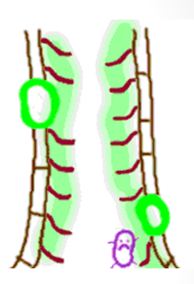
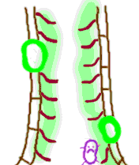
Pathogenesis
ETT
Micro-aspiration is the primary route of infection to the lungs
Typically, there are many defenses preventing micro-aspiration, including mucociliary clearance
In intubated patients, this is not possible, and is deficient in many hospitalized patients
The longer the patient is in the hospital, the more likely they are to accumulate multi-drug resistant organisms

Slide 14
Outline (click to jump to a section)
Overview, pathogenesis, and prevention
Microbiology
Diagnosis
Treatment
Practice cases

Slide 15
What bacteria are involved in HAP/VAP?
No great data that VAP/HAP organisms differ dramatically
Depends on multi-drug resistance risk factors, and early (<5 days) or late (>5 days) onset from start of hospitalization (for HAP/VAP)
The local antibiogram is very important, as hospital to hospital can differ in terms of MDR resistance

Slide 16
Bacteria that cause HAP/VAP
This is one study that looked at 20 centers in the USA. Your local biogram may be different!
Unlike CAP, Gram negative bacilli play a much larger role, including the Enterobacteriaceae and Non-Fermenters
Enterobacteriaceae: E. coli, Klebsiella, Enterobacter, others
Non-Fermenters: Psuedomonas, Acinetobacter, Stenotrophomonas maltophilia, Burkholderia, others
Staph aureus, particularly MRSA, is more common
Viruses and atypical organisms (IE: mycoplasma) are much less common. Anaerobes are still uncommon.
In one study of 398 cases of VAP:
Pathogen | Prevalence | Mortality
MRSA | 14.8% | 32.2%
Pseudomonas | 14.3% | 28.6%
MSSA | 8.8% | 22.9%
Klebsiella pneumoniae | 3.3% | 23.1%
Enterbacter | 3.0% | 7.7%
E. coli | 3.0% | 25%
Acinetobacter | 2.0% | 50%

Slide 17
Some important HAP/VAP organisms

Slide 18
Enterobacteriaceae
Large family of gram-negative bacilli bacteria
Includes some of our old favorites:
E. coli, Klebsiella, Enterobacter, Salmonella Serratia, Citrobacter
Often quite sensitive, though they have potential to be extensively multi-drug resistance
Carbapenem resistant enterobacteriaeceae (CRE) are a cause of major concern and important emerging infectious threat
Klebsiella pneumoniae carbapenemase (KPC) is a particularly dangerous variant, quite transmissible, (not only in Klebsiella) and can be very hard to treat
Some have an inducible B-lactamase (called “AmpC”)
Which means that it looks sensitive to a B-lactam, but then turns on resistance
Most commonly seen in Enterobacter , Citrobacter, and Serratia
Typically avoid penicillins and 3rd generation cephalosporins here
Cefepime and meropenem may be needed for longer courses
Review paper link

Slide 19
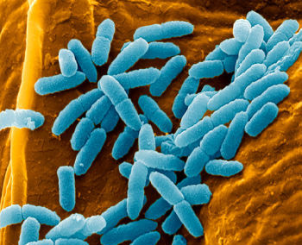
Pseudomonas aeruginosa
Ahhh, Pseudomonas…how we fret over you
A non-fermenting GNR that is very common, very pathogenic, and often multi-drug resistant
Intrinsically resistant to many antibiotics from MANY resistance pathways
B-lactamases, porins, multidrug efflux pumps, biofilm formation…
Often need higher “pseudomonal” dosing of antibiotics
Often associated with water: hot tubs, respirator equipment, sinks, hospital vents
Very common colonizer in cystic fibrosis patients

Slide 20
ANTI-PSEUDOMONAS DRUGS
Rates of effective coverage will differ hospital to hospital. Be aware of your local antibiogram
Only PO option!
Fluoroquinoles (ciprofloxacin/levofloxacin) (PO)
Zosyn (pipercillin/tazobactam) (IV)
Ceftazidime (IV)
Cefepime (IV)
Aztreonam (IV)
Aminoglycosides (IV)
Carbapenems (not ertapenem) (IV)
Colistin (IV)
Zerbaxa (ceftolozane/tazobactam) (IV)
Avitaz (ceftazidime/avibactam)

Slide 21
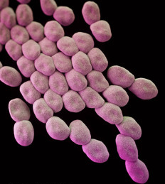
Acinetobacter
A Non-fermenter GNR that is commonly seen in HAP and especially VAP (8-9% in some series)
Widely distributed in nature, especially in humid areas
Often multidrug resistant, and associated with significant mortality…a bad iatrogenic infection to pick up
In one study, 33% of hospital-related Acinetobacter infection were fatal
Lemos et al. Carbapenem resistance and mortality in patients with Acinetobacter baumannii infection: systematic review and meta-analysis. Clin Microbiol Infect. 2014 May;20(5):416-23.

Slide 22
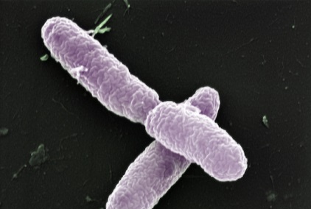
Burkholderia
Several types, Burkholderia cepacia is the most significant
Similar to acinetobacter, it is a non-fermenter GNR that is a common MDR cause of iatrogenic infection , especially HAP/VAP
Particularly common in cystic fibrosis and lung transplant patients

Slide 23
Stenotrophomonas maltophilia
Another non-fermenter GNR seen in HAP/VAP
It is an opportunistic pathogen, usually seen in patients who are immunocompromised or after EXTENDED hospital exposure
Steno is VERY drug resistant
Bactrim is the treatment of choice, and often the only thing Steno is sensitive to
Mortality rates range from 21-69%...Steno is quite serious

Slide 24
“Yeast pneumonia” is very rare: Usually, don’t chase it
Candida is the most commonly seen. It is a frequent colonizer
Autopsy study¹ of 77 patients with pneumonia and candida on BAL culture found no histological evidence of invasive candidal infection in any sample
The few candida PNA cases are from hematogenous spread (in severely immunocompromised patients), so multi-nodular disease would be expected and make candida in sputum more suspicious
If suspicion for yeasts that DO causes dangerous PNA (histoplasma, blastomycosis, coccidiomycosis, cryptococcus, PCP), call the Micro lab and have then speciate the yeast
1) Kontoyiannis DP et al. Pulmonary candidiasis in patients with cancer: an autopsy study. Clin Infect Dis. 2002;34(3):400.

Slide 25
Outline (click to jump to a section)
Overview, pathogenesis, and prevention
Microbiology
Diagnosis
Treatment
Practice cases

Slide 26
Diagnosing VAP
Needs to be diagnosed early: mortality is 25-50%
Reasonable to start treatment if:
1) New lung infiltrate
AND
2) One of the following:
Fever
Purulent tracheobronchial secretions
Leukocytosis
Increased respiratory rate
Decreased tidal volume
Increased minute ventilation
Decreased oxygenation

Slide 27
Diagnosing VAP
UNLIKE most cases of CAP, finding the organism is vitally important in VAP
Pt will be on BROAD antibiotic coverage, and need to narrow down to the correct abx quickly
In CAP, empiric therapy almost always works, so microbial diagnosis less important
So, get a good culture!

Slide 28
Diagnosing VAP: getting a good sputum sample
Multiple options
BAL: use bronchoscope, infuse saline, aspirate back (intensive)
Mini-BAL: put catheter down ET tube until resistance, infuse saline, aspirate back (less intensive)
Tracheobronchial aspiration: put catheter down ET tube until resistance, aspirate back (least intensive)
Protected specimen brush: brush comes out the bronchoscope, so only samples lower airway (intensive)
What to choose? NEJM RCT¹ showed similar diagnostic yield, mortality, and antibiotic-narrowing from BAL vs ET aspiration
The Canadian Critical Care Trials Group. A Randomized Trial of Diagnostic Techniques for Ventilator-Associated Pneumonia. N Engl J Med 2006; 355:2619-2630. December 21, 2006

Slide 29
Diagnosing VAP: quantitative cultures
In “normal” sputum cultures, growth is measured in qualitative terms of “sparse, rare, moderate, or heavy”
In VAP, we go quantitative with CFU’s (colony-forming units), with different cut-offs depending on how sample was obtained
Tracheobronchial aspiration: >1,000,000 CFU
Broncheoalveolar lavage (BAL): > 10,000 CFU
Protected specimen brush: > 1,000 CFU

Slide 30
Differential diagnosis for PNA: keep these in mind
Radiation pneumonitis
Organizing pneumonia (BOOP)
Aspiration pneumonitis
Pulmonary embolism with infarct
Mimic of bacterial pneumonia
Pulmonary hemorrhage
Infiltrative tumor (esp. bronchioloalveolar carcinoma
ARDS
Drug reaction
Methotrexate,
Cyclophosphamide,
Busulfan
Nitrofurantoin
Lung contusion
Pulmonary edema

Slide 31
Outline (click to jump to a section)
Overview, pathogenesis, and prevention
Microbiology
Diagnosis
Treatment
Practice cases

Slide 32
Empiric Treatment for HAP/VAP
1) One of the following for pseudomonal and gram negative (-) coverage:
Anti-pseudomonal cephalosporin (cefepime or ceftazidime)
Piperacillin/Tazobactam (zosyn)
Carbapenem (any except ertapenem)
Aztreonam for anaphylactic penicillin allergy
If this all sounds like word salad or you need a quick review, take the IDmodules.com “Antibiotics” module, which covers these all in detail
++ PLUS ++
2) Double pseudomonal coverage (as it is so often resistant) with one of the following:
Anti-pseudomonal fluoroquinolone (ciprofloxacin or levofloxacin)
Aminoglycoside (tobramycin, gentamicin, or amikacin)
In severe patients, if Pseudomonas is resistant to cefepime or zosyn, more likely to be resistant to cipro, so usually aminoglycoside is the best choice
++ PLUS ++
3) Broad gram positive (+) coverage with one of the following:
Vancomycin or linezolid

Slide 33
Empiric Treatment for HAP/VAP
Really, give 3 antibiotics to everyone up front??
No! That is for the sickest patients and those with the highest risk for MDR organisms
The authors’ experience is usually to use 3 for VAP patients (including an aminoglycoside) and 2 for HAP patients
Clinical decision must be nuanced in each case
Should be based on your local antibiogram

Slide 34
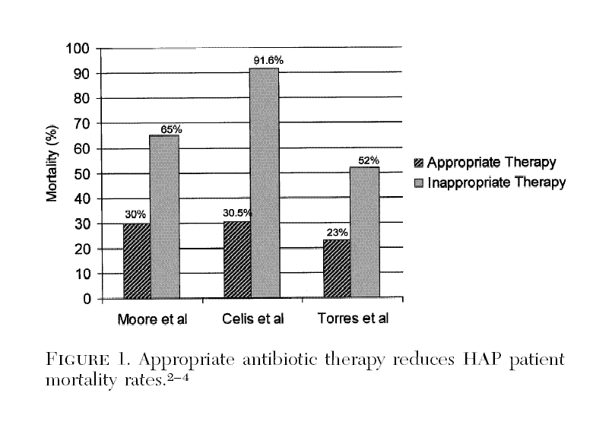
Appropriate Initial Antibiotic Therapy Reduces Mortality: Get it right from the get-go!
Fiel, S, Chest 2001; 119:412S-418S

Slide 35
Treating HAP/VAP
Notice that the main differences for HAP/VAP treatment vs CAP treatment are:
No atypical coverage
Still no empiric anaerobe coverage needed
Double pseudomonas coverage in some cases (usually for VAP, unless patient has MDR history)
Single MRSA coverage (low rates of MRSA resistance to vancomycin or linezolid)
Everything is intravenous

Slide 36
Vancomycin vs Linezolid for MRSA Pneumonia: the controversy
One study¹ from 2003 showed improved survival (80% vs 63.5%, p=0.03) with linezolid over vanco
However, not reproduced in other studies. Meta-analysis² from 2010 showed no difference
Vancomycin is much cheaper, likely non-inferior, so it is 1st line still
However, RCT³ in 2012 showed better end-of-stay outcome with linezolid, but similar outcome at 60 days, so still a controversial topic that could change
For now, I am a Vancomycin Man
Note: daptomycin should never be used for MRSA pneumonia. It is inactivated by pulmonary surfactant
1) Wunderink et al, Chest 2003;124(5):1789
2) Chest 2010; epub, Crit Care Med 2010 38:1802
3) Wunderink et al. Linezolid in methicillin-resistant Staphylococcus aureus nosocomial pneumonia: a randomized, controlled study. Clin Infect Dis. 2012 Mar 1;54(5):621-9

Slide 37
Treating HAP/VAP
So do we start 2-3 IV antibiotics and finish an 8 day course?
NO!! The above antibiotics are for empiric therapy
Because many MDR organisms are in play, it is critical to find the cause of the infection (see “diagnosis” section)
Once an organism is identified, rapidly narrow antibiotics
So if a patient is on vancomycin/cefepime/tobramycin, and a pan-sensitive E. coli is recovered on sputum culture, narrow to ceftriaxone?
YES!!!!!
De-escalation is critical
Just because it’s a sensitive organism doesn’t mean it’s not highly pathogenic…YES, that pan-sensitive Strep pneumo can cause fulminant ARDS…narrow antibiotics based on results

Slide 38
De-escalation based on culture data is critical
Review on de-escalation if you’re interested

Slide 39
Reasons for Lack of Improvement
What do you think? Why would a patient not be improving, even on “appropriate” antibiotics?
Complications (empyema, abscess): look for them with imaging (usually CT scan)
Misdiagnosis (CHF, ARDS, PE…see differential diagnosis earlier in the module)
Wrong antibiotics (unusual or resistant organism, improper dosing)
Do you need atypical coverage?
Confirm all correct dosing

Slide 40
Duration of treatment for HAP/VAP
The 2016 IDSA guidelines for HAP/VAP recommend a 7 day course regardless of pathogen
They do state that shorter or longer duration can be used based on clinical/radiographic/lab parameters
Recent data has suggested even shorter could be OK
In the past, longer courses were often given for MRSA or Pseudomonas (often 14-21 days was given)
Eight days (8!) has also been a “famous number” for HAP/VAP. Where did that come from?

Slide 41
The 8 day thing for HAP/VAP
This study: Chastre, et al. JAMA 2003;290:2588.
Prospective RCT of 401 French ICU patients with VAP
Randomized to receive 8 vs 15 days of antibiotics chosen by treating physician
No difference in mortality (18.8% vs 17.2%) or recurrent infections (29% vs 26%)
Patients with VAP caused by non-fermenting GNR (including pseudomonas) had more frequent recurrences (40.6% vs 25.4%) when treated for 8 vs 15 days, though no difference in mortality
You’ll still see people stick to this, but again updated data/guidelines suggest a 7 day course;
longer if “clinically indicated”

Slide 42
Outline (click to jump to a section)
Overview, pathogenesis, and prevention
Microbiology
Diagnosis
Treatment
Practice cases

Slide 43
Case 1
A 52 year old female with Down's syndrome is admitted from her nursing home with fever, hypotension, tachycardia and increasing lethargy. Per nursing home staff, there were no witnessed aspirations. On arrival, she is tachypneic with an oxygen saturation of 88% on a 100% non-rebreather mask. A portable chest xray demonstrates a dense multifocal infiltrate. She is intubated and admitted to the ICU, where she is requiring pressors for blood pressure support. She has a creatinine of 0.4. Blood and endotracheal aspirate cultures are pending.
What treatment do you recommend, Dr?

Slide 44
Case 1 Review
The patient is at risk for MDR organisms based on
1) Long-term residence in a nursing facility
2) Shock as an initial presentation of her pneumonia
Empiric coverage should cover MRSA, pseudomonas, and other GNR’s
Vancomycin and cefepime would be very reasonable
Addition of an aminoglycoside or fluoroquinolone is reasonable, given how sick she is

Slide 45
Case 2
56 year old woman, previously healthy, is admitted in the ICU with pneumonia
She is intubated and sedated
Sputum cultures initially grew MRSA, and she has been on vancomycin for 6 days
On Hospital Day 7, sputum cultures grow yeast
What treatment do you recommend, Dr?

Slide 46
“Yeast pneumonia” is very rare: Usually, don’t chase it
Trick Question!
Candida is a frequent colonizer of the tracheobronchial tree
Autopsy study¹ of 77 patients with pneumonia and candida on BAL culture found no histological evidence of invasive candidal infection in any sample
The few candida PNA cases are from hematogenous spread (in severely immunocompromised patients), so multi-nodular disease would be expected and make candida in sputum more suspicious
If suspicion for yeasts that DO causes dangerous PNA (histoplasma, blastomycosis, coccidiomycosis, cryptococcus, PCP), call the Micro lab and have then speciate the yeast
1) Kontoyiannis DP et al. Pulmonary candidiasis in patients with cancer: an autopsy study. Clin Infect Dis. 2002;34(3):400.

Slide 47
Case 3
A 76 year old man with COPD is admitted to the MICU with respiratory failure related to COPD exacerbation
He has been hospitalized 4 times in the last 5 months for similar episodes
On hospital day 9, he remains intubated, and has new fevers and purulent secretions coming from his endotracheal tube
CXR suggests a new infiltrate
What treatment do you recommend, Dr?

Slide 48
Case 3 review
The patient has a classic ventilator associated pneumonia
With the caveat that treatment should be “based on local antibiogram”, this is the sort of patient to strongly consider “empiric double pseudomonas”
Would consider vancomycin/cefepime/tobramycin
Obtaining adequate sputum or BAL samples will be critical so that we can quickly find the organism and de-escalate therapy

Slide 49
Case 3 continued
3 days later, our patient is significantly worsened. Ventilator requirements are up, and he is now on 2 pressors
The MICU team currently has the patient on meropenem, ciprofloxacin, and linezolid
Endotracheal sputum cultures return with Klebsiella pneumonia, which is pan-sensitive
What do you recommend, Dr?

Slide 50
Case 3 review
Although the patient is clinically worsened, a pathogenic organism (Klebsiella) causing his VAP has been identified
It is appropriate to de-escalate antibiotics at this time, and stop the mero/cipro/linezolid and start something like ceftriaxone or levofloxacin
Just because he is clinically worse doesn’t mean all those broad antibiotics are any more effective at killing THIS bacteria…in fact they likely will just add drug-drug interactions and give unwanted side-effects

Slide 51
Congratulations! You have completed the HAP/VAP module Please take the post-module quiz. This is essential to our project https://goo.gl/forms/fIcBE87nkanfw0Ct1

