Slide 1
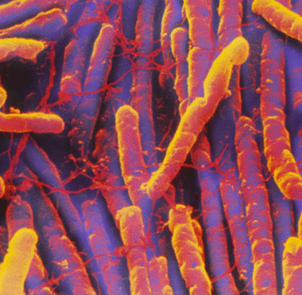
Clostridioides* difficile
* formerly Clostridium

Slide 2
This module works a lot better in “presentation” mode
Start presentation mode now

Slide 3
Welcome to the module on C. difficile!
Please take this brief pre-module quiz
INSERT HYPERLINK HERE

Slide 4
A Starter Question
Table of Contents
A 25 year old woman presents to clinic with loose stools for 1 week. At first, she was having on average 5 bowel movements per day. This has increased from 5 to 10 bowel movements daily over the past 2 days. She has also been having mild lower abdominal cramping and low grade temperatures to 100F. She was recently treated for a tooth infection with clindamycin.
What must be on your differential diagnosis for her diarrhea?
C. difficile

Slide 5
TABLE OF CONTENTS
Background & Microbiology
Pathogenesis & C. difficile Toxins
Epidemiology
Transmission
Risk Factors & Host Defense
Clinical Manifestations
Diagnosis
Treatment
Recurrence
Cases

Slide 6
Background: C. Difficile
Return to Table of Contents
Bartlett et al., Gastroenterology 1978
Pepin et al., Clin Infect Dis 2005
Bartlett JG, Ann Intern Med 2006
First discovered in 1935 in neonates as a commensal organism in stool
Named “difficile” because it is difficult to culture
After antibiotics became widely available, there was an increase in antibiotic-associated diarrhea & colitis! Early work implicated S. aureus, however...
In 1978, C. difficile was identified as the pathogen causing the majority of cases of colitis
Initially the most common cause was clindamycin
However, from the early-mid 1980s to early 2000s, cephalosporins were the most implicated antibiotics
Today, fluoroquinolones are thought to be associated with the development of a highly virulent strain!
Notes:
Bartlett JG. Narrative review: the new epidemic of Clostridium difficile-associated enteric disease. SOAnn Intern Med. 2006;145(10):758.
Bartlett JG, Moon N, Chang TW, Taylor N, Onderdonk AB. Role of Clostridium difficile in antibiotic-associated pseudomembranous colitis. Gastroenterology. 1978;75(5):778.
Pépin J, Saheb N, Coulombe MA, Alary ME, Corriveau MP, Authier S, Leblanc M, Rivard G, Bettez M, Primeau V, Nguyen M, Jacob CE, Lanthier L. Emergence of fluoroquinolones as the predominant risk factor for Clostridium difficile-associated diarrhea: a cohort study during an epidemic in Quebec. Clin Infect Dis. 2005;41(9):1254.

Slide 7
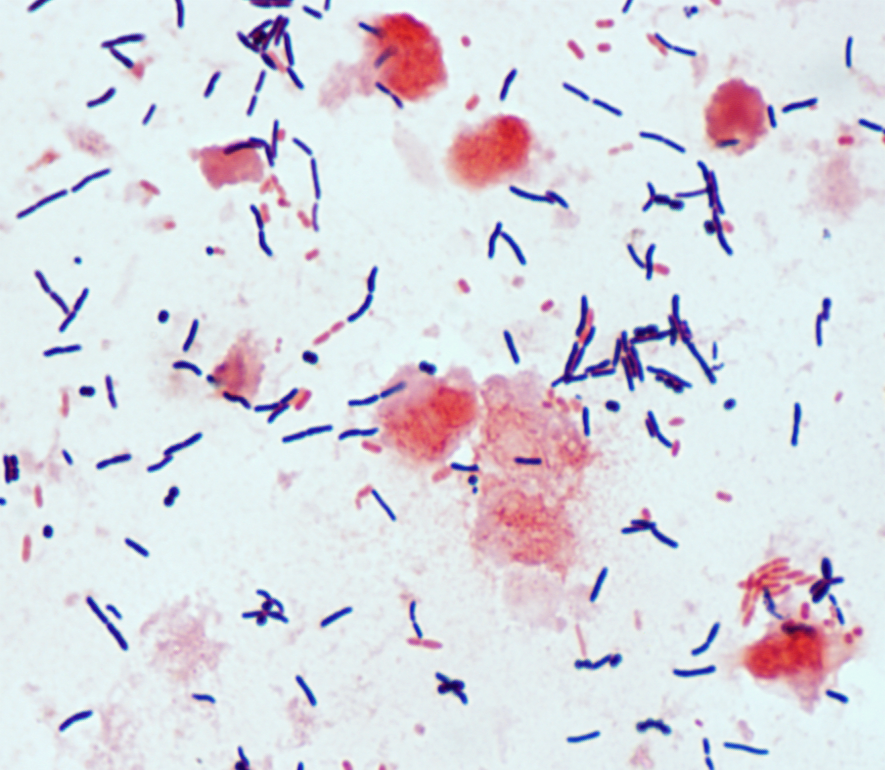
Microbiology
Return to Table of Contents
Obligate anaerobe
Gram positive rod (GPR)
Spore-forming, toxin-producing
Spores allow it to survive in aerobic environments (i.e. on the patient gown you just touched!)
Transmitted amongst humans through the fecal-oral route by ingestion of spores
Inhabits the soil & intestinal tracts of animals including humans
Once a spore gets into the colon, it can reactivate into a toxin-producing GPR

Slide 8
Pathogenesis of CDI (C. difficile infection)
Return to Table of Contents
Tonna & Welsby, Postgrad Med Journal 2005
Normally, the colon has more than 500 species of bacteria, including C. difficile
There are >400 strains of C. difficile and only toxin-producing strains cause disease
1g of feces contains up to 10¹² bacteria that resist colonization & prevent proliferation of C. difficile
Lactobacilli & group D Enterococci are the most antagonistic bacteria against C. difficile
If these bacteria are eradicated by antibiotics, C. difficile can overpopulate the colon!
Notes:
Tonna I, Welsby PD
Pathogenesis and treatment of Clostridium difficileinfection
Postgraduate Medical Journal 2005;81:367-369.

Slide 9
Pathogenesis of CDI
Return to Table of Contents
Requirements for Developing CDI
There must be a disruption of the normal gut flora (i.e. antibiotics) → leading to diminished colonization favoring C. difficile
You must acquire the organism!

Slide 10
Pathogenesis of CDI
Return to Table of Contents
Leffler & Lamont, NEJM 2015
Tonna & Welsby, Postgrad Med Journal 2005
Antibiotics
in the setting of risk factors (i.e. elderly, IBD, immunosuppression)
disrupt the barrier function of colonic flora
Abnormal colonic microbiota
Asymptomatic carriage
Effective antitoxin response
Toxigenic C. difficile exposure & colonization or activation of prior colonization
Toxin production
Inadequate immune response
Diarrhea &
colitis
Notes:
Leffler and Lamont. Clostridium difficile Infection. N Engl J Med 2015; 372:1539-1548
Tonna I, Welsby PD
Pathogenesis and treatment of Clostridium difficileinfection
Postgraduate Medical Journal 2005;81:367-369.

Slide 11
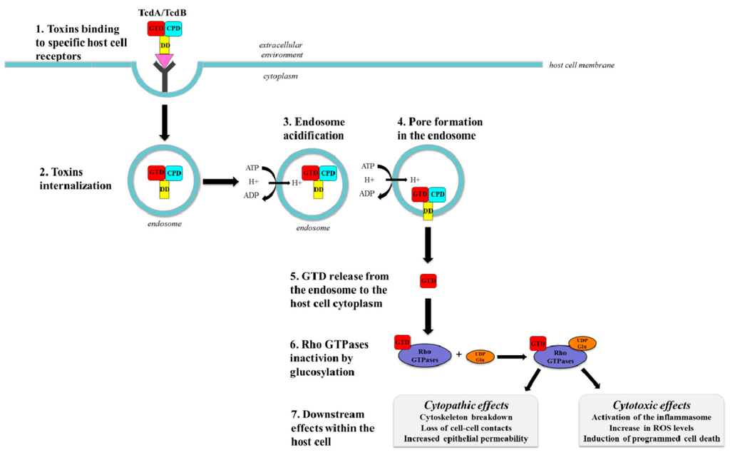
C. difficile causes disease via TOXIN production…
Di Bella et al., Toxins 2016
Return to Table of Contents
C. difficile DOES NOT invade tissue
Pathogenic strains produce protein exotoxins
Enterotoxin (Toxin A)
Cytotoxin (Toxin B)
These toxins, once intracellular, inactivate GTPases → disrupting cytoskeletal structure & tight junctions of colonic cells → leading to apoptosis
Toxin A causes inflammation leading to intestinal fluid secretion & mucosal injury
Toxin B is important for virulence
Strains without toxin are non-pathogenic (10-30% of strains)
You CAN have non-toxin producing C. difficile and only have asymptomatic colonization
Notes:
Pathogenic strains produce multiple toxins including
Enterotoxin (C dif toxin A)
Cytotoxin (C dif toxin B)
Di Bella, Stefano; Ascenzi, Paolo; Siarakas, Steven; Petrosillo, Nicola; di Masi, Alessandra (2016-01-01). "Clostridium difficile Toxins A and B: Insights into Pathogenic Properties and Extraintestinal Effects". Toxins. 8 (5): 134.

Slide 12
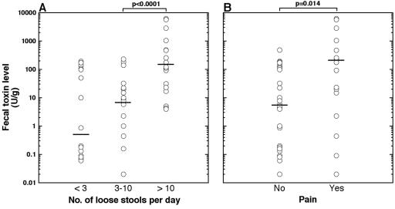
Toxin A and B levels directly correlate with symptom severity
Return to Table of Contents
Akerlund et al. J Clin Microbiol 2006

Slide 13
Epidemiology
Return to Table of Contents
There are several different virulent strains of C. diff (J, 078, NAP1)
J is more likely to cause disease after clindamycin
NAP1 is more likely to cause disease after ciprofloxacin
Each strain has different levels of toxin-production
NAP1/BI/027 is a “hypervirulent” strain & has been implicated as the responsible pathogen in selected outbreaks since the early 2000s
Lower clinical cure rates & increased recurrence rates have been observed with patients infected with BI strains
Petrella et al., Clin Infect Dis 2012
Marsh et al., J Clin Microbiol 2012
Walker et al., Clin Infect Dis 2013
Notes:
Decreased cure and increased recurrence rates for Clostridium difficile infection caused by the epidemic C. difficile BI strain. Petrella LA, Sambol SP, Cheknis A, Nagaro K, Kean Y, Sears PS, Babakhani F, Johnson S, Gerding DN SOClin Infect Dis. 2012;55(3):351.
Marsh JW, Arora R, Schlackman JL, Shutt KA, Curry SR, Harrison LH.Association of relapse of Clostridium difficile disease with BI/NAP1/027. J Clin Microbiol. 2012 Dec;50(12):4078-82.
Walker AS, Eyre DW, Wyllie DH, Dingle KE, Griffiths D, Shine B, Oakley S, O'Connor L, Finney J, Vaughan A, Crook DW, Wilcox MH, Peto TE, Infections in Oxfordshire Research Database. Relationship between bacterial strain type, host biomarkers, and mortality in Clostridium difficile infection. Clin Infect Dis. 2013;56(11):1589.

Slide 14
Return to Table of Contents
Hospital admissions
for C. diff are increasing

Slide 15
Mortality in hospitalized adults is not insignificant
Return to Table of Contents

Slide 16
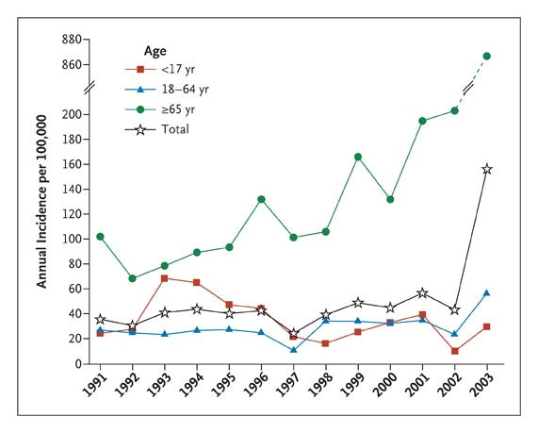
Kelly CP, LaMont JT. N Engl J Med 2008
Return to Table of Contents
Incidence of C. diff in the
elderly is increasing
Annual Incidence (per 100,000 Population) of C. difficile Infection in Sherbrooke, Quebec, 1991–2003.
Notes:
Figure 1. Annual Incidence (per 100,000 Population) of C. difficile Infection in Sherbrooke, Quebec, 1991–2003. The overall incidence of C. difficile infection was relatively stable during the period from 1991 through 2002, although there was a gradual increase in the rate of infection among elderly patients (≥65 years). In 2003, the population incidence increased by a factor of 4, as compared with 2002. This increase was especially evident in the elderly. Data are from Pépin et al. 3

Slide 17
Length of stay is not short
Return to Table of Contents

Slide 18
Risk Factors for CDI
Return to Table of Contents
Antibiotics within last 3 months
Advanced age
Chemotherapy
Inflammatory Bowel Disease
GI surgery
Hospitalization
Gastric acid suppression (PPI)
C. diff infection is 1.4 to 2.75 times higher among patients with PPI exposure compared with those without PPI exposure
Loo et al., NEJM 2011
Notes:
Loo VG, Bourgault AM, Poirier L, Lamothe F, Michaud S, Turgeon N, Toye B, Beaudoin A, Frost EH, Gilca R, Brassard P, Dendukuri N, Béliveau C, Oughton M, Brukner I, Dascal A. Host and pathogen factors for Clostridium difficile infection and colonization. N Engl J Med. 2011 Nov;365(18):1693-703.

Slide 19
Not all antibiotics are created equal…
Return to Table of Contents
Frequently Associated
Clindamycin
Fluoroquinolones (ciprofloxacin, levofloxacin)
Broad-spectrum penicillins (zosyn)
Broad-spectrum cephalosporins (cefepime)
Occasionally Associated
Macrolides (azithromycin)
TMP-SMX
Rarely Associated
Vancomycin
Doxycycline
Metronidazole
Aminoglycosides
Antimicrobial agents that may induce C. difficile colitis
Leffler et al., NEJM 2015
Notes:
Leffler DA, Lamont JT. Clostridium difficile infection. N Engl J Med 2015; 372:1539

Slide 20
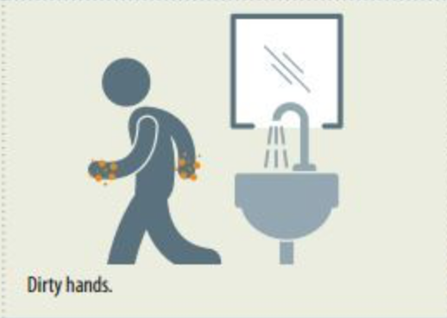
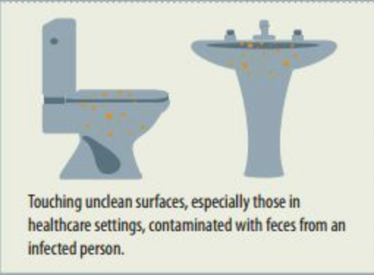
Transmission
Return to Table of Contents
C. difficile is transmitted from person to person by the fecal-oral route
C. difficile is shed in feces
Any surface, device, material that is contaminated with feces may become a reservoir for spores!
Heat-resistant spores are not killed by alcohol-based hand cleansers or routine surface cleaning
Once spores are ingested, they pass through the stomach [resistant to acid] and once exposed to bile acids, they germinate and multiple in the colon!

Slide 21
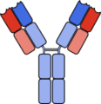
Host Defense & Response
Kyne et al., Lancet 2001
Kelly CP Eur J Gastroenterol Hepatol 1996
Abt et al., Nat Rev Microbiol 2016
Return to Table of Contents
The intestinal microbiota are responsible for resisting colonization against C. diff!
Commensal bacteria convert bile acids to inhibit growth of C. diff by depriving the spores of germinant & some of these acids are toxic to the vegetative form of C. diff
Serum antitoxin antibodies are the best described factor protecting against CDI!
Mounting a serum Ab response to toxin A during an initial episode is associated with protection against recurrent CDI
Asymptomatic carriers demonstrate higher serum levels of IgG against toxin A
Notes:
Kyne L, Warny M, Qamar A, Kelly CP. Association between antibody response to toxin A and protection against recurrent Clostridium difficile diarrhoea. Lancet. 2001;357(9251):189.
Kelly CP. Immune response to Clostridium difficile infection. Eur J Gastroenterol Hepatol. 1996;8(11):1048.
Abt MC, McKenney PT, Pamer EG. Clostridium difficile colitis: pathogenesis and host defense. Nat Rev Microbiol. 2016 Oct;14(10):609-20.

Slide 22
Clinical Manifestations
Return to Table of Contents
Typical Disease States
Asymptomatic carriage
Diarrhea with colitis
Pseudomembranous colitis
Fulminant colitis

Slide 23
1. Asymptomatic Carriage
Up to 20% of hospitalized adults!
Return to Table of Contents
No symptoms but they shed C. diff. Why?
The strain may not produce any toxins
This is actually preventative of toxin-producing C. diff! The ecological niche is already filled…
Host-factors: People who have higher serum IgG against Toxin A are less likely to develop disease
Kyne, Kelly C, et al. N Engl J Med. 2000

Slide 24
2. Diarrhea with Colitis
Return to Table of Contents
The patient has WATERY diarrhea (typically >3 stools / 24h)
+/– mucus or occult bleeding (nothing major)
+/– lower abdominal pain, abdominal distension, cramping, fever, nausea
Leukocytosis is VERY common
Lower endoscopy findings: non-specific colitis
Range = patchy mild erythema & friability → pseudomembranous colitis (severe inflammation of bowel lining)
Bagdasarian et al., JAMA 2015
Notes:
Bagdasarian N, Rao K, Malani PN. Diagnosis and treatment of Clostridium difficile in adults: a systematic review. JAMA. 2015 Jan;313(4):398-408.

Slide 25
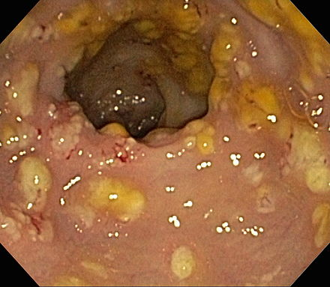
3. Pseudomembranous Colitis
Return to Table of Contents
More profuse diarrhea
More likely to have bleeding
More severe leukocytosis
Pseudomembranes seen on endoscopy

Slide 26
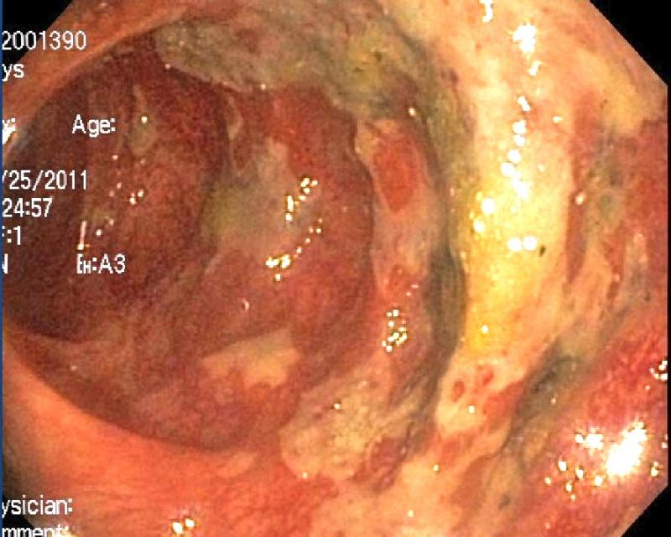
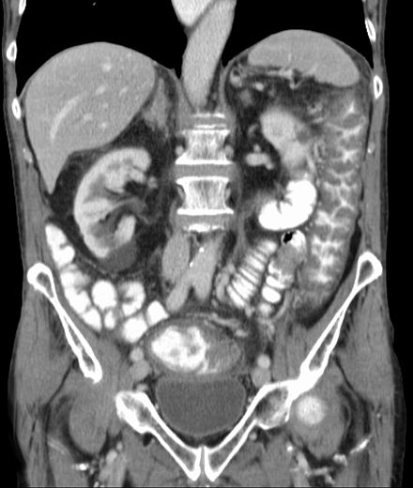
Pseudomembranous Colitis
Return to Table of Contents
Endoscopic image: yellow pseudomembranes on wall of colon
Colitis on CT abdomen

Slide 27
4. Fulminant Colitis
Return to Table of Contents
Diarrhea may be severe or minimal!
Can be minimal if there is a paralytic ileus or severe colonic distension
Toxic megacolon may be present (colonic dilation >7cm)
Septic shock
WBC often > 40,000
At risk of perforation
Imminently life-threatening and needs urgent surgical evaluation!
Endoscopy is contraindicated as risk of perforation is too high

Slide 28
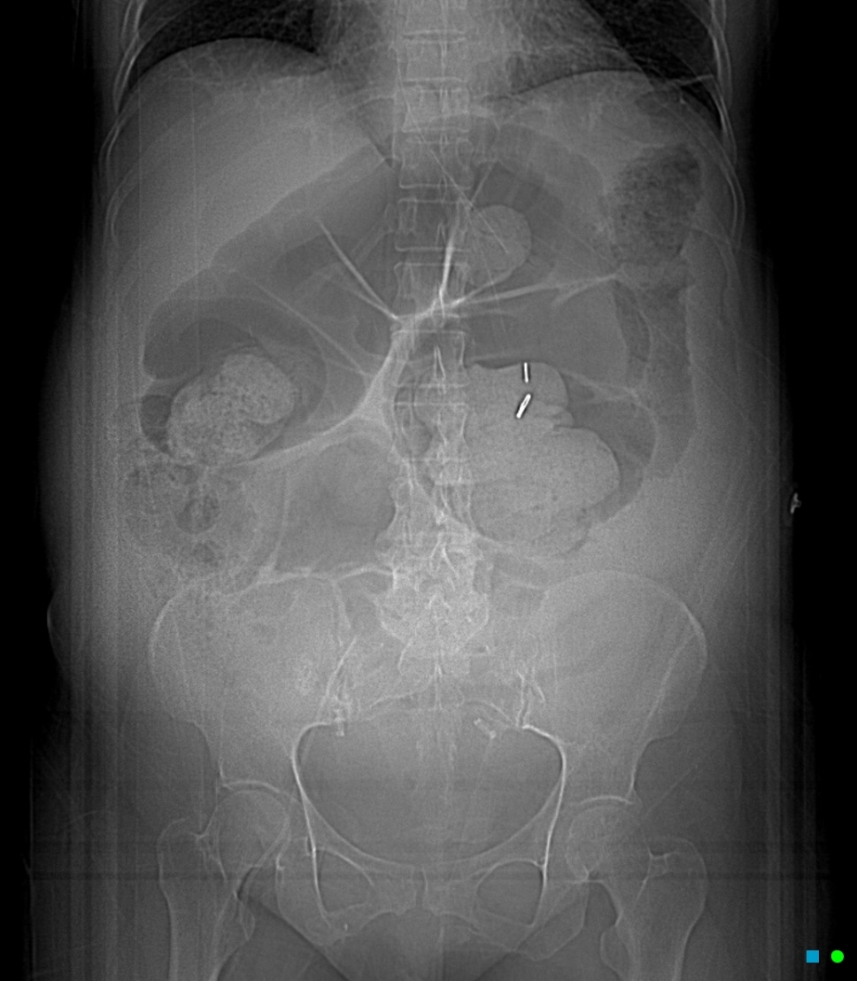
Fulminant C. diff colitis with toxic megacolon
Return to Table of Contents

Slide 29
Can there be minimal or no diarrhea in C. difficile infection?
Return to Table of Contents
Yes!! With ileus or toxic megacolon. The patient is VERY SICK. Their abdomen is distended and may be peritoneal.
In mild cases, lack of diarrhea argues against the diagnosis of active, toxin-producing C. diff.

Slide 30
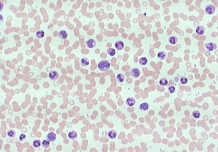
C. difficile and Leukocytosis
Wanahita et al., Am J Med 2003
Return to Table of Contents
The average WBC for patients with CDI is ~15K
Values much higher can be seen
Unexplained leukocytosis in hospitalized patients (even in the absence of diarrhea) may reflect underlying C. diff infection
In one prospective study, 60 hospitalized patients with unexplained leukocytosis had stool studies
58% had positive C. diff toxin assay vs 12% in control arm
Notes:
Wanahita A, Goldsmith EA, Marino BJ, Musher DM. Clostridium difficile infection in patients with unexplained leukocytosis. Am J Med. 2003;115(7):543.

Slide 31
Diagnosis
Return to Table of Contents
The diagnosis of CDI is established via a positive laboratory stool test for C. diff toxin or detection of toxigenic C. diff organisms usually via a multistep approach
Major Methods
Enzyme Immunoassay (EIA) for C. diff glutamate dehydrogenase
Pro: Detects GDH enzyme essential to all isolates
Con: Cannot distinguish between toxigenic & non toxigenic strains
Enzyme Immunoassay (EIA) for C. diff toxin A&B
Pro: Specificity 99%
Con: Sensitivity 75%, high false negative rate given 100-1000pg toxin must be present for test to be positive
NAAT (nucleic acid amplification test)
Pro: Detects 1⁺ genes specific to toxigenic strains (critical gene tcdB = toxin B), very sensitive & specific
Con: Does not test for active infection, may be negative if delay in stool collection or patient is on empiric treatment
Notes:
]

Slide 32
Example: 2 Step Testing Algorithm
Return to Table of Contents
Step 1: Perform C. difficile PCR assay (NAAT)
If positive, lab reflexes to step 2 to differentiate colonization from infection
If negative, given this highly sensitive assay, CDI is unlikely
Step 2: Lab performs C. difficile EIA toxin assay for toxins A & B
If positive, this is specific for CDI
If negative, the patient is colonized with C. diff

Slide 33
Treatment
Return to Table of Contents
Question 1:
Do they have nonsevere or severe infection?
Question 2:
Has this patient ever had C. diff before?

Slide 34
Step 1 of Treatment: Classify Disease Severity
Return to Table of Contents
There is no consensus on how to classify disease severity!
Per ISDA Guidelines
Nonsevere CDI | Severe CDI | Fulminant colitis
WBC <15,000 cells/mL | WBC > 15,000 cells/mL | Hypotension or shock
Cr <1.5 mg/dL | Cr >1.5 mg/dL | Ileus
 |  | Megacolon

Slide 35
Step 2 of Treatment: Has the patient had C. diff before?
Return to Table of Contents

Slide 36
Initial Episode
Return to Table of Contents
Nonsevere
Vancomycin 125mg orally QID for 10 days, OR
Fidaxomicin 200mg orally BID for 10 days
* If above agents not available: Metronidazole 500mg orally TID for 10 days
Severe
Vancomycin 125mg orally QID for 10 days, OR
Fidaxomicin 200mg orally BID for 10 days

Slide 37
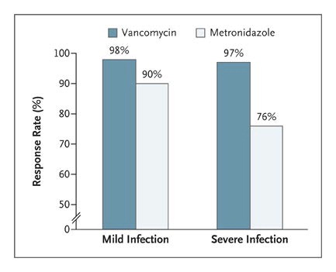
Initial Episode: PO Vancomycin vs Metronidazole
Return to Table of Contents
About the same efficacy for mild infection
Metronidazole is significantly worse for severe infection!
Why use metronidazole at all? It’s much cheaper!
Kelly CP, LaMont JT. N Engl J Med 2008;359:1932-1940.

Slide 38
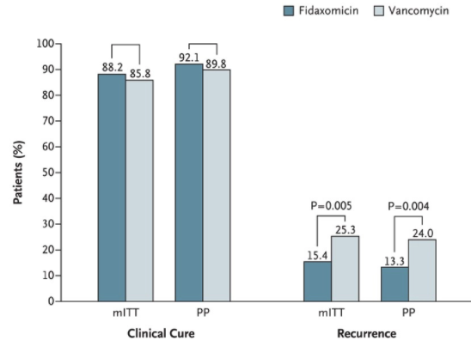
Evidence for Fidaxomicin
Return to Table of Contents
Significantly fewer patients receiving fidaxomicin had recurrence of infection!
The rate of clinical cure with fidaxomicin is non inferior to vancomycin!
*
^
*
^
*modified intention to treat analysis
^per-protocol analysis
Louie et al. N Engl J Med 2011 364(5):422-31

Slide 39
Does PO vs IV matter?
Return to Table of Contents
For vancomycin, yes!
PO vancomycin has near 0% bioavailability
It will whoosh down the GI track and stay there (establishing high concentrations with minimal toxicity)
IV vancomycin is not excreted through the gut wall
IV vancomycin has NO role in the treatment of C. diff
For metronidazole, maybe.
PO has excellent bioavailability
Only use IV if you think PO won’t reach the colon (i.e. ileus, obstruction, vomiting)

Slide 40
Risk Factors For Recurrence
Return to Table of Contents
Age >65
Severe underlying medical disorders
Need for ongoing therapy with concomitant antibiotics during treatment for C. diff
>10 unformed stools per 24 hours
Serum Cr > 1.2 mg/dL
Lack of Ab-mediated response to C. diff toxins

Slide 41
Treatment: First Recurrence
Return to Table of Contents
Nonsevere OR Severe
If vancomycin was used for initial episode → vancomycin pulse-tapered regimen: 125mg orally QID for 10-14 days, then 125mg orally BID for 7 days, then 125mg orally QD for 7 days, then 125mg orally every 2 or 3 days for 2– 8 weeks, OR
Fidaxomicin 200mg orally BID x 10 days, OR
** If fidaxomicin or metronidazole was used for initial episode: vancomycin 125mg orally QID for 10 days

Slide 42
Treatment: Second… or subsequent Recurrence
Return to Table of Contents
Nonsevere OR Severe
Vancomycin pulse-tapered regimen (outlined in first recurrence), OR
Fidaxomicin 200mg orally BID x 10 days, OR
Vancomycin followed by rifixamin: Vancomycin 125mg orally QID for 10 days, then Rixiamin 400mg orally TID for 20 days
3 or more episodes? You need to start thinking about fecal microbiota transplantation (if available)

Slide 43
Treatment of ANY episode of FULMINANT DISEASE
Return to Table of Contents
Vancomycin 500mg PO or via nasogastric tube QID PLUS Metronidazole 500mg Q8H IV
If complete ileus, add rectal instillation of vancomycin (500mg retained for as long as possible q 6 hours)
Consult surgery for consideration of colectomy
Consult ID
Vancomycin should be reduced from 500mg to 125mg QID after clinical improvement
Notes:
Risk factors for complications (perforation, toxic megacolon, colectomy, admission to ICU, death include age >80 years, WBC <4K or >20K, albumin <2.5, BUN >7, CRP >150, HR >90, RR >20

Slide 44
Extra-colonic Involvement
Jacobs et al., Medicine (Baltimore) 2001
Return to Table of Contents
C. diff can cause disease in a variety of organ systems!
C. diff can cause a protein-losing enteropathy from excessive diarrhea
Leads to low albumin (<2.0) and ascites
C. diff enteritis (in the small bowel) is seen in patients with ileostomy, often fulminant
C. diff bacteremia, wound-infection, visceral abscess, and pneumonia have been very rarely described
C. diff reactive arthritis is frequently polyarticular
Notes:
Jacobs A, Barnard K, Fishel R, Gradon JD. Extracolonic manifestations of Clostridium difficile infections. Presentation of 2 cases and review of the literature. Medicine (Baltimore). 2001 Mar;80(2):88-101.

Slide 45
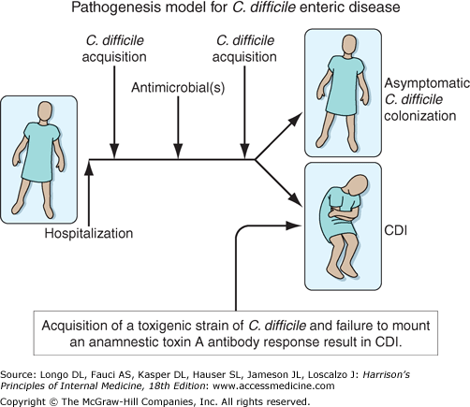
What if a patient tests + for C. diff and is asymptomatic?
Return to Table of Contents
This patient is likely COLONIZED
Do not treat this patient if they have NO symptoms
Why did this patient have C. diff testing sent in the first place?

Slide 46
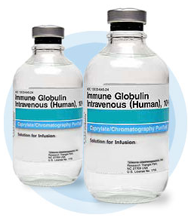
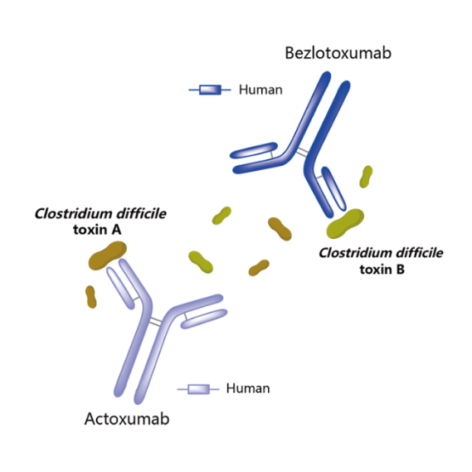
Non-antibiotic Treatment Adjuncts
Juang et al., Am J Infect Control 2007*
Lowy et al., NEJM 2010
Johnson et al., CID 2014^
Return to Table of Contents
IVIG
The best, although limited, data DO NOT SUPPORT the efficacy of IVIG in treatment of patients with severe CDI*
Anion-binding resins
Cholestyramine
Limited utility as a toxin binder, also binds PO vancomycin!
Tolevamer
Specific toxin-binding resin
Found to be inferior to vancomycin and metronidazole in a RCT^
Monoclonal Antibodies
Bezlotoxumab
FDA-approved in 2016 for secondary prevention of CDI in patients with high risk of recurrence
Notes:
Juang P, Skledar SJ, Zgheib NK, et al. Clinical outcomes of intravenous immune globulin in severe Clostridium difficile-associated diarrhea. Am J Infect Control 2007;35:131-7.
Lowy I, Molrine DC, Leav BA, Blair BM, et al. Treatment with monoclonal antibodies against Clostridium difficile toxins. N Engl J Med. 2010 Jan 21;362(3):197-205.
Johnson S, Louie TJ, Gerding DN, Cornely OA, Chasan-Taber S, Fitts D, Gelone SP, Broom C, Davidson DM, Polymer Alternative for CDI Treatment (PACT) investigators. CID 2014;59(3):345

Slide 47
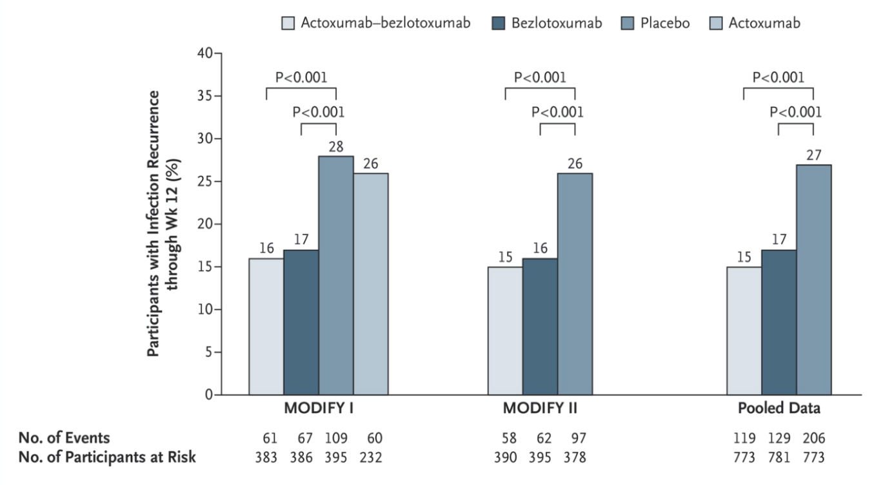
Monoclonal Antibodies
Wilcox et al., NEJM 2017
RESULTS
The rate of recurrent infection was significantly lower with bezlotoxumab versus placebo (17% vs 28%)!
The rate of recurrent infection was significantly lower with actoxumab plus bezlotoxumab than with placebo (16 vs 28%) but the addition of actoxumab did not improve efficacy!
Actoxumab/Bezlotoxumab are human monoclonal Abs against C. diff toxins A & B, respectively
The data from MODIFY I & II (phase III clinical trials) was published in NEJM 2017 to evaluate the prevention of C. diff infection recurrence
Notes:
Wilcox MH, Gerding DN, Poxton IR, Kelly C, Nathan R, Birch T, Cornely OA, Rahav G, Bouza E, Lee C, Jenkin G, Jensen W, Kim YS, Yoshida J, Gabryelski L, Pedley A, Eves K, Tipping R, Guris D, Kartsonis N, Dorr MB, MODIFY I and MODIFY II Investigators. Bezlotoxumab for Prevention of Recurrent Clostridium difficile Infection. N Engl J Med. 2017;376(4):305.
Johnson S, Gerding DN. Bezlotoxumab. CID 2009;68(4):699

Slide 48
What About Probiotics? Proposed Mechanisms of Action
Gill HS Best Pract Res Clin Gastroenterol 2003
Castagliuolo et al., Infect Immun 1999
Rea et al., J Med Microbiol 2007
Qamar et al., Infect Immun 2001
Return to Table of Contents
Colonize the gut & promote “competition” among gut microbes → reducing favorability of the environment for C. difficile
Produce acids that acidify the environment and inhibit growth of other bacteria
S. boulardii secretes proteases that inhibit binding of enterotoxin A
Lactococcous lactis secretes a cationic peptide that has activity against strains of C. difficile
May interfere with binding of toxin A & B to intestinal epithelial cells
Modulate the innate & adaptive immune system
Stimulate toll-like receptors and upregulate cytokine expression in dendritic cells and monocytes
Notes:
Gill HS. Probiotics to enhance anti-infective defences in the gastrointestinal tract. Best Pract Res Clin Gastroenterol. 2003;17(5):755.
Castagliuolo I, Riegler MF, Valenick L, LaMont JT, Pothoulakis C. Saccharomyces boulardii protease inhibits the effects of Clostridium difficile toxins A and B in human colonic mucosa. Infect Immun. 1999;67(1):302.
Rea MC, Clayton E, O'Connor PM, Shanahan F, Kiely B, Ross RP, Hill C. Antimicrobial activity of lacticin 3,147 against clinical Clostridium difficile strains. J Med Microbiol. 2007;56(Pt 7):940.
Qamar A, Aboudola S, Warny M, Michetti P, Pothoulakis C, LaMont JT, Kelly CP. Saccharomyces boulardii stimulates intestinal immunoglobulin A immune response to Clostridium difficile toxin A in mice. Infect Immun. 2001;69(4):2762.

Slide 49
Can Probiotics Prevent C. diff?
Return to Table of Contents
Maybe?
Maybe not…
In a meta-analysis of 22 RCTs (n=7957 participants), probiotic use significantly reduced the risk of developing CDI by 60.5%! Lactobacillus, Saccharomyces, and a mixture of probiotics were all beneficial in reducing the risk of developing CDI (63.7%, 58.5%, + 58.2% reduction)
However… there are limitations to these results as included RCTs were variable/heterogenous
Ehrhardt et al. 2016 conducted a RCT in hospitalized patients receiving systemic antibiotic therapy and found no evidence for an effect of S. boulardii in preventing antibiotic-associated diarrhea or CDI
Lau CS & Chamberlain RS. Int J Gen Med 2016.
Ehrhardt et al. Open Forum Infect Dis 2016.
Notes:
Lau CS & Chamberlain RS. Probiotics are effective at preventing Clostridium difficile-associated diarrhea: a systematic review and meta-analysis. Int J Gen Med 2016;9:27-37.
Ehrhardt S, Guo N, Hinz R, Schoppen S, May J, Reiser M, Schroeder MP, Schmiedel S, Keuchel M, Reisinger EC, Langeheinecke A, de Weerth A, Schuchmann M, Schaberg T, Ligges S, Eveslage M, Hagen RM, Burchard GD, Lohse AW. Saccharomyces boulardii to Prevent Antibiotic-Associated Diarrhea: A Randomized, Double-Masked, Placebo-Controlled Trial. Open Forum Infect Dis. 2016 Jan 29;3(1):ofw011.

Slide 50
Bottom Line
Return to Table of Contents
“There is insufficient data at this time to recommend administration of probiotics for primary prevention of CDI outside of clinical trials” per IDSA
!! There is the potential for organisms in probiotic formulations to cause invasive infections (i.e. bacteremia, fungemia) !!
Do not use probiotics for severe CDI, immunocompromised patients, or severely ill patients!

Slide 51
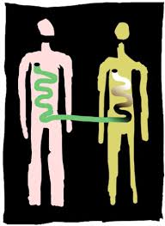
Fecal Microbiota Transplantation (FMT)
Return to Table of Contents
Recurrent C. diff is associated with a decrease in fecal microbial diversity; transplantation of stool from healthy individuals to these patients restores the microbiota
FMT can break the cycle of recurrent C. difficile infections
Efficacy has been evaluated in RCT & open-label trials
Cure rates range from 70-90% in patients with recurrent disease!
Chang et al., J Infect Dis 2008
Khoruts et al., J Clin Gastroenterol 2010
van Nood et al., NEJM 2013
Notes:
Chang JY, Antonopoulos DA, Kalra A, Tonelli A, Khalife WT, Schmidt TM, Young VB. Decreased diversity of the fecal Microbiome in recurrent Clostridium difficile-associated diarrhea. J Infect Dis. 2008;197(3):435.
Khoruts A, Dicksved J, Jansson JK, Sadowsky MJ. Changes in the composition of the human fecal microbiome after bacteriotherapy for recurrent Clostridium difficile-associated diarrhea. J Clin Gastroenterol. 2010;44(5):354.
van Nood E , Vrieze A, Nieuwdorp M et al. Duodenal infusion of donor feces for recurrent Clostridium difficile. N Engl J Med 2013; 368:407–15.
.

Slide 52
Fecal Microbiota Transplantation (FMT)
Return to Table of Contents
HOW IS THIS DONE?
Choice of delivery depends on factors including: patient preferences, risk, facility resources, cost, etc
Enema – but cannot reach above the splenic flexure
Colonoscopy – allows administration of stool up to the distal small bowel
Nasoduodenal/jejunal tube – delivery of bacteria to small bowel and rest of colon
Oral capsules
WHO DOES THIS?
Gastroenterologists! Refer typically after 2nd recurrence
Notes:
Yoon SS, Brandt LJ. Treatment of refractory/recurrent C. difficile-associated disease by donated stool transplanted via colonoscopy: a case series of 12 patients. J Clin Gastroenterol. 2010;44(8):562.
van Nood E, Vrieze A, Nieuwdorp M, Fuentes S, Zoetendal EG, de Vos WM, Visser CE, Kuijper EJ, Bartelsman JF, Tijssen JG, Speelman P, Dijkgraaf MG, Keller JJ. Duodenal infusion of donor feces for recurrent Clostridium difficile. N Engl J Med. 2013;368(5):407.
More than one administration of FMT may be necessary for optimal effiacy

Slide 53
FMT: Words of Caution
Return to Table of Contents
SAFETY ALERT
In 2019, the FDA released a safety alert highlighting two cases (one fatal) of invasive ESBL-producing E. Coli infections
One patient was neutropenic as a result of a stem cell transplant
In 2020, the FDA was notified of more patients who received FMT & developed infections caused by enteropathogenic E. Coli & Shigatoxin-producing E. Coli.
“Patients considering FMT for the treatment of CDI should speak to their health care provider to understand these risk”
Notes:
https://www.fda.gov/safety/medical-product-safety-information/fecal-microbiota-transplantation-safety-alert-risk-serious-adverse-events-likely-due-transmission

Slide 54
Prevention and Infection Control
Return to Table of Contents
Prevention Strategies
Early detection & isolation of patients is essential to prevent transmission!
Patients with suspected or proven CDI should be placed on contact precautions
Single room, dedicated toilet
Gloves & gowns should be worn upon room entry and exit
Hand hygiene with soap & water following care of patients
Continue precautions until diarrhea ends
Disinfection of clinical areas require a sporicidal agent (i.e. bleach)
Infection Control Strategies
Minimize antibiotic use with antibiotic
stewardship
Track rates of CDI to evaluate trends within or among facilities
Notes:
https://www.uptodate.com/contents/clostridioides-formerly-clostridium-difficile-infection-prevention-and-control?search=c.diff%20prevention&topicRef=2698&source=see_link

Slide 55
C. Diff Prophylaxis?
Johnson et al., CID 2019
Return to Table of Contents
Primary prophylaxis may be of benefit in patients with high risk of CDI
In a randomized open label trial of 100 hospitalized patients at high risk of first episode of CDI, vancomycin (125mg PO daily) reduced rate of CDI compared to placebo (0 vs 6 cases)!
High risk defined as:
Age >60 years who received systemic antibiotics during a prior hospitalization within 30 days & were receiving antibiotics during current hospitalization
Notes:
Johnson SW, Brown SV, Priest DH. Effectiveness of Oral Vancomycin for Prevention of Healthcare Facility-Onset Clostridioides difficile Infection in Targeted Patients During Systemic Antibiotic Exposure. Clin Infect Dis. 2019 Sept 27. pii:ciz966.

Slide 56
C. Diff Vaccine?
Kociolek et al., Nat Rev Gastroenterol Hepatol 2016
Henderson et al., Vaccines 2017
clinicaltrials.gov
Return to Table of Contents
A vaccine appears to be a promising intervention to offer long-term protection against CDI!
No vaccines have yet to be approved for clinical use
Different types of vaccines in various phases are under development/study
Sponsor | Vaccine Product | Clinicaltrials.gov ID | Status
Pfizer | Toxoid-based | Phase III NCT03090191 Phase III NCT03918629 | Active
GSK | - Vaccine based on F2 antigen (GSK2904545A) - Vaccine based on F2 antigen adjuvanted with AS01B | Phase 1 NCT04026009 | Active
Valneva Austria GmbH | Recombinant fusion protein (VLA84) of toxin A + B binding regions | Phase II NCT02316470 | Completed
Notes:
http://www.infectiousdiseaseadvisor.com/clostridium-difficile/status-of-clostridium-difficile-vaccines/article/646015/
Kociolek LK, Gerding DN. Breakthroughs in the treatment and prevention of Clostridium difficile infection. Nat Rev Gastroenterol Hepatol. 2016 Mar;13(3):150-60.
Henderson, M, Bragg, A, Fahim, G, Shah, M, Hermes-DeSantis, E. A Review of the Safety and Efficacy of Vaccines as Prophylaxis for Clostridium difficile infections. Vaccines (Basel). 2017 Sep; 5(3):25

Slide 57
Cases
Return to Table of Contents

Slide 58
Case 1
Return to Table of Contents
A 68 year old man presents to clinic with 5 days of lower abdominal cramping and several episodes per day of loose watery stool after taking several weeks of ciprofloxacin for a prostate infection. His CBC & CHEM10 are normal and a test for C. diff is pending. He is afebrile and tolerating PO. He has no significant PMHx. What is the next appropriate step in management?
Given patient’s high pre-test probability for C.diff it is appropriate to prescribe him 14 days of oral metronidazole
Given the patient’s high pre-test probability for C.diff it is appropriate to prescribe him 10 days of oral vancomycin
Wait until the stool testing results before deciding upon further treatment management
Obtain an abdominal xray to rule out the complication of megacolon and begin empiric metronidazole for C.diff colitis

Slide 59
Case 1 Explanation
Return to Table of Contents
This man has a high pre-test probability of C. difficile colitis given his symptoms and antibiotic exposure. When a patient has a high pre-test probability of CDI, empiric therapy for CDI should be considered regardless of the laboratory testing result. He has nonsevere CDI given his presentation and given his normal renal function and white blood cell count. Preferred treatment options for a first episode of nonsevere CDI include PO vancomycin 125mg QID for 10 days or PO fidaxomicin 200mg BID for 10 days. Metronidazole is a reasonable alterative if unable to obtain vancomycin or fidaxomicin but may be less effective.

Slide 60
Case 2
Return to Table of Contents
A 78 year old woman is admitted to the hospital with dysuria & flank pain found to have a pyelonephritis. On hospital day 5, she develops profuse watery diarrhea with fever. Her renal function is stable but she has a new leukocytosis of 22K and C.diff testing is positive. She is started on oral vancomycin but 48 hours later, her fevers persist and her leukocytosis climbs to >30K. Her diarrhea has now stopped completely and her abdomen is distended. She is vomiting. What is the next appropriate step in management?
Continue vancomycin as it is too soon to tell if she is failing.
Continue oral vancomycin and add PR vancomycin given concern for severe CDI. Obtain abdominal imaging to evaluate for toxic megacolon. Obtain a lactate. Consider colorectal surgery consultation.
Change from oral vancomycin to rectal vancomycin and add IV metronidazole given concern for fulminant CDI. Obtain abdominal imaging to evaluate for toxic megacolon. Obtain a lactate. Consider colorectal surgery consultation.
Change from oral vancomycin to IV vancomycin and add IV metronidazole as you are concerned she may not have adequate enteral medication absorption.
Notes:
- 2. Severe treatment

Slide 61
Case 2 Explanation
Return to Table of Contents
This patient may have fulminant infection and there is concern for toxic megacolon given the development of abdominal distention and cessation of diarrhea. Appropriate next steps include adding IV metronidazole and PR vancomycin given that in a patient with ileus or megacolon, orally administered vancomycin will not be able to reach the colon. Surgical consult should be obtained in all patients with concern for complicated CDI. Surgery should be considered in patients with CDI and any of the following: hypotension requiring vasopressors, mental status changes, WBC > 50K, lactate >5, or failure to improve on medical therapy after 5 days.
Surawicz et al., Am J Gastroenterol 2013
Notes:
Surawicz CM¹, Brandt LJ, Binion DG, Ananthakrishnan AN, Curry SR, Gilligan PH, McFarland LV, Mellow M, Zuckerbraun BS. Guidelines for diagnosis, treatment, and prevention of Clostridium difficile infections. Am J Gastroenterol. 2013 Apr;108(4):478-98.

Slide 62
Case 3
Return to Table of Contents
A 55 year old woman presents to clinic concerned for recurrent C. diff infection. She was treated 9 months ago as an outpatient for nonsevere C. diff colitis with 10 days of metronidazole. Her symptoms completely resolved after treatment. She recently took bactrim to treat a urinary tract infection and shortly after developed diarrhea that reminded her of C. diff. She reports poor appetite but is afebrile and has only minimal lower abdominal tenderness on exam. A stool sample is positive for C. diff. What is the next appropriate step in management?
Prescribe a 10 day course of vancomycin given this first recurrence of C. diff and she has not been previously treated with this agent.
Given a first recurrence of CDI, it is appropriate to treat with another 10-14 days of oral metronidazole.
Prescribe fidaxamicin 200mg orally twice daily for 10 days followed by daily for 10 days then every other day for 10 days. She needs a prolonged taper.
Prescribe 10 days of both oral metronidazole and vancomycin.
Notes:
If vancomycin was used for initial episode → vancomycin pulse-tapered regimen:
125mg orally QID for 10-14 days, then
125mg orally BID for 7 days, then
125mg orally QD for 7 days, then
125mg orally every 2 or 3 days for 2– 8 weeks, OR
Fidaxomicin 200mg orally BID x 10 days, OR
** If fidaxomicin or metronidazole was used for initial episode: vancomycin 125mg orally QID for 10 days

Slide 63
Case 3 Explanation
Return to Table of Contents
This patient is having a first recurrence of CDI. For a first recurrence of nonsevere CDI, suggested regimens include: vancomycin orally for 10 days if vancomycin was not used for the initial episode. If vancomycin was used for treatment of the initial episode, a vancomycin pulse-tapered regimen is recommended. Fidaxomicin is an alternative treatment strategy for treatment of first recurrence.

Slide 64
Case 4
Return to Table of Contents
Mr. H presents to your clinic for advice on how to prevent another CDI. His past medical history is notable for two episodes of C. diff colitis. Mr. H’s dentist has recommended treatment with a week of clindamycin for a tooth infection. Clindamycin has previously caused one of his episodes of C. diff colitis. Mr. H wants to know if he needs to take an antibiotic to prevent a recurrence?
Yes. You prescribe him two weeks of oral vancomycin to take while he is taking the clindamycin.
Yes. You prescribe him three weeks of oral vancomycin to start while he is taking the clindamycin. Evidence supports taking vancomycin prophylaxis for two weeks after the clindamycin is stopped.
No. You tell him that prophylactic antibiotics are not recommended to prevent recurrent CDI.
Maybe. You tell him you will prescribe him a 10 day course of oral metronidazole to take if he develops diarrhea following his clindamycin course.

Slide 65
Case 4 Explanation
Return to Table of Contents
Oral vancomycin prophylaxis has been shown to decrease the risk of recurrent CDI in patients with a history of recurrent CDI who are re-exposed to antibiotics. A recent study by Van Nise et al., Clin Infect Dis 2016 compared the rates of recurrent CDI in patients receiving or not receiving oral vancomycin prophylaxis with systemic antimicrobials and found the incidence of CDI was lower in patients receiving prophylaxis (4.3%) versus those not receiving prophylaxis (26.6%). Current prophylactic dosing recommendation is vancomycin 125mg QID while receiving antibiotics and to extend vancomycin treatment for two weeks after the cessation of the antibiotics.
Notes:
Van Hise NW, Bryant AM, Hennessey EK, Crannage AJ, Khoury JA, Manian FA. Efficacy of Oral Vancomycin in Preventing Recurrent Clostridium difficile Infection in Patients Treated With Systemic Antimicrobial Agents. Clin Infect Dis. 2016 Sep 1;63(5):651-3.

Slide 66
Case 5
Return to Table of Contents
In one week, three patients are admitted to the hospital ward with C. diff colitis. You are worried about the possibility of an outbreak developing in the hospital. Which of the following statements are false regarding preventing CDI ?
Patients with suspected or proven CDI should be placed on contact precautions including assignment to a single room with dedicated toileting facilities
Contact precautions should be continued at least until diarrhea has ceased
Hand hygiene with soap and water or use of alcohol-based hand rub is required before and after contact with patients with CDI
Disinfection of clinical areas where patients with CDI are treated requires use of a sporicidal agent (i.e. bleach)

Slide 67
Case 5 Explanation
Return to Table of Contents
Hand hygiene should be performed with soap and water. The use of alcohol based hand sanitizer is not adequate because it does not eradicate C. difficile spores. Patients with CDI should wash hands after using the bathroom, before eating or food preparation, and when hands are soiled.

Slide 68
Thank you for using our module on C. diff!
Please take this brief post-module quiz
INSERT HYPERLINK HERE

Slide 69
Resources
Return to Table of Contents
https://www.uptodate.com/contents/clostridioides-formerly-clostridium-difficile-infection-in-adults-clinical-manifestations-and-diagnosis?search=c.diff&topicRef=2696&source=see_link#H4
https://www.uptodate.com/contents/clostridioides-formerly-clostridium-difficile-infection-in-adults-epidemiology-microbiology-and-pathophysiology?search=c.diff&topicRef=2699&source=see_link
https://www.uptodate.com/contents/clostridioides-formerly-clostridium-difficile-infection-in-adults-treatment-and-prevention?search=c.diff&topicRef=2699&source=see_link
Bartlett JG. Narrative review: the new epidemic of Clostridium difficile-associated enteric disease. Ann Intern Med. 2006;145(10):758.
Bartlett JG, Moon N, Chang TW, Taylor N, Onderdonk AB. Role of Clostridium difficile in antibiotic-associated pseudomembranous colitis. Gastroenterology. 1978;75(5):778.
Pépin J, Saheb N, Coulombe MA, Alary ME, Corriveau MP, Authier S, Leblanc M, Rivard G, Bettez M, Primeau V, Nguyen M, Jacob CE, Lanthier L. Emergence of fluoroquinolones as the predominant risk factor for Clostridium difficile-associated diarrhea: a cohort study during an epidemic in Quebec. SOClin Infect Dis. 2005;41(9):1254.
Tonna I and Welsby P. Pathogenesis and treatment of Clostridium difficile infection. Postgraduate Medical Journal 2005;81:367-369.
Leffler and Lamont. Clostridium difficile Infection. N Engl J Med 2015; 372:1539-1548
Di Bella, Stefano; Ascenzi, Paolo; Siarakas, Steven; Petrosillo, Nicola; di Masi, Alessandra (2016-01-01). "Clostridium difficile Toxins A and B: Insights into Pathogenic Properties and Extraintestinal Effects". Toxins. 8 (5): 134.

Slide 70
Resources
Petrella LA, Sambol SP, Cheknis A, Nagaro K, Kean Y, Sears PS, Babakhani F, Johnson S, Gerding DN. Decreased cure and increased recurrence rates for Clostridium difficile infection caused by the epidemic C. difficile BI strain. Clin Infect Dis. 2012;55(3):351.
Marsh JW, Arora R, Schlackman JL, Shutt KA, Curry SR, Harrison LH.Association of relapse of Clostridium difficile disease with BI/NAP1/027. J Clin Microbiol. 2012 Dec;50(12):4078-82.
Walker AS, Eyre DW, Wyllie DH, Dingle KE, Griffiths D, Shine B, Oakley S, O'Connor L, Finney J, Vaughan A, Crook DW, Wilcox MH, Peto TE, Infections in Oxfordshire Research Database. Relationship between bacterial strain type, host biomarkers, and mortality in Clostridium difficile infection. Clin Infect Dis. 2013;56(11):1589.
Loo VG, Bourgault AM, Poirier L, Lamothe F, Michaud S, Turgeon N, Toye B, Beaudoin A, Frost EH, Gilca R, Brassard P, Dendukuri N, Béliveau C, Oughton M, Brukner I, Dascal A. Host and pathogen factors for Clostridium difficile infection and colonization. N Engl J Med. 2011 Nov;365(18):1693-703.
Kyne L, Warny M, Qamar A, Kelly CP. Association between antibody response to toxin A and protection against recurrent Clostridium difficile diarrhoea. Lancet. 2001;357(9251):189.
Kelly CP. Immune response to Clostridium difficile infection. Eur J Gastroenterol Hepatol. 1996;8(11):1048.
Abt MC, McKenney PT, Pamer EG. Clostridium difficile colitis: pathogenesis and host defense. Nat Rev Microbiol. 2016 Oct;14(10):609-20.
Bagdasarian N, Rao K, Malani PN. Diagnosis and treatment of Clostridium difficile in adults: a systematic review. JAMA. 2015 Jan;313(4):398-408.

Slide 71
Resources
Wanahita A, Goldsmith EA, Marino BJ, Musher DM. Clostridium difficile infection in patients with unexplained leukocytosis. Am J Med. 2003;115(7):543.
Louie TJ, Miller MA, Mullane KM, Weiss K, Lentek A, Golan Y, Gorbach S, Sears P, Shue YK; OPT-80-003 Clinical Study Group. Fidaxomicin versus vancomycin for Clostridium difficile infection. N Eng J Med. 2011;364(5):422-31.
Jacobs A, Barnard K, Fishel R, Gradon JD. Extracolonic manifestations of Clostridium difficile infections. Presentation of 2 cases and review of the literature. Medicine (Baltimore). 2001 Mar;80(2):88-101.
Juang P, Skledar SJ, Zgheib NK, et al. Clinical outcomes of intravenous immune globulin in severe Clostridium difficile-associated diarrhea. Am J Infect Control 2007;35:131-7.
Lowy I, Molrine DC, Leav BA, Blair BM, et al. Treatment with monoclonal antibodies against Clostridium difficile toxins. N Engl J Med. 2010 Jan 21;362(3):197-205.
Johnson S, Louie TJ, Gerding DN, Cornely OA, Chasan-Taber S, Fitts D, Gelone SP, Broom C, Davidson DM, Polymer Alternative for CDI Treatment (PACT) investigators. CID 2014;59(3):345
Wilcox MH, Gerding DN, Poxton IR, Kelly C, Nathan R, Birch T, Cornely OA, Rahav G, Bouza E, Lee C, Jenkin G, Jensen W, Kim YS, Yoshida J, Gabryelski L, Pedley A, Eves K, Tipping R, Guris D, Kartsonis N, Dorr MB, MODIFY I and MODIFY II Investigators. Bezlotoxumab for Prevention of Recurrent Clostridium difficile Infection. N Engl J Med. 2017;376(4):305.
Johnson S, Gerding DN. Bezlotoxumab. CID 2009;68(4):699

Slide 72
Resources
Gill HS. Probiotics to enhance anti-infective defences in the gastrointestinal tract. Best Pract Res Clin Gastroenterol. 2003;17(5):755.
Castagliuolo I, Riegler MF, Valenick L, LaMont JT, Pothoulakis C. Saccharomyces boulardii protease inhibits the effects of Clostridium difficile toxins A and B in human colonic mucosa. Infect Immun. 1999;67(1):302.
Rea MC, Clayton E, O'Connor PM, Shanahan F, Kiely B, Ross RP, Hill C. Antimicrobial activity of lacticin 3,147 against clinical Clostridium difficile strains. J Med Microbiol. 2007;56(Pt 7):940.
Qamar A, Aboudola S, Warny M, Michetti P, Pothoulakis C, LaMont JT, Kelly CP. Saccharomyces boulardii stimulates intestinal immunoglobulin A immune response to Clostridium difficile toxin A in mice. Infect Immun. 2001;69(4):2762.
McFarland LV, Surawicz CM, Greenberg RN, Fekety R, Elmer GW, Moyer KA, Melcher SA, Bowen KE, Cox JL, Noorani Z. A randomized placebo-controlled trial of Saccharomyces boulardii in combination with standard antibiotics for Clostridium difficile disease. JAMA. 1994;271(24):1913.
Allen SJ, Wareham K, Wang D, Bradley C, Hutchings H, Harris W, Dhar A, Brown H, Foden A, Gravenor MB, Mack D. Lactobacilli and bifidobacteria in the prevention of antibiotic-associated diarrhoea and Clostridium difficile diarrhoea in older inpatients (PLACIDE): a randomised, double-blind, placebo-controlled, multicentre trial. Lancet. 2013;382(9900):1249.
Lau CS & Chamberlain RS. Probiotics are effective at preventing Clostridium difficile-associated diarrhea: a systematic review and meta-analysis. Int J Gen Med 2016;9:27-37.

Slide 73
Resources
Ehrhardt S, Guo N, Hinz R, Schoppen S, May J, Reiser M, Schroeder MP, Schmiedel S, Keuchel M, Reisinger EC, Langeheinecke A, de Weerth A, Schuchmann M, Schaberg T, Ligges S, Eveslage M, Hagen RM, Burchard GD, Lohse AW. Saccharomyces boulardii to Prevent Antibiotic-Associated Diarrhea: A Randomized, Double-Masked, Placebo-Controlled Trial. Open Forum Infect Dis. 2016 Jan 29;3(1):ofw011.
McFarland LV. Meta-analysis of probiotics for the prevention of antibiotic associated diarrhea and the treatment of Clostridium difficile disease. Am J Gastroenterol. 2006;101(4):812. Chang JY, Antonopoulos DA, Kalra A, Tonelli A, Khalife WT, Schmidt TM, Young VB. Decreased diversity of the fecal Microbiome in recurrent Clostridium difficile-associated diarrhea. J Infect Dis. 2008;197(3):435.
https://www.uptodate.com/contents/fecal-microbiota-transplantation-for-treatment-of-recurrent-clostridioides-formerly-clostridium-difficile-infection?sectionName=CLINICAL%20APPROACH&search=c.diff&topicRef=2698&anchor=H3690387803&source=see_link#H3690387803
Khoruts A, Dicksved J, Jansson JK, Sadowsky MJ. Changes in the composition of the human fecal microbiome after bacteriotherapy for recurrent Clostridium difficile-associated diarrhea. J Clin Gastroenterol. 2010;44(5):354.
Yoon SS, Brandt LJ. Treatment of refractory/recurrent C. difficile-associated disease by donated stool transplanted via colonoscopy: a case series of 12 patients. J Clin Gastroenterol. 2010;44(8):562.
van Nood E, Vrieze A, Nieuwdorp M, Fuentes S, Zoetendal EG, de Vos WM, Visser CE, Kuijper EJ, Bartelsman JF, Tijssen JG, Speelman P, Dijkgraaf MG, Keller JJ. Duodenal infusion of donor feces for recurrent Clostridium difficile. N Engl J Med. 2013;368(5):407.

Slide 74
Resources
http://www.infectiousdiseaseadvisor.com/clostridium-difficile/status-of-clostridium-difficile-vaccines/article/646015/
Kociolek LK, Gerding DN. Breakthroughs in the treatment and prevention of Clostridium difficile infection. Nat Rev Gastroenterol Hepatol. 2016 Mar;13(3):150-60.
Surawicz CM1, Brandt LJ, Binion DG, Ananthakrishnan AN, Curry SR, Gilligan PH, McFarland LV, Mellow M, Zuckerbraun BS. Guidelines for diagnosis, treatment, and prevention of Clostridium difficile infections. Am J Gastroenterol. 2013 Apr;108(4):478-98.
Carignan A, Poulin S, Martin P, LabbéAC, Valiquette L, Al-Bachari H, Montpetit LP, Pépin. Efficacy of Secondary Prophylaxis With Vancomycin for Preventing Recurrent Clostridium difficile Infections. J. Am J Gastroenterol. 2016;111(12):1834.
Johnson SW, Brown SV, Priest DH. Effectiveness of Oral Vancomycin for Prevention of Healthcare Facility-Onset Clostridioides difficile Infection in Targeted Patients During Systemic Antibiotic Exposure. Clin Infect Dis. 2019 Sept 27. pii:ciz966.
Van Hise NW, Bryant AM, Hennessey EK, Crannage AJ, Khoury JA, Manian FA. Efficacy of Oral Vancomycin in Preventing Recurrent Clostridium difficile Infection in Patients Treated With Systemic Antimicrobial Agents. Clin Infect Dis. 2016 Sep 1;63(5):651-3.
https://www.fda.gov/safety/medical-product-safety-information/fecal-microbiota-transplantation-safety-alert-risk-serious-adverse-events-likely-due-transmission
Henderson, M, Bragg, A, Fahim, G, Shah, M, Hermes-DeSantis, E. A Review of the Safety and Efficacy of Vaccines as Prophylaxis for Clostridium difficile infections. Vaccines (Basel). 2017 Sep; 5(3):25

