Slide 1
ANTIBIOTICS REVIEW
FOR STUDENTS, INTERNS, AND RESIDENTS
Notes:
www.businessgrow.com

Slide 2
Welcome to the module on ANTIBIOTICS!!
Please take this brief (2 minute) pre-module quiz
https://docs.google.com/forms/d/e/1FAIpQLSd0cuaWNhrZXfmUJiVcHsNn1UkD5c_c-mXQ4L2cUZiMmhLLVQ/viewform

Slide 3
This module works a lot better in “presentation” mode

Slide 4
Outline
Click a section to jump ahead to it
Classifying bacteria
Microbiome of common infections
Antibiotics review!
Quick antibiotics review

Slide 5
Outline
Click a section to jump ahead to it
Classifying bacteria
Microbiome of common infections
Antibiotics review!
Quick antibiotics review

Slide 6
BACTERIA: Overview
HOW WE CHARACTERIZE BACTERIA:
GRAM POSITIVE VS. GRAM NEGATIVE
AEROBIC VS. ANAEROBIC
ATYPICALS
Notes:
http://www.sigmaaldrich.com/technical-documents/articles/biology/glycobiology/peptidoglycans.html

Slide 7
BACTERIA: Overview
HOW WE CHARACTERIZE BACTERIA:
GRAM POSITIVE VS. GRAM NEGATIVE
AEROBIC VS. ANAEROBIC
ATYPICALS
Notes:
http://www.sigmaaldrich.com/technical-documents/articles/biology/glycobiology/peptidoglycans.html

Slide 8
BACTERIA: Gram Positive vs. Gram Negative
GRAM NEGATIVE
2 CELL MEMBRANES
THIN CELL WALL
GRAM POSITIVE
1 CELL MEMBRANE
THICK CELL WALL
This actually matters for which antibiotics will work…
Notes:
http://www.sigmaaldrich.com/technical-documents/articles/biology/glycobiology/peptidoglycans.html

Slide 9
BACTERIA: Gram Positive vs. Gram Negative
GRAM NEGATIVE
2 CELL MEMBRANES
THIN CELL WALL
GRAM POSITIVE
1 CELL MEMBRANE
THICK CELL WALL
DOESN’T RETAIN CRYSTAL VIOLET DYE
RETAINS CRYSTAL VIOLET DYE
(RETAINS COUNTERSTAIN)
PINK ON GRAM STAIN
PURPLE ON GRAM STAIN

Slide 10
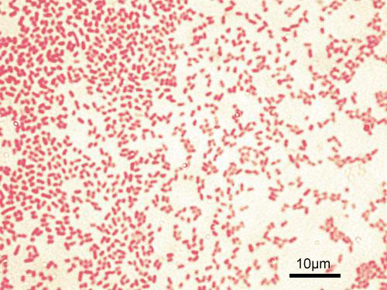
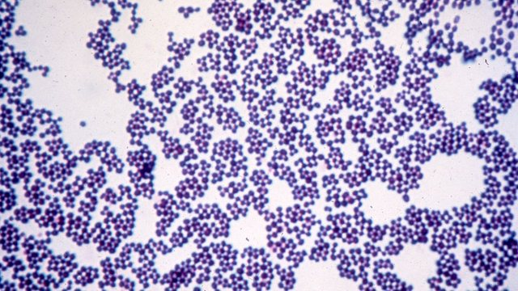
BACTERIA: Gram Positive vs. Gram Negative
GRAM NEGATIVE
2 CELL MEMBRANES
THIN CELL WALL
GRAM POSITIVE
1 CELL MEMBRANE
THICK CELL WALL
Notes:
https://www.google.com/search?q=gram+positive&rlz=1C1NHXL_enUS700US700&espv=2&biw=1600&bih=771&source=lnms&tbm=isch&sa=X&ved=0ahUKEwjHkabflqbOAhVBw4MKHQOIA7wQ_AUIBigB#imgrc=Bx4m5jBNZ4p3PM%3A
https://www.google.com/search?q=gram+negative&espv=2&biw=1600&bih=771&site=webhp&source=lnms&tbm=isch&sa=X&ved=0ahUKEwiF8IfylqbOAhVq54MKHf-VAB0Q_AUIBigB#imgrc=cKEL8Znco8VASM%3A

Slide 11
BACTERIA: Gram Positive vs. Gram Negative
Staphylococcus
Staph aureus
Streptococcus
Strep pneumoniae
Group B Strep (agalactiae)
Enterococcus
Staph epidermidis
Staph saprophyticus
Group A Strep (pyogenes)
Strep viridans
Listeria
Clostridium
C. difficile
C. perfringes
C. tetani
Some common examples…
GRAM
POSITIVES

Slide 12
BACTERIA: Gram Positive vs. Gram Negative
E. Coli
Pseudomonas
H. Influenzae
Proteus
Neisseria
N. Gonorrhea
N. Meningitides
Klebsiella
Legionella
Serratia
H. Pylori
Some common examples…
GRAM
NEGATIVES

Slide 13
BACTERIA: Overview
HOW WE CHARACTERIZE BACTERIA:
GRAM POSITIVE VS. GRAM NEGATIVE
AEROBIC VS. ANAEROBIC
ATYPICALS

Slide 14
BACTERIA: Overview
HOW WE CHARACTERIZE BACTERIA:
GRAM POSITIVE VS. GRAM NEGATIVE
AEROBIC VS. ANAEROBIC
ATYPICALS

Slide 15
BACTERIA: Aerobic vs. Anaerobic
AEROBIC
CAN ONLY SURVIVE IN THE PRESENCE OF O2
Aerobic
ANAEROBIC
CAN ONLY SURVIVE IN THE ABSENCE OF O2
FACULTATIVE ANAEROBIC
CAN GO BOTH WAYS!
Notes:
Take home about aerobes?

Slide 16
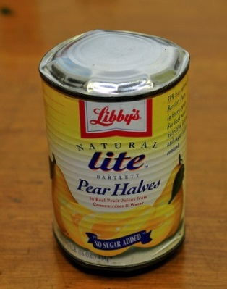
BACTERIA: Aerobic vs. Anaerobic
AEROBIC
CAN ONLY SURVIVE IN THE PRESENCE OF O2
Gram (+) → Clostridium
This is why C. Botulinum can
be obtained from canned food (anaerobic environment)
Gram (+)→ Peptostreptococcus
Found in the mouth
Aerobic
ANAEROBIC
CAN ONLY SURVIVE IN THE ABSENCE OF O2
FACULTATIVE ANAEROBIC
CAN GO BOTH WAYS!
Gram ( - ) → Bacteroides, Porphyromonas
Found in the GI Tract

Slide 17
BACTERIA: Aerobic vs. Anaerobic
AEROBIC
CAN ONLY SURVIVE IN THE PRESENCE OF O2
Aerobic
ANAEROBIC
CAN ONLY SURVIVE IN THE ABSENCE OF O2
FACULTATIVE ANAEROBIC
CAN GO BOTH WAYS!
STAPH AUREUS!

Slide 18
BACTERIA: Overview
HOW WE CHARACTERIZE BACTERIA:
GRAM POSITIVE VS. GRAM NEGATIVE
AEROBIC VS. ANAEROBIC
ATYPICALS
Notes:
http://www.sigmaaldrich.com/technical-documents/articles/biology/glycobiology/peptidoglycans.html

Slide 19
BACTERIA: Overview
HOW WE CHARACTERIZE BACTERIA:
GRAM POSITIVE VS. GRAM NEGATIVE
AEROBIC VS. ANAEROBIC
ATYPICALS

Slide 20
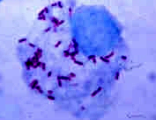
BACTERIA: Atypicals
MYCOPLASMA:
No cell well, small organism, common cause of atypical pneumonia
RICKETTSIAL SPECIES:
Obligate intracellular organism (can’t make own ATP)
Rickettsia rickettsii (Rocky Mountain Spotted Fever)
CHLAMYDIA:
Obligate intracellular (also can’t make ATP), small
Chlamydia trachomatis (STD) and Chlamydophila pneumoniae
LEGIONELLA
Causes atypical pneumonia
SPIROCHETES: Lyme disease (B. burgdorferi), syphilis (T. pallidum), leptospirosis
Rickettsia rickettsii
Notes:
http://www.otcbiotech.com/aptamers/index.php?cPath=42_55_46

Slide 21
Outline
Click a section to jump ahead to it
Classifying bacteria
Microbiome of common infections
Antibiotics review!
Quick antibiotics review

Slide 22
Typical Microbiome of common infections
 | Gram positives |  |  |  |  | Gram negatives |  | Anaerobes | Atypicals
 | Strep | MSSA | MRSA | VSE | VRE | “Normals” | Pseudomonas
Cellulitis | +++ | +++ | + | 0 | 0 | 0 | 0 | 0 | 0
CAP | +++ | + | 0 | 0 | 0 | + | 0 | 0 | +++
HCAP/HAP/VAP | +++ | +++ | +++ | 0 | 0 | ++++ | +++ | 0 | 0
UTI | ++ | 0 | 0 | + | + | +++ | 0 | 0 | 0
Intra-abdominal infection | 0 | + | + | ++ | ++ | +++ | 0 | +++ | 0
Line/port infections | +++ | ++++ | ++++ | ++ | ++ | +++ | ++ | 0 | 0

Slide 23
Outline
Click a section to jump ahead to it
Classifying bacteria
Microbiome of common infections
Antibiotics review!
Quick antibiotics review

Slide 24
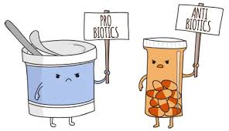
Now, to antibiotics…

Slide 25
ANTIBIOTICS: Overview (click to jump to a section)
PENICILLINS
CEPHALOSPORINS
FLUOROQUINOLONES
MACROLIDES
TETRACYCLINES
AZTREONAM
AMINOGLYCOSIDES
METRONIDAZOLE
NITROFURANTOIN
COLISTIN
CARBAPENEMS
RIFAXIMIN
VANCOMYCIN
DAPTOMYCIN
LINEZOLID
CLINDAMYCIN
BACTRIM
What you will use intern year!
Jump to the end

Slide 26
ANTIBIOTICS: Overview
PENICILLINS
CEPHALOSPORINS
FLUOROQUINOLONES
MACROLIDES
TETRACYCLINES
AZTREONAM
AMINOGLYCOSIDES
METRONIDAZOLE
NITROFURANTOIN
COLISTIN
CARBAPENEMS
RIFAXIMIN
VANCOMYCIN
DAPTOMYCIN
LINEZOLID
CLINDAMYCIN
BACTRIM
What you will use intern year!

Slide 27
PENICILLINS: Overview
1. PENICILLIN
2. AMPICILLIN/AMOXICILLIN
3. AUGMENTIN/UNASYN
4. NAFCILLIN/OXACILLIN
5. PIPERACILLIN/TAZOBACTAM

Slide 28
PENICILLINS: Overview
1. PENICILLIN
2. AMPICILLIN/AMOXICILLIN
3. AUGMENTIN/UNASYN
4. NAFCILLIN/OXACILLIN
5. PIPERACILLIN/TAZOBACTAM

Slide 29
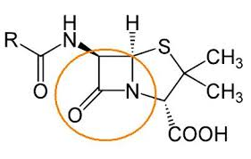
PENICILLIN:
MECHANISM OF ACTION:
B-lactam ring inhibits penicillin-binding protein, inhibiting cross-linking of peptidoglycan in cell wall. Weakened cell wall causes osmotic lysis
SPECTRUM OF COVERAGE:
Gram (+): most Strep, not Staph
Gram (-): Minimal
Anaerobes: Most oral anaerobes
Atypicals: Good for spirochetes (syphilis)
BETA-LACTAM RING

Slide 30
PENICILLIN:
DOSING:
Several million units every few hours (disease specific)
SPECIFIC SIDE EFFECTS:
Hypersensitivity, diarrhea (10%)
COMMENTS:
Good for strep throat, Group A Strep (GAS). Good for spirochetes (leptospirosis, syphilis)
 | Gram positives |  |  |  |  | Gram negatives |  | Anaerobes | Atypicals | Comments
 | Strep | MSSA | MRSA | VSE | VRE | “Normals” | Pseudomonas
Penicillin | +++ | 0 | 0 | + | + | + | 0 | ++ (mouth) | Syphilis, leptospir. | GAS, syphilis
Notes:
Jarisch-Herxheimer reaction when treating syphilis (benzathine peniciilin, Gen1 penicillin). Break structure of treponema and release antigenic proteins into the blood. Causes immune inflammatory response with fever, joint pain and swelling. FTA-ABS testing now used as diagnosis, so this is more of a side effect than a tool to diagnose

Slide 31
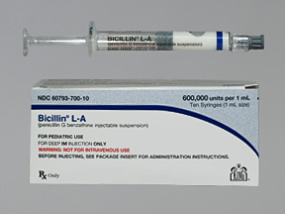
PENICILLIN: Penicillin
What’s up with all the types of penicillin?
Penicillin G: IV
Penicillin G benzathine: IM
Penicillin V potassium: PO
Penicillin has a fascinating history. Read the next 4 slides if you’d like to hear about it, otherwise skip ahead.

Slide 32
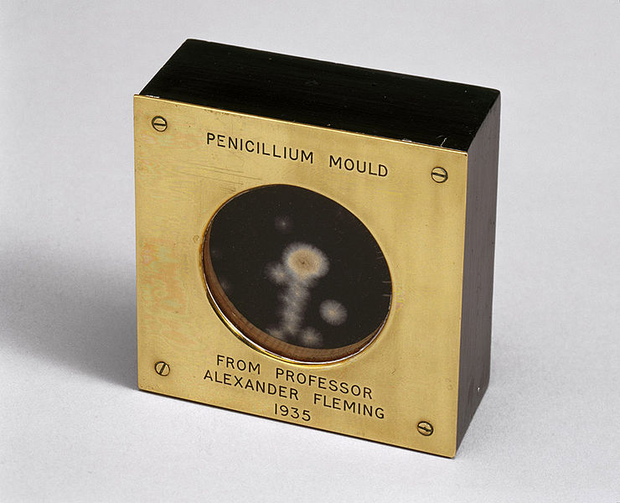
HISTORY OF PENICILLIN
Naturally produced by penicillum mold (which is occasionally invasive: “penicilliosis”)
Discovered by Alexander Flemming in 1928, who noticed that bacteria didn’t grow around mold contamination in some of his Petri dishes
Florey, an Australian physician working in London, was the 1st to purify it and try it in humans in 1940

Slide 33
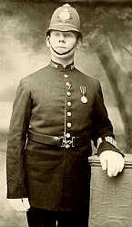
HISTORY OF PENICILLIN
Albert Alexander, a constable in the police force of the County of Oxford, was accidentally scratched by a rose thorn on his mouth in Dec 1940. By the end of the month the scratch was badly infected with Staphylococcus and Streptococcus.
Despite various treatments, his head was covered with abscesses and one of his eyes had to be removed.
The case was brought to Dr. Howard Florey’s attention, who had been trying to isolate large quantities of penicillin. Having only tried the extracted penicillin on mice, Florey was fearful of the side effects large doses might have, and needed a human volunteer in a terminal condition. Constable Alexander suited this requirement.

Slide 34
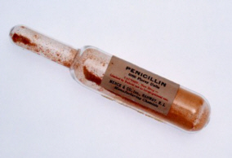
HISTORY OF PENICILLIN
Constable Alexander was given a single intravenous infusion of 200 units of penicillin. Within 24 hours, his temperature dropped and appetite improved (so they say…). However, he soon worsened and expired 5 days later.
Note: dose for skin and soft tissue infections these days is 4 million units every 4 hours! It was that hard to get large doses at the time

Slide 35
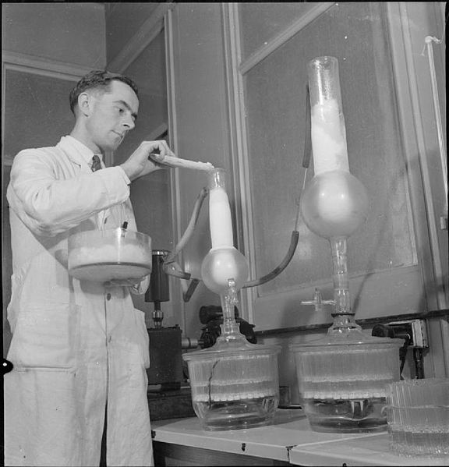
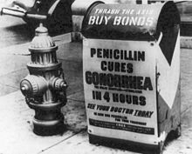
HISTORY OF PENICILLIN
Penicillin was mass-produced by 1944
It was made by growing penicillin mold in large liquid broths, then trying to purify the penicillin from the broth
Supply was still short; it was routinely re-purified from patient’s urine and re-used
Synthetically created at MIT in 1957, solving supply issues

Slide 36
PENICILLINS: Overview
1. PENICILLIN
2. AMPICILLIN/AMOXICILLIN
3. AUGMENTIN/UNASYN
4. NAFCILLIN/OXACILLIN
5. PIPERACILLIN/TAZOBACTAM

Slide 37
PENICILLINS: Overview
1. PENICILLIN
2. AMPICILLIN/AMOXICILLIN
3. AUGMENTIN/UNASYN
4. NAFCILLIN/OXACILLIN
5. PIPERACILLIN/TAZOBACTAM

Slide 38
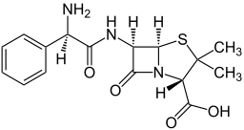
AMPICILLIN/AMOXICILLIN:
EXTRA AMINO
GROUP
MECHANISM OF ACTION:
B-lactam ring, same as penicillin.
SPECTRUM OF COVERAGE:
Addition of an amino group to penicillin allows better
Penetration of outer membrane in gram negatives.
Gram (+): Same as PCN, + Listeria and
Enterococcus (drug of choice for enterococcus)
Gram (-): Pretty good (E coli, proteus, salmonella, shigella, H-flu).
No pseudomonas.
Anaerobes: Less than penicillin
Atypicals: Less than penicillin. Amox used for Lyme in pregnant women
“PENICLLIN WITH MORE
GRAM (-) COVERAGE”
Notes:
Think “HELPSS kill Enterococcus” = H. Influenza, E. Coli, Listeria, Proteus, Shigella/Salmonella, Enterococcus

Slide 39
AMPICILLIN/AMOXICILLIN:
EXTRA AMINO
GROUP
DOSING:
AmOxicillin is preferred PO (Oral)
AmpIcillin is preferred IV (Intravenous)
SIDE EFFECTS:
Hypersensitivity, diarrhea
COMMENTS:
Use for otitis media, UTI’s, Listeria meningitis
 | Gram positives |  |  |  |  | Gram negatives |  | Anaerobes | Atypicals | Comments
 | Strep | MSSA | MRSA | VSE | VRE | “Normals” | Pseudomonas
Amox/Amp | ++ | 0 | 0 | +++ | +++ | ++ | 0 | + | Lyme | UTI’s, Listeria, Enterococcus

Slide 40
PENICILLINS: Overview
1. PENICILLIN
2. AMPICILLIN/AMOXICILLIN
3. AUGMENTIN/UNASYN
4. NAFCILLIN/OXACILLIN
5. PIPERACILLIN/TAZOBACTAM

Slide 41
PENICILLINS: Overview
1. PENICILLIN
2. AMPICILLIN/AMOXICILLIN
3. AUGMENTIN/UNASYN
4. NAFCILLIN/OXACILLIN
5. PIPERACILLIN/TAZOBACTAM

Slide 42
AUGMENTIN / UNASYN:
MECHANISM OF ACTION:
Add beta-lactamase inhibitors.
Amoxicillin + Clavulanate = Augmentin
Ampicillin + Sulbactam= Unasyn
SPECTRUM OF COVERAGE:
Improved activity against bacteria that make
beta-lactamases (e.g. Staph, anaerobes—e.g. bacteroides)
Gram (+)= Strep, most MSSA, (not MRSA)
Gram (-) = Pretty broad, most GN.
Not Pseudomonas
Anaerobes= Excellent
Atypicals = No
“AMP/AMOX WITH MORE
ANAEROBE COVERAGE”

Slide 43
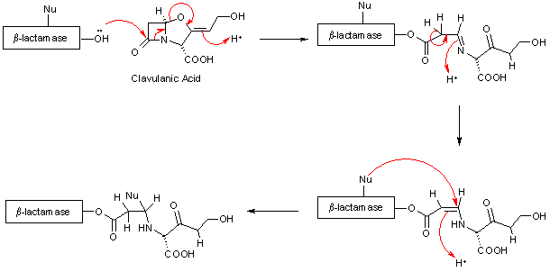
AUGMENTIN / UNASYN:
DOSING:
Augmentin is PO
Unasyn is IV
SIDE EFFECTS:
Increased C dif risk
COMMENTS:
Sinusitis
Aspiration PNA
Bite wounds
 | Gram positives |  |  |  |  | Gram negatives |  | Anaerobes | Atypicals | Comments
 | Strep | MSSA | MRSA | VSE | VRE | “Normals” | Pseudomonas
Augmentin/Unasyn | ++ | ++ | 0 | +++ | +++ | +++ | 0 | +++ | 0 | Sinusitis, asp. PNA, bites, cholangitis

Slide 44
PENICILLINS: Overview
1. PENICILLIN
2. AMPICILLIN/AMOXICILLIN
3. AUGMENTIN/UNASYN
4. NAFCILLIN/OXACILLIN
5. PIPERACILLIN/TAZOBACTAM

Slide 45
PENICILLINS: Overview
1. PENICILLIN
2. AMPICILLIN/AMOXICILLIN
3. AUGMENTIN/UNASYN
4. NAFCILLIN/OXACILLIN
5. PIPERACILLIN/TAZOBACTAM

Slide 46
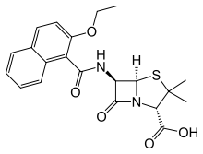
NAFCILLIN/OXACILLIN
BULKY R GROUP:
TOO BIG FOR
B-LACTAMASE
MECHANISM OF ACTION:
B-lactam ring, same as PCN. Side-chains prevent staph beta-lactamase from working.
SPECTRUM OF COVERAGE:
Great for MSSA. Otherwise worse than PCN.
Gram (+): MSSA
Gram (-): Minimal
Anaerobe: Minimal
Atypicals: Minimal
“Drug of choice for MSSA”
Notes:
Were second type of PCNs to be made, synthesized when beta-lactamases started to develop and cause resistance. Used this monotherapy, which is beta-lactamase resistant, but then developed MRSA bc changed PBP.
Antistaphylococcals are the only penicillins that by themselves are resistant to penicillinases. Their rank order of resistance is methicillin > cloxacillin = dicloxacillin > oxacillin.

Slide 47
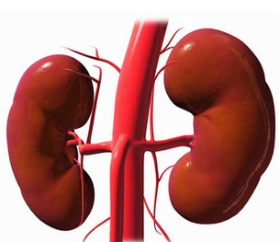
NAFCILLIN/OXACILLIN
DOSING:
IV every Q4-6 hrs.
SIDE EFFECTS:
Risk for acute interstitial nephritis (AIN).
COMMENTS:
Preferred over Vanc for MSSA.
Use requires a special pump (as VNA often can’t do this)
Methicillin was first drug of this class…
but incidence of AIN = 17% at 10 days!
Naf and Ox aren’t that bad, but still a risk.
Vanc is a large molecule, doesn’t get as deep into the staph peptidoglycan cell wall.
Multiple studies have shown improved activity and better outcomes with Naf over Vanc for MSSA
 | Gram positives |  |  |  |  | Gram negatives |  | Anaerobes | Atypicals | Comments
 | Strep | MSSA | MRSA | VSE | VRE | “Normals” | Pseudomonas
Nafcillin/ Oxacillin | + | ++++ | 0 | 0 | 0 | 0 | 0 | 0 | 0 | Drug of choice for MSSA

Slide 48
PENICILLINS: Overview
1. PENICILLIN
2. AMPICILLIN/AMOXICILLIN
3. AUGMENTIN/UNASYN
4. NAFCILLIN/OXACILLIN
5. PIPERACILLIN/TAZOBACTAM

Slide 49
PENICILLINS: Overview
1. PENICILLIN
2. AMPICILLIN/AMOXICILLIN
3. AUGMENTIN/UNASYN
4. NAFCILLIN/OXACILLIN
5. PIPERACILLIN/TAZOBACTAM

Slide 50
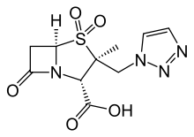
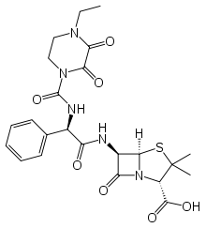
PIPERACILLIN/TAZOBACTAM
B-LACTAMASE
INHIBITOR
ZOSYN
MECHANISM OF ACTION:
B-lactam ring, with side-group to increase gram (-) coverage and a B-lactamase inhibitor (tazo) to broaden spectrum
SPECTRUM OF COVERAGE:
Great for MSSA. Otherwise worse than PCN.
Gram (+): Covers Strep and MSSA
Gram (-): Broad, including pseudomonas
Anaerobes: Broad, very strong
Atypicals: Minimal
INC PENETRATION OF GRAM (-) WALLS
“A BIG GUN GRAM-NEGATIVE
AND ANAEROBE DRUG”
Notes:
Side chain prevents porins from GN to block, beta-lactamase to make beta-lactam producing organisms susceptible

Slide 51
PIPERACILLIN/TAZOBACTAM
ZOSYN
DOSING:
IV only
SPECIFIC SIDE EFFECTS:
Similar to others in PCN class
COMMENTS:
Good for resistant gram-negatives,
PSEUDOMONAS, and anaerobes
Broad GI coverage
Often combined w/ vanc for HCAP
Note that, compared to cefepime, it also covers anaerobes. Do you need anaerobe coverage for HCAP?
 | Gram positives |  |  |  |  | Gram negatives |  | Anaerobes | Atypicals | Comments
 | Strep | MSSA | MRSA | VSE | VRE | “Normals” | Pseudomonas
Zosyn | ++ | ++ | 0 | + | + | ++++ | ++++ | ++++ | 0 | Pseudomonas, GI, HCAP

Slide 52
PENICILLIN FAMILY REVIEW
 | Gram positives |  |  |  |  | Gram negatives |  | Anaerobes | Atypicals | Comments
 | Strep | MSSA | MRSA | VSE | VRE | “Normals” | Pseudomonas
Penicillin | +++ | 0 | 0 | + | + | + | 0 | ++ (mouth) | Syphilis, leptospir. | GAS, syphilis
Amox/Amp | ++ | 0 | 0 | +++ | +++ | ++ | 0 | + | Lyme | UTI’s, Listeria, Enterococcus
Augmentin/Unasyn | ++ | ++ | 0 | +++ | +++ | +++ | 0 | +++ | 0 | Sinusitis, asp. PNA, bites, cholangitis
Nafcillin/ Oxacillin | + | ++++ | 0 | 0 | 0 | 0 | 0 | 0 | 0 | Invasive MSSA
Zosyn | ++ | ++ | 0 | + | + | ++++ | ++++ | ++++ | 0 | Pseudomonas, GI, HCAP
= drug of choice

Slide 53
PENICILLIN FAMILY: TEST YOURSELF!!!
 | Gram positives |  |  |  |  | Gram negatives |  | Anaerobes | Atypicals | Comments
 | Strep | MSSA | MRSA | VSE | VRE | “Normals” | Pseudomonas
Penicillin
Amox/Amp
Augmentin/Unasyn
Nafcillin/ Oxacillin
Zosyn
= drug of choice

Slide 54
PENICILLIN FAMILY: TEST YOURSELF!!!
 | Gram positives |  |  |  |  | Gram negatives |  | Anaerobes | Atypicals | Comments
 | Strep | MSSA | MRSA | VSE | VRE | “Normals” | Pseudomonas
Penicillin | +++ | 0 | 0 | + | + | + | 0 | ++ (mouth) | Syphilis, leptospir. | GAS, syphilis
Amox/Amp
Augmentin/Unasyn
Nafcillin/ Oxacillin
Zosyn
= drug of choice

Slide 55
PENICILLIN FAMILY: TEST YOURSELF!!!
 | Gram positives |  |  |  |  | Gram negatives |  | Anaerobes | Atypicals | Comments
 | Strep | MSSA | MRSA | VSE | VRE | “Normals” | Pseudomonas
Penicillin | +++ | 0 | 0 | + | + | + | 0 | ++ (mouth) | Syphilis, leptospir. | GAS, syphilis
Amox/Amp | ++ | 0 | 0 | +++ | +++ | ++ | 0 | + | Lyme | UTI’s, Listeria, Enterococcus
Augmentin/Unasyn
Nafcillin/ Oxacillin
Zosyn
= drug of choice

Slide 56
PENICILLIN FAMILY: TEST YOURSELF!!!
 | Gram positives |  |  |  |  | Gram negatives |  | Anaerobes | Atypicals | Comments
 | Strep | MSSA | MRSA | VSE | VRE | “Normals” | Pseudomonas
Penicillin | +++ | 0 | 0 | + | + | + | 0 | ++ (mouth) | Syphilis, leptospir. | GAS, syphilis
Amox/Amp | ++ | 0 | 0 | +++ | +++ | ++ | 0 | + | Lyme | UTI’s, Listeria, Enterococcus
Augmentin/Unasyn | ++ | ++ | 0 | +++ | +++ | +++ | 0 | +++ | 0 | Sinusitis, asp. PNA, bites, cholangitis
Nafcillin/ Oxacillin
Zosyn
= drug of choice

Slide 57
PENICILLIN FAMILY: TEST YOURSELF!!!
 | Gram positives |  |  |  |  | Gram negatives |  | Anaerobes | Atypicals | Comments
 | Strep | MSSA | MRSA | VSE | VRE | “Normals” | Pseudomonas
Penicillin | +++ | 0 | 0 | + | + | + | 0 | ++ (mouth) | Syphilis, leptospir. | GAS, syphilis
Amox/Amp | ++ | 0 | 0 | +++ | +++ | ++ | 0 | + | Lyme | UTI’s, Listeria, Enterococcus
Augmentin/Unasyn | ++ | ++ | 0 | +++ | +++ | +++ | 0 | +++ | 0 | Sinusitis, asp. PNA, bites, cholangitis
Nafcillin/ Oxacillin | + | ++++ | 0 | 0 | 0 | 0 | 0 | 0 | 0 | Invasive MSSA
Zosyn
= drug of choice

Slide 58
PENICILLIN FAMILY: TEST YOURSELF!!!
 | Gram positives |  |  |  |  | Gram negatives |  | Anaerobes | Atypicals | Comments
 | Strep | MSSA | MRSA | VSE | VRE | “Normals” | Pseudomonas
Penicillin | +++ | 0 | 0 | + | + | + | 0 | ++ (mouth) | Syphilis, leptospir. | GAS, syphilis
Amox/Amp | ++ | 0 | 0 | +++ | +++ | ++ | 0 | + | Lyme | UTI’s, Listeria, Enterococcus
Augmentin/Unasyn | ++ | ++ | 0 | +++ | +++ | +++ | 0 | +++ | 0 | Sinusitis, asp. PNA, bites, cholangitis
Nafcillin/ Oxacillin | + | ++++ | 0 | 0 | 0 | 0 | 0 | 0 | 0 | Invasive MSSA
Zosyn | ++ | ++ | 0 | + | + | ++++ | ++++ | ++++ | 0 | Pseudomonas, GI, HCAP
= drug of choice

Slide 59
ANTIBIOTICS: Overview (click to jump to a section)
PENICILLINS
CEPHALOSPORINS
FLUOROQUINOLONES
MACROLIDES
TETRACYCLINES
AZTREONAM
AMINOGLYCOSIDES
METRONIDAZOLE
NITROFURANTOIN
COLISTIN
CARBAPENEMS
RIFAXIMIN
VANCOMYCIN
DAPTOMYCIN
LINEZOLID
CLINDAMYCIN
BACTRIM
What you will use intern year!
Jump to the end

Slide 60
ANTIBIOTICS: Overview
PENICILLINS
CEPHALOSPORINS
FLUOROQUINOLONES
MACROLIDES
TETRACYCLINES
AZTREONAM
AMINOGLYCOSIDES
METRONIDAZOLE
NITROFURANTOIN
COLISTIN
CARBAPENEMS
RIFAXIMIN
VANCOMYCIN
DAPTOMYCIN
LINEZOLID
CLINDAMYCIN
BACTRIM
What you will use intern year!

Slide 61
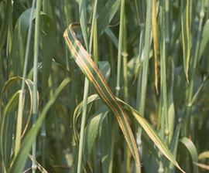
CEPHALOSPORIN FAMILY
Most are semi-synthetic derivatives of cephalosporin C, an anti-microbial compound produced by the fungus Cephalosporium (just like penicillin!)
Mechanism of action is a B-lactam ring, similar to penicillins.

Slide 62
CEPHALOSPORIN FAMILY
4 MAJOR GENERATIONS
In general:
Gram + Coverage
1st GENERATION
2nd GENERATION
3rd GENERATION
B-lactamase Sensitive
Gram - Coverage
B-lactamase Resistant
4th GENERATION: good Gram – and Gram + activity; more beta-lactamase resistant
Notes:
http://www.proprofs.com/flashcards/story.php?title=cephalosporins_1

Slide 63
1st GENERATION CEPHALOSPORINS
CEFAZOLIN/ CEPHALEXIN
MECHANISM OF ACTION:
B-lactam ring, similar to penicillin
SPECTRUM OF COVERAGE:
Think: bacteria on the skin
Gram +: Strep, MSSA
Gram -: Minimal (Proteus, E. Coli, Klebsiella)
Anaerobes: Minimal
Atypicals: Minimal
“GOOD FOR STREP AND
NON-MRSA STAPH…
THINK: SKIN”
Notes:
http://www.sheffield.ac.uk/news/nr/psychological-interventions-psoriasis-atopic-dermatitis-british-journal-dermatology-1.202870
1st generation G- = PEcK (proteus, E. Coli, Klebsiella)
Surgical Prophylaxis-because long duration of action and work on gram (+). Tend to use Cefazolin.

Slide 64
1st GENERATION CEPHALOSPORINS
CEFAZOLIN/ CEPHALEXIN
DOSING:
Cefazolin is IV
Cephalexin (Keflex) is PO
SIDE EFFECTS:
Hypersensitivity: 15% cross-reactivity to PCN
COMMENTS:
Good for skin infections and cellulitis.
Used as pre-operative prophylaxis for procedures involving the skin.
“GOOD FOR STREP AND
NON-MRSA STAPH…
THINK: SKIN”
 | Gram positives |  |  |  |  | Gram negatives |  | Anaerobes | Atypicals | Comments
 | Strep | MSSA | MRSA | VSE | VRE | “Normals” | Pseudomonas
Cefazolin/ Cephalexin | +++ | ++++ | 0 | 0 | 0 | + | 0 | 0 | 0 | Skin, cellulitis

Slide 65
2nd GENERATION CEPHALOSPORINS
CEFOTETAN, CEFUROXAMINE (+ others)
MECHANISM OF ACTION:
B-lactam ring, similar to penicillin
SPECTRUM OF COVERAGE:
Lose MSSA, add some gram (-) and anaerobe coverage
Gram +: Strep species
Gram -: E. coli, proteus, klebsiella, H. flu, moraxella
(no pseudomonas)
Anaerobes: Bacteroides
Atypicals: Minimal
“LESS GRAM (+), BUT MORE GRAM (-) THAN 1st GENERATION”
Notes:
2nd generation: HEN PEcKs (H. Infl, Enterobacter, Neisseria spp. Proteus, E. Coli, Klebsiella, Serratia)

Slide 66
2nd GENERATION CEPHALOSPORINS
CEFOTETAN, CEFUROXAMINE (+ others)
DOSING:
IV
SIDE EFFECTS:
Similar to 1st generation
COMMENTS:
Used for some abdominal/pelvic infections (most frequently)
“LESS GRAM (+), BUT MORE GRAM (-) THAN 1st GENERATION”
 | Gram positives |  |  |  |  | Gram negatives |  | Anaerobes | Atypicals | Comments
 | Strep | MSSA | MRSA | VSE | VRE | “Normals” | Pseudomonas
Cefotetan | ++ | ++ | 0 | 0 | 0 | ++ | 0 | ++ | 0 | abdominal/ pelvic infections
Notes:
Disulfiram-like rxn with cefotetan

Slide 67
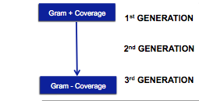
3rd GENERATION CEPHALOSPORINS
“GOOD GRAM NEGATIVE COVERAGE”
CEFTRIAXONE, CEFTAZIDIME, CEFPODOXIME
MECHANISM OF ACTION:
B-lactam ring
SPECTRUM OF COVERAGE:
More gram negative coverage.
Remember…
Gram +: Strep, MMSA
Gram -: Broad and highly active. Ceftazidime (only) covers pseudomonas
Anaerobe: Minimal
Atypicals: Ceftriaxone →Gonorrhea and CNS Lyme
Notes:
Broad spectrum—things it doesn’t cover= “LAME”-- No activity against:
Listeria (use penicillins--amox)
Atypicals (use macrolides)
MRSA (use vanco)
Enterococci

Slide 68
3rd GENERATION CEPHALOSPORINS
“GOOD GRAM NEGATIVE COVERAGE”
CEFTRIAXONE, CEFTAZIDIME, CEFPODOXIME
DOSING:
Ceftriaxone and Ceftazidime are IV
CefPOdoxime is PO
SIDE EFFECTS:
Can cause biliary sludging
MECHANISM OF ACTION:
B-lactam ring
COMMENTS:
Ceftriaxone crosses BBB easily and is used for meningitis.
Ceftazidime gets pseudomonas.

Slide 69
3rd GENERATION CEPHALOSPORINS
“GOOD GRAM NEGATIVE COVERAGE”
CEFTRIAXONE, CEFTAZIDIME, CEFPODOXIME
SPECTRUM OF COVERAGE:
Even less gram (+), more gram negative.
 | Gram positives |  |  |  |  | Gram negatives |  | Anaerobes | Atypicals | Comments
 | Strep | MSSA | MRSA | VSE | VRE | “Normals” | Pseudomonas
Ceftriaxone | ++ | ++ | 0 | 0 | 0 | +++ | 0 | 0 | CNS or Cardiac Lyme | q24H dosing convenient; UTI’s; CAP w/ azithro
Cefpodoxime | ++ | ++ | 0 | 0 | 0 | ++ | 0 | 0 | 0 | PO, similar spectrum as ceftriaxone
Ceftazidime | + | + | 0 | 0 | 0 | +++ | +++ | 0 | 0 | Febrile neutropenia

Slide 70
4th GENERATION CEPHALOSPORINS
CEFEPIME
MECHANISM OF ACTION:
B-lactam ring
SPECTRUM OF COVERAGE:
Weak gram (+), but broad gram negative including pseudomonas
Gram +: Strep pneumo, MSSA, no MRSA!
Gram -: Broad, including pseudomonas
Anaerobe: Minimal
Atypicals: Minimal
“BROAD GRAM NEGATIVES AND PSEUDOMONAS!”

Slide 71
4th GENERATION CEPHALOSPORINS
CEFEPIME
“BROAD GRAM NEGATIVES AND PSEUDOMONAS!”
DOSING:
IV
SIDE EFFECTS:
Decreased seizure threshold
COMMENTS:
Add it when you need broad gram (-) coverage.
Note: Unlike piperacillin/tazobactam (zosyn), it doesn’t cover anaerobes
 | Gram positives |  |  |  |  | Gram negatives |  | Anaerobes | Atypicals | Comments
 | Strep | MSSA | MRSA | VSE | VRE | “Normals” | Pseudomonas
Cefepime | ++ | ++ | 0 | 0 | 0 | ++++ | +++ | 0 | 0 | Broad GNR coverage

Slide 72
5th GENERATION CEPHALOSPORINS
CEFTAROLINE
“ANTI-MRSA DRUG”
MECHANISM OF ACTION:
B-lactam ring
SPECTRUM OF COVERAGE:
Covers MRSA, gram (-) spectrum similar to ceftriaxone
Gram +: MRSA, approved for skin and soft tissue and pneumonia (not bacteremia at this point)
Gram -: Similar to ceftriaxone (pretty good!)
No pseudomonas
Anaerobe: Minimal
Atypicals: Minimal

Slide 73
5th GENERATION CEPHALOSPORINS
CEFTAROLINE
“ANTI-MRSA DRUG”
DOSING:
IV
SIDE EFFECTS:
Hits the wallet hard ($$)!
COMMENTS:
Being used for MRSA infections +
VISA (vanc-intermediate resistant staph aureus)
 | Gram positives |  |  |  |  | Gram negatives |  | Anaerobes | Atypicals | Comments
 | Strep | MSSA | MRSA | VSE | VRE | “Normals” | Pseudomonas
Ceftaroline | ++ | +++ | ++++ | 0 | 0 | +++ | 0 | 0 | 0 | MRSA

Slide 74
CEPHALOSPORIN FAMILY
 | Gram positives |  |  |  |  | Gram negatives |  | Anaerobes | Atypicals | Comments
 | Strep | MSSA | MRSA | VSE | VRE | “Normals” | Pseudomonas
Cefazolin/ Cephalexin | +++ | ++++ | 0 | 0 | 0 | + | 0 | 0 | 0 | Skin, cellulitis
Cefotetan | ++ | ++ | 0 | 0 | 0 | ++ | 0 | ++ | 0 | abdominal/ pelvic infections
Ceftriaxone | ++ | ++ | 0 | 0 | 0 | +++ | 0 | 0 | CNS or Cardiac Lyme | q24H dosing convenient; UTI’s; CAP w/ azithro
Cefpodoxim | ++ | ++ | 0 | 0 | 0 | ++ | 0 | 0 | 0 | PO, similar spectrum as ceftriaxone
Ceftazidime | + | + | 0 | 0 | 0 | +++ | +++ | 0 | 0 | Febrile neutropenia
Cefepime | ++ | ++ | 0 | 0 | 0 | ++++ | +++ | 0 | 0 | Broad GNR coverage
Ceftaroline | ++ | +++ | ++++ | 0 | 0 | +++ | 0 | 0 | 0 | MRSA
1
2
3
3
3
4
5

Slide 75
QUIZ YOURSELF: CEPHALOSPORINS
 | Gram positives |  |  |  |  | Gram negatives |  | Anaerobes | Atypicals | Comments
 | Strep | MSSA | MRSA | VSE | VRE | “Normals” | Pseudomonas
Cefazolin/ Cephalexin
Cefotetan
Ceftriaxone
Cefpodoxim
Ceftazidime
Cefepime
Ceftaroline
1
2
3
3
3
4
5

Slide 76
CEPHALOSPORIN FAMILY
 | Gram positives |  |  |  |  | Gram negatives |  | Anaerobes | Atypicals | Comments
 | Strep | MSSA | MRSA | VSE | VRE | “Normals” | Pseudomonas
Cefazolin/ Cephalexin | +++ | ++++ | 0 | 0 | 0 | + | 0 | 0 | 0 | Skin, cellulitis
Cefotetan
Ceftriaxone
Cefpodoxim
Ceftazidime
Cefepime
Ceftaroline
1
2
3
3
3
4
5

Slide 77
CEPHALOSPORIN FAMILY
 | Gram positives |  |  |  |  | Gram negatives |  | Anaerobes | Atypicals | Comments
 | Strep | MSSA | MRSA | VSE | VRE | “Normals” | Pseudomonas
Cefazolin/ Cephalexin | +++ | ++++ | 0 | 0 | 0 | + | 0 | 0 | 0 | Skin, cellulitis
Cefotetan | ++ | ++ | 0 | 0 | 0 | ++ | 0 | ++ | 0 | abdominal/ pelvic infections
Ceftriaxone
Cefpodoxim
Ceftazidime
Cefepime
Ceftaroline
1
2
3
3
3
4
5

Slide 78
CEPHALOSPORIN FAMILY
 | Gram positives |  |  |  |  | Gram negatives |  | Anaerobes | Atypicals | Comments
 | Strep | MSSA | MRSA | VSE | VRE | “Normals” | Pseudomonas
Cefazolin/ Cephalexin | +++ | ++++ | 0 | 0 | 0 | + | 0 | 0 | 0 | Skin, cellulitis
Cefotetan | ++ | ++ | 0 | 0 | 0 | ++ | 0 | ++ | 0 | abdominal/ pelvic infections
Ceftriaxone | ++ | ++ | 0 | 0 | 0 | +++ | 0 | 0 | CNS or Cardiac Lyme | q24H dosing convenient; UTI’s; CAP w/ azithro
Cefpodoxim
Ceftazidime
Cefepime
Ceftaroline
1
2
3
3
3
4
5

Slide 79
CEPHALOSPORIN FAMILY
 | Gram positives |  |  |  |  | Gram negatives |  | Anaerobes | Atypicals | Comments
 | Strep | MSSA | MRSA | VSE | VRE | “Normals” | Pseudomonas
Cefazolin/ Cephalexin | +++ | ++++ | 0 | 0 | 0 | + | 0 | 0 | 0 | Skin, cellulitis
Cefotetan | ++ | ++ | 0 | 0 | 0 | ++ | 0 | ++ | 0 | abdominal/ pelvic infections
Ceftriaxone | ++ | ++ | 0 | 0 | 0 | +++ | 0 | 0 | CNS or Cardiac Lyme | q24H dosing convenient; UTI’s; CAP w/ azithro
Cefpodoxim | ++ | ++ | 0 | 0 | 0 | ++ | 0 | 0 | 0 | PO, similar spectrum as ceftriaxone
Ceftazidime
Cefepime
Ceftaroline
1
2
3
3
3
4
5

Slide 80
CEPHALOSPORIN FAMILY
 | Gram positives |  |  |  |  | Gram negatives |  | Anaerobes | Atypicals | Comments
 | Strep | MSSA | MRSA | VSE | VRE | “Normals” | Pseudomonas
Cefazolin/ Cephalexin | +++ | ++++ | 0 | 0 | 0 | + | 0 | 0 | 0 | Skin, cellulitis
Cefotetan | ++ | ++ | 0 | 0 | 0 | ++ | 0 | ++ | 0 | abdominal/ pelvic infections
Ceftriaxone | ++ | ++ | 0 | 0 | 0 | +++ | 0 | 0 | CNS or Cardiac Lyme | q24H dosing convenient; UTI’s; CAP w/ azithro
Cefpodoxim | ++ | ++ | 0 | 0 | 0 | ++ | 0 | 0 | 0 | PO, similar spectrum as ceftriaxone
Ceftazidime | + | + | 0 | 0 | 0 | +++ | +++ | 0 | 0 | Febrile neutropenia
Cefepime
Ceftaroline
1
2
3
3
3
4
5

Slide 81
CEPHALOSPORIN FAMILY
 | Gram positives |  |  |  |  | Gram negatives |  | Anaerobes | Atypicals | Comments
 | Strep | MSSA | MRSA | VSE | VRE | “Normals” | Pseudomonas
Cefazolin/ Cephalexin | +++ | ++++ | 0 | 0 | 0 | + | 0 | 0 | 0 | Skin, cellulitis
Cefotetan | ++ | ++ | 0 | 0 | 0 | ++ | 0 | ++ | 0 | abdominal/ pelvic infections
Ceftriaxone | ++ | ++ | 0 | 0 | 0 | +++ | 0 | 0 | CNS or Cardiac Lyme | q24H dosing convenient; UTI’s; CAP w/ azithro
Cefpodoxim | ++ | ++ | 0 | 0 | 0 | ++ | 0 | 0 | 0 | PO, similar spectrum as ceftriaxone
Ceftazidime | + | + | 0 | 0 | 0 | +++ | +++ | 0 | 0 | Febrile neutropenia
Cefepime | ++ | ++ | 0 | 0 | 0 | ++++ | +++ | 0 | 0 | Broad GNR coverage
Ceftaroline
1
2
3
3
3
4
5

Slide 82
CEPHALOSPORIN FAMILY
 | Gram positives |  |  |  |  | Gram negatives |  | Anaerobes | Atypicals | Comments
 | Strep | MSSA | MRSA | VSE | VRE | “Normals” | Pseudomonas
Cefazolin/ Cephalexin | +++ | ++++ | 0 | 0 | 0 | + | 0 | 0 | 0 | Skin, cellulitis
Cefotetan | ++ | ++ | 0 | 0 | 0 | ++ | 0 | ++ | 0 | abdominal/ pelvic infections
Ceftriaxone | ++ | ++ | 0 | 0 | 0 | +++ | 0 | 0 | CNS or Cardiac Lyme | q24H dosing convenient; UTI’s; CAP w/ azithro
Cefpodoxim | ++ | ++ | 0 | 0 | 0 | ++ | 0 | 0 | 0 | PO, similar spectrum as ceftriaxone
Ceftazidime | + | + | 0 | 0 | 0 | +++ | +++ | 0 | 0 | Febrile neutropenia
Cefepime | ++ | ++ | 0 | 0 | 0 | ++++ | +++ | 0 | 0 | Broad GNR coverage
Ceftaroline | ++ | +++ | ++++ | 0 | 0 | +++ | 0 | 0 | 0 | MRSA
1
2
3
3
3
4
5

Slide 83
ANTIBIOTICS: Overview (click to jump to a section)
PENICILLINS
CEPHALOSPORINS
FLUOROQUINOLONES
MACROLIDES
TETRACYCLINES
AZTREONAM
AMINOGLYCOSIDES
METRONIDAZOLE
NITROFURANTOIN
COLISTIN
CARBAPENEMS
RIFAXIMIN
VANCOMYCIN
DAPTOMYCIN
LINEZOLID
CLINDAMYCIN
BACTRIM
What you will use intern year!
Jump to the end

Slide 84
ANTIBIOTICS: Overview
PENICILLINS
CEPHALOSPORINS
FLUOROQUINOLONES
MACROLIDES
TETRACYCLINES
AZTREONAM
AMINOGLYCOSIDES
METRONIDAZOLE
NITROFURANTOIN
COLISTIN
CARBAPENEMS
RIFAXIMIN
VANCOMYCIN
DAPTOMYCIN
LINEZOLID
CLINDAMYCIN
BACTRIM
What you will use intern year!

Slide 85
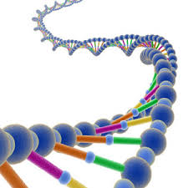
FLUOROQUINOLONES
* CIPROFLOXACIN * LEVOFLOXACIN * MOXIFLOXACIN *
MECHANISM OF ACTION:
Only class of antibiotics that directly inhibit bacterial DNA synthesis.
Blocks two enzymes:
DNA Gyrase
Topoisomerase IV
Leads to DNA damage and cell death
Notes:
Mechanism: Bactericidal, interferes with DNA synthesis by inhibiting topoisomerase II (DNA gyrase; prevents supercoiling, can both relax and introduce negative supercoil to open DNA for replication) and topoisomerase IV (prevents sister chromatid from getting twisted and recombined. Helps in next step of G2 and mitosis)
Pharmacokinetics: Iron, Ca2+ limit absorption, Eliminated mainly by kidney, Reduced dose in renal dysfunction

Slide 86
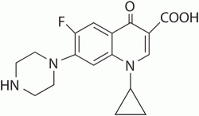
CIPROFLOXACINOXACINCI
MECHANISM OF ACTION:
DNA inhibition
SPECTRUM OF COVERAGE:
Broad gram (-) coverage, including pseudomonas (though resistance rates are high; at BIDMC 2012, Cipro covered 62% of pseudomonas)
Gram +: Minimal
Gram -: Broad gram negative.
If suspect pseudomonas infxn, don’t trust it alone-resistance rates are high
Anaerobe: Minimal
Atypicals: Minimal
“A GOOD GRAM NEGATIVE DRUG”

Slide 87
CIPROFLOXACINOXACINCI
DOSING:
IV or PO. In general, high bioavailability
SIDE EFFECTS:
Tendonitis, relative contra-indication in elderly for AMS. Increased QTc
COMMENTS:
Many uses, but resistance is growing
 | Gram positives |  |  |  |  | Gram negatives |  | Anaerobes | Atypicals | Comments
 | Strep | MSSA | MRSA | VSE | VRE | “Normals” | Pseudomonas
Ciproflox | 0 | + | + | 0 | 0 | +++ | ++ | 0 | 0 | GI, GU infections
Notes:
Tendonitis and tendon rupture Since distribute in bones and soft tissues, blocks our topoisomerases, dec turnover rate of cartilage, generally achilles tendon
INCREASED QT: Torsades rhythm due to calcium and ions in our tissues

Slide 88
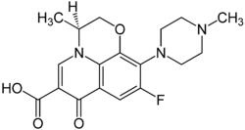
LEVOFLOXACINOXACINCI
MECHANISM OF ACTION:
DNA inhibition
SPECTRUM OF COVERAGE:
Retains gram (-) coverage of cipro, but adds some gram (+) and atypical coverage
Gram +: Strep pneumoniae, some Staph aureus
Gram -: Broad gram (-).
If suspect pseudomonas infxn, don’t trust it alone-resistance rates are high
Anaerobes: minimal
Atypicals: TB
Mycoplasma, Chlamydia pneumonia → good for CAP!
“RESPIRATORY
FLUOROQUINOLONE”
Don’t use for CAP if you have suspicion for TB; may breed resistance if patient turns out having TB

Slide 89
LEVOFLOXACINOXACINCI
DOSING:
IV or PO. In general, high bioavailability
SIDE EFFECTS:
Tendonitis, relative contra-indication in elderly for AMS. Increased QTc
COMMENTS:
A strong community acquired PNA drug
“RESPIRATORY
FLUOROQUINOLONE”
 | Gram positives |  |  |  |  | Gram negatives |  | Anaerobes | Atypicals | Comments
 | Strep | MSSA | MRSA | VSE | VRE | “Normals” | Pseudomonas
Levoflox | ++ | ++ | + | 0 | 0 | +++ | ++ | 0 | +++ | Pneumonia, expensive

Slide 90
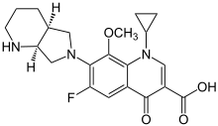
MOXIFLOXACINOXACINCI
Similar to levofloxacin—somewhat better coverage of gram positives and anaerobes than other quinolones, but more GI side-effects.

Slide 91
FLUOROQUINOLONES REVIEW
 | Gram positives |  |  |  |  | Gram negatives |  | Anaerobes | Atypicals | Comments
 | Strep | MSSA | MRSA | VSE | VRE | “Normals” | Pseudomonas
Ciproflox | 0 | + | + | 0 | 0 | +++ | ++ | 0 | 0 | GI, GU infections
Levoflox | ++ | ++ | + | 0 | 0 | +++ | ++ | 0 | +++ | Pneumonia, expensive

Slide 92
ANTIBIOTICS: Overview (click to jump to a section)
PENICILLINS
CEPHALOSPORINS
FLUOROQUINOLONES
MACROLIDES
TETRACYCLINES
AZTREONAM
AMINOGLYCOSIDES
METRONIDAZOLE
NITROFURANTOIN
COLISTIN
CARBAPENEMS
RIFAXIMIN
VANCOMYCIN
DAPTOMYCIN
LINEZOLID
CLINDAMYCIN
BACTRIM
What you will use intern year!
Jump to the end

Slide 93
ANTIBIOTICS: Overview
PENICILLINS
CEPHALOSPORINS
FLUOROQUINOLONES
MACROLIDES
TETRACYCLINES
AZTREONAM
AMINOGLYCOSIDES
METRONIDAZOLE
NITROFURANTOIN
COLISTIN
CARBAPENEMS
RIFAXIMIN
VANCOMYCIN
DAPTOMYCIN
LINEZOLID
CLINDAMYCIN
BACTRIM
What you will use intern year!

Slide 94
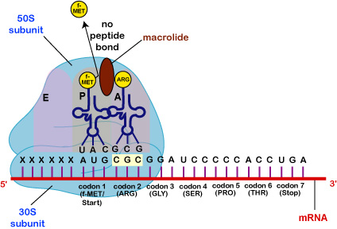
MACROLIDES
■ ERYTHROMYCIN  AZITHROMYCIN  CLARITHROMYCIN 
MECHANISM OF ACTION:
Inhibit 50S subunit of bacterial ribosomes, inhibiting RNA translation and protein synthesis
In general, they are used for CAP and atypical organisms
Notes:
http://faculty.ccbcmd.edu/courses/bio141/lecguide/unit2/control/macresp_illus.html

Slide 95
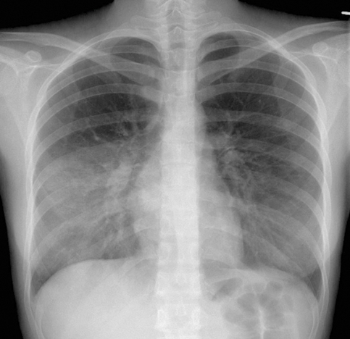
AZITHROMYCIN
MACROLIDES
“ATYPICAL RESPIRATORY BUGS AND CHLAMYDIA”
MECHANISM OF ACTION:
50S ribosomal inhibition
SPECTRUM OF COVERAGE:
Strep pneumo and respiratory atypicals-- such as Mycoplasma, Chlamydophilia pneumonae
Gram +: Strep pneumo, some MSSA
Gram -: “Respiratory” gram (-)’s like H. flu, Moraxella. Also traveller’s diarrhea bugs
Anaerobes: Minimal
Atypicals: Mycoplasma, Chlamydophila, Chlamydia
Mycoplasma PNA
Notes:
http://www.medicalgrapevineasia.com/mg/2012/11/20/the-mycoplasma-story/

Slide 96
AZITHROMYCIN
MACROLIDES
“ATYPICAL RESPIRATORY BUGS AND CHLAMYDIA”
DOSING:
IV or PO.
“Z-pack” is 6 pills of 250mg; patient takes 2 on day one and then 1 daily to complete a 5 day course.
SIDE EFFECTS:
Increased QTc.
Increased risk of dying from cardiac complications while taking it.
COMMENTS:
#1 antibiotic prescribed (and over-prescribed) in the USA, and resistance rates are broadly up.
 | Gram positives |  |  |  |  | Gram negatives |  | Anaerobes | Atypicals | Comments
 | Strep | MSSA | MRSA | VSE | VRE | “Normals” | Pseudomonas
Azithro | ++ | + | 0 | 0 | 0 | + | 0 | 0 | +++ | CAP, chlamydia
Notes:
http://www.medicalgrapevineasia.com/mg/2012/11/20/the-mycoplasma-story/

Slide 97
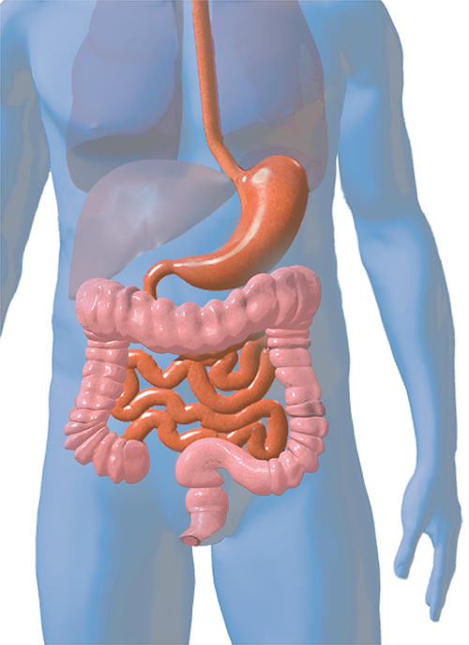
ERYTHROMYCIN
MACROLIDES
“ATYPICAL INFECTIONS, GASTROPARESIS”
An older drug; it is similar to azithromycin, but with more side-effects so infrequently used nowadays.
Infants get erythromycin eye drops for chlamydia conjunctivitis.
One prominent side-effect is increased GI peristalsis, causing diarrhea and abdominal cramping. This occurs because Erythromycin is a motilin receptor agonist.
This “side-effect” is capitalized on in treatment of gastroparesis. IV erythromycin can be effective for up to 7 days. PO erythromycin or long-term use has not been shown to be effective.
Motilin is a hormone that stimulates inter-digestive peristalsis in the GI tract.
Notes:
http://beasurvivor-colorectal.com/anatomy-of-the-bowel/

Slide 98
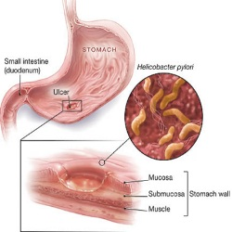
CLARITHROMYCIN
MACROLIDES
Similar to azithromycin, but more side-effects.
Part of “triple-therapy” for Helicobacter pylori eradication
Notes:
http://www.girlishh.com/simple-natural-cure-for-pylori-bacteria/

Slide 99
ANTIBIOTICS: Overview (click to jump to a section)
PENICILLINS
CEPHALOSPORINS
FLUOROQUINOLONES
MACROLIDES
TETRACYCLINES
AZTREONAM
AMINOGLYCOSIDES
METRONIDAZOLE
NITROFURANTOIN
COLISTIN
CARBAPENEMS
RIFAXIMIN
VANCOMYCIN
DAPTOMYCIN
LINEZOLID
CLINDAMYCIN
BACTRIM
What you will use intern year!
Jump to the end

Slide 100
ANTIBIOTICS: Overview
PENICILLINS
CEPHALOSPORINS
FLUOROQUINOLONES
MACROLIDES
TETRACYCLINES
AZTREONAM
AMINOGLYCOSIDES
METRONIDAZOLE
NITROFURANTOIN
COLISTIN
CARBAPENEMS
RIFAXIMIN
VANCOMYCIN
DAPTOMYCIN
LINEZOLID
CLINDAMYCIN
BACTRIM
What you will use intern year!

Slide 101
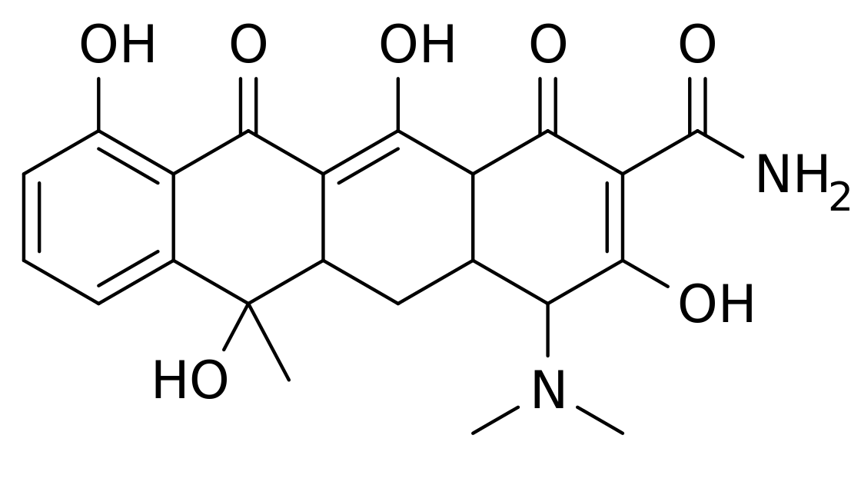
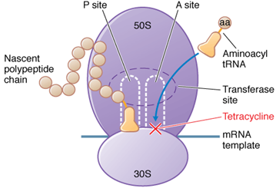
TETRACYCLINE FAMILY
❖ DOXYCYCLINE  MINOCYCLINE  TIGECYCLINE 
MECHANISM OF ACTION:
Bind to 30S subunit of bacterial ribosomes, inhibiting translation and protein synthesis
Tetracycline has more side-effects than doxycycline, so not used frequently anymore

Slide 102
TETRACYCLINE FAMILY
❖ DOXYCYCLINE
“ATYPICAL BACTERIA”
MECHANISM OF ACTION:
30S ribosomal inhibition
SPECTRUM OF COVERAGE:
Strep pneumo, sometimes staph and MRSA, and many atypicals
Gram +: Strep pneumo, some MSSA and MRSA
Gram -: Minimal
Anaerobes: Minimal
Atypicals: Broad. Spirochetes (lyme, syphilis, leptospira), Rickettsial disease (Rocky Mountain Spotted Fever), Chlamydia, Malaria, Mycoplasma

Slide 103
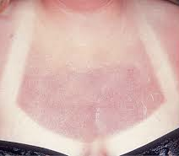
TETRACYCLINE FAMILY
❖ DOXYCYCLINE
“ATYPICAL BACTERIA”
DOSING:
IV or PO
SIDE EFFECTS:
Sun-sensitivity, teeth discoloration, liver toxicity.
If treating spirochetes, watch for Jarisch-Herxheimer reaction
COMMENTS:
Sometimes a PO MRSA option.
Broadly used for atypical infections.
Doxycycline induced photosensitive rash
 | Gram positives |  |  |  |  | Gram negatives |  | Anaerobes | Atypicals | Comments
 | Strep | MSSA | MRSA | VSE | VRE | “Normals” | Pseudomonas
Doxycycline | ++ | ++ | ++ | + | + | 0 | 0 | 0 | ++++ | CAP, atypical infections
Notes:
Tooth Enamel dysplasia: accumulation in bones and teeth because of Ca2+ chelation.
Decreased bone growth: don't give to children
Teratogenic
Phototoxicity: rash in sun, often in patients on Doxy for Acne

Slide 104
TETRACYCLINE FAMILY
❖ TIGECYCLINE
“CONSIDER IF OTHER ANTIBIOTICS ARE NOT INDICATED OR NOT WORKING”
Not strictly speaking a tetracycline-derivative,
but a close relative
SPECTRUM OF COVERAGE:
Broader spectrum than doxy: Includes enterococcus, VRE, strep, staph, c dif, gram (-) bacteria [not including pseudomonas]
NOTE: Tigecycline has been associated with increased mortality relative to other antimicrobials. Reserve its use for when other antibiotics are not indicated or not working. This is an “ID consult” drug!
 | Gram positives |  |  |  |  | Gram negatives |  | Anaerobes | Atypicals | Comments
 | Strep | MSSA | MRSA | VSE | VRE | “Normals” | Pseudomonas
Tigecycline | +++ | +++ | +++ | +++ | +++ | +++ | 0 | +++ | 0 | 3rd line, may increase mortality

Slide 105
ANTIBIOTICS: Overview (click to jump to a section)
PENICILLINS
CEPHALOSPORINS
FLUOROQUINOLONES
MACROLIDES
TETRACYCLINES
AZTREONAM
AMINOGLYCOSIDES
METRONIDAZOLE
NITROFURANTOIN
COLISTIN
CARBAPENEMS
RIFAXIMIN
VANCOMYCIN
DAPTOMYCIN
LINEZOLID
CLINDAMYCIN
BACTRIM
What you will use intern year!
Jump to the end

Slide 106
ANTIBIOTICS: Overview
PENICILLINS
CEPHALOSPORINS
FLUOROQUINOLONES
MACROLIDES
TETRACYCLINES
AZTREONAM
AMINOGLYCOSIDES
METRONIDAZOLE
NITROFURANTOIN
COLISTIN
CARBAPENEMS
RIFAXIMIN
VANCOMYCIN
DAPTOMYCIN
LINEZOLID
CLINDAMYCIN
BACTRIM
MRSA DRUGS
What you will use intern year!

Slide 107
MRSA DRUGS
IV
PO
Vancomycin
Daptomycin
Linezolid
Ceftaroline
Linezolid
Doxycycline
Bactrim
Clindamycin

Slide 108
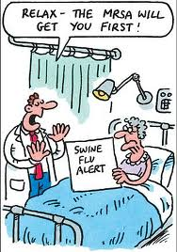
VANCOMYCIN
“GRAM POSITIVES, MRSA”
MECHANISM OF ACTION:
Binds to peptidoglycan and prevents cell-wall cross linking, thus causing osmotic cell death. Different binding than PCN’s.
SPECTRUM OF COVERAGE:
Almost all gram (+) bacteria, and nothing else.
Enterococcus is becoming resistant (VRE), and VRSA is on the rise.
Gram +: Almost all, including MRSA.
Gram -: None
Anaerobes: Kills gram (+) anaerobes, like C. difficile
Atypicals: None
Notes:
http://freshmanmonroe.blogs.wm.edu/2011/04/24/abstract-clinical-effects-of-vancomycin-resistant-strains-of-mrsa/
Binds at the D-ala-D-ala muramyl pentapeptide (not PBP) to sterically hinder the transglycosylation (not cross linking, but elongation of the peptidoglycan chains) reactions involved in elongation of peptidoglycan chains. Doesn't interfere with PBP’s, which is what we target with methicillin etc.

Slide 109
VANCOMYCIN
“GRAM POSITIVES, MRSA”
This is why we use
PO Vanc for C. dif
DOSING:
IV only.
Bioavailability is ~0%, so when given orally or PR it stays in the GUT
SIDE EFFECTS:
Red Man syndrome (not a true allergy)
Nephrotoxicity. Ototoxicity.
COMMENTS:
For most infections, Vanc trough (before 4th dose) goal is 15-20.
For skin and soft-tissue it is 10-20.
Very important to get to trough goal 15-20 for bacteremia
Vanc causes
histamine release
 | Gram positives |  |  |  |  | Gram negatives |  | Anaerobes | Atypicals | Comments
 | Strep | MSSA | MRSA | VSE | VRE | “Normals” | Pseudomonas
Vancomycin | +++ | ++ | ++++ | +++ | 0 | 0 | 0 | C. Dif if PO | 0 | Measure troughs
Notes:
http://strangesyndromes.blogspot.com/
Did the red man make you LOL?

Slide 110
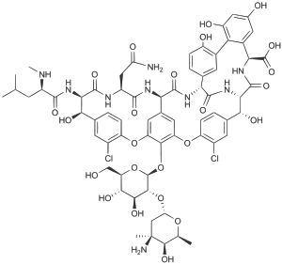
NOTE ABOUT VANCOMYCIN
Vanc is a very LARGE molecule, so it doesn’t penetrate gram (+) cell walls as well as penicillins do, as they are much smaller.
For MSSA infections, nafcillin or oxacillin are preferred. They have better in-vitro activity against MSSA than vanc, and clinic trials have also shown superiority!
VANC
NAF

Slide 111
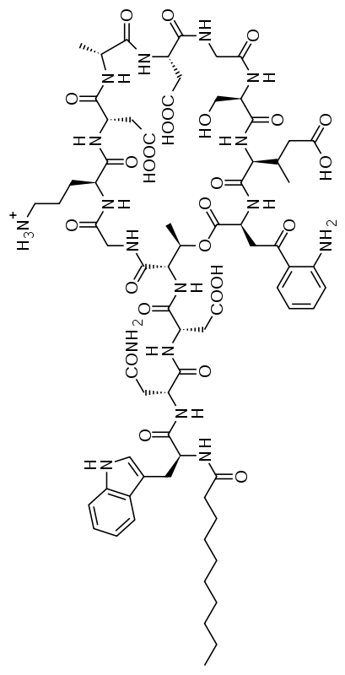
DAPTOMYCIN
“LIKE VANC BUT FOR VRE AND MORE EXPENSIVE”
MECHANISM OF ACTION:
Puts holes in bacterial cell membrane, causing depolarization and then inhibition of DNA synthesis and RNA translation.
SPECTRUM OF COVERAGE:
Broadly covers gram (+)’s, including MRSA and VRE. Indicated for skin and soft tissue, and for endocarditis/bacteremia.
Gram +: Pretty much all, including MRSA and VRE
Gram -: None
Anaerobes: None
Atypicals: None

Slide 112
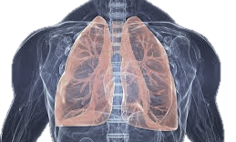
DAPTOMYCIN
“LIKE VANC BUT FOR VRE AND MORE EXPENSIVE”
DOSING:
IV only
SIDE EFFECTS:
Neuropathy and myopathy.
COMMENTS:
Do NOT use in lung infections. Inactivated by surfactant.
Serum CK should be
checked regularly
 | Gram positives |  |  |  |  | Gram negatives |  | Anaerobes | Atypicals | Comments
 | Strep | MSSA | MRSA | VSE | VRE | “Normals” | Pseudomonas
Daptomycin | +++ | +++ | ++++ | +++ | +++ | 0 | 0 | 0 | 0 | MRSA, VRE. Don’t use for lung infection
Notes:
http://guardianlv.com/2014/02/human-lungs-being-grown-in-fish-tanks-state-texas-scientists/

Slide 113
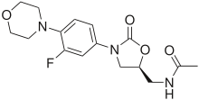
LINEZOLID
“POWERFUL GRAM POSITIVE, BUT $$ AND TOXIC TO BM”
MECHANISM OF ACTION:
Inhibit 50S subunit of bacterial ribosome
SPECTRUM OF COVERAGE:
Broadly covers gram (+)’s, including MRSA and VRE.
Gram +: Almost all, including MRSA and VRE
Gram -: none
Anaerobes: none
Atypicals: none

Slide 114
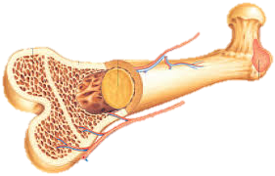
LINEZOLID
“POWERFUL GRAM POSITIVE, BUT $$ AND TOXIC TO BM”
DOSING:
IV or PO.
This is nice because it’s a strong MRSA oral option (of which there are not many)
SIDE EFFECTS:
Marrow-toxicity (neutropenia, thrombocytopenia) and MAO inhibition, so can cause serotonin syndrome (care with SSRI’s or other similar drugs).
COMMENTS:
Unlike Daptomycin, can be used in the lungs.
Expensive $$$$
 | Gram positives |  |  |  |  | Gram negatives |  | Anaerobes | Atypicals | Comments
 | Strep | MSSA | MRSA | VSE | VRE | “Normals” | Pseudomonas
Linezolid | +++ | +++ | ++++ | +++ | +++ | 0 | 0 | 0 | 0 | MRSA, VRE. Marrow toxicity
Notes:
http://lifesun.info/tag/bone/page/3/

Slide 115
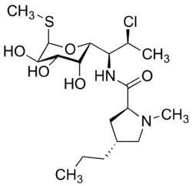
CLINDAMYCIN
“STREP, STAPH, AND ANAEROBES”
MECHANISM OF ACTION:
Inhibit 50S subunit of bacterial ribosome
SPECTRUM OF COVERAGE:
Strep, Staph (occasionally MRSA), and anaerobes
Gram +: Strep and Staph, though resistance on the rise
Gram -: minimal
Anaerobes: fairly broad spectrum for anaerobes
Atypicals: babesiosis

Slide 116
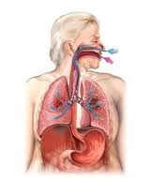
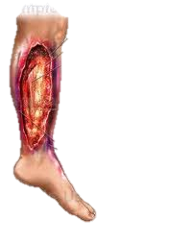
CLINDAMYCIN
“STREP, STAPH, AND ANAEROBES”
DOSING:
IV or PO.
SIDE EFFECTS:
Diarrhea up to 20%. Increased C dif risk.
COMMENTS:
Useful for skin and soft-tissue infections, PO MRSA coverage.
Aspiration pneumonia—covers anaerobes.
Can “shut down” toxin production in GAS (Strep pyogenes) disease such as necrotizing fasciitis
 | Gram positives |  |  |  |  | Gram negatives |  | Anaerobes | Atypicals | Comments
 | Strep | MSSA | MRSA | VSE | VRE | “Normals” | Pseudomonas
Clinda | +++ | +++ | ++ | 0 | 0 | 0 | 0 | +++ | Babesia | GI side effects common
Notes:
http://www.pharmacy-and-drugs.com/Lung_diseases/Aspiration_pneumonia.html

Slide 117
BACTRIM: Trimethoprim-Sulfmethoxazole
MECHANISM OF ACTION:
Inhibit synthesis of tetrahydrofolic acid, so can’t make folate, which is necessary for DNA synthesis
SPECTRUM OF COVERAGE
Fairly broad, though resistance is also wide-spread.
Gram +: Staph, and MRSA; NOT good for strep
Gram -: Will cover typical gram (-)’s that cause UTI’s and some GI bacteria
Anaerobes: Minimal
Atypicals: Pneumocystis jirovecii (formerly PCP), Nocardia, Listeria
Pteridine + PABA
Dihydropteroic Acid
Dihydrofolic Acid
Tetrahydofolic Acid
SULFONAMIDES
Dihydropteroate
Synthetase
*Not in humans
TRIMETHOPRIM
Dihydrofolate
reductase
*Also in
humans
Notes:
Folate is needed to convert U to T, and thus A and G (methylate it). Bacteria can’t make folic acid from scratch. We share some of these enzymes (not dihydropteroate synthetase, yes DHFR---this is why we get a chemo-type effect, inhibited also by methotrexate)

Slide 118
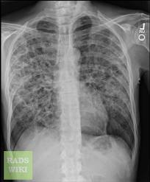
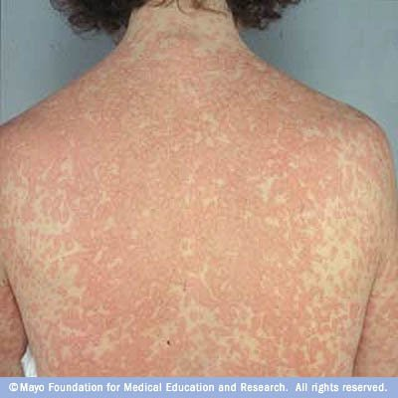
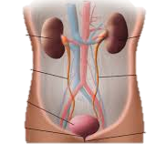
BACTRIM: Trimethoprim-Sulfmethoxazole
PCP
PNA
DOSING:
IV or PO
SIDE EFFECTS:
Inhibits Cr secretion in renal
Sulfa-allergy
Hyperkalemia
Skin reactions (can be severe->SJS)
COMMENTS:
Used for PCP tx/prophylaxis, UTI’s, PO MRSA option.
Note that for skin infection, it doesn’t get Strep well.
Causes elevated Cr
without decreased GFR!
Bactrim-induced Rash
UTI
 | Gram positives |  |  |  |  | Gram negatives |  | Anaerobes | Atypicals | Comments
 | Strep | MSSA | MRSA | VSE | VRE | “Normals” | Pseudomonas
Bactrim | + | +++ | ++ | 0 | 0 | ++ | 0 | 0 | PCP, nocardia | Elevates K+ and Cr
Notes:
PCP prophylaxis at CD4 <200
http://radiopaedia.org/articles/pneumocystis-pneumonia
(mayo foundation—rash)= Totalpict.com/bactrim

Slide 119
ANTIBIOTICS: Overview (click to jump to a section)
PENICILLINS
CEPHALOSPORINS
FLUOROQUINOLONES
MACROLIDES
TETRACYCLINES
AZTREONAM
AMINOGLYCOSIDES
METRONIDAZOLE
NITROFURANTOIN
COLISTIN
CARBAPENEMS
RIFAXIMIN
VANCOMYCIN
DAPTOMYCIN
LINEZOLID
CLINDAMYCIN
BACTRIM
What you will use intern year!
Jump to the end

Slide 120
ANTIBIOTICS: Overview
PENICILLINS
CEPHALOSPORINS
FLUOROQUINOLONES
MACROLIDES
TETRACYCLINES
AZTREONAM
AMINOGLYCOSIDES
METRONIDAZOLE
NITROFURANTOIN
COLISTIN
CARBAPENEMS
RIFAXIMIN
VANCOMYCIN
DAPTOMYCIN
LINEZOLID
CLINDAMYCIN
BACTRIM
What you will use intern year!

Slide 121
AZTREONAM
“2nd LINE BROAD GRAM (-) COVERAGE”
MECHANISM OF ACTION:
“Monobactam”
B-lactam ring, similar to penicillin
SPECTRUM OF COVERAGE:
Broad gram (-) coverage, including pseudomonas
Gram +: Minimal
Gram -: Broad coverage, Pseudomonas
Anaerobes: None
Atypicals: Minimal
DOSING:
IV
SIDE EFFECTS:
Diarrhea
COMMENTS:
Broad spectrum, but probably less effective than cephalosporins of similar coverage (like cefepime).
Used when a patient needs gram (-) coverage (febrile neutropenia) but has severe PCN allergy
Doesn’t cross react with PCNs
 | Gram positives |  |  |  |  | Gram negatives |  | Anaerobes | Atypicals | Comments
 | Strep | MSSA | MRSA | VSE | VRE | “Normals” | Pseudomonas
Aztreonam | 0 | 0 | 0 | 0 | 0 | +++ | ++ | 0 | 0 | OK in severe penicillin allergy
Notes:
Mechanism:
-Same as penicillins and cephalosporins
-Resistant to beta-lactamases
-no effect on anaerobes!
Uses:
-IV drug mainly active against gram-negative rods because binds PBP only found in bacterias (PBP3) that have the shape of a rod and are aerobic. Use with enterobacteria, including Pseudomonas aeruginosa.
-No cross allergenicity with penicillins or cephalosporins!
→Give to people with pseusodomonas with allergies to penicillin or cephalosporins

Slide 122
ANTIBIOTICS: Overview (click to jump to a section)
PENICILLINS
CEPHALOSPORINS
FLUOROQUINOLONES
MACROLIDES
TETRACYCLINES
AZTREONAM
AMINOGLYCOSIDES
METRONIDAZOLE
NITROFURANTOIN
COLISTIN
CARBAPENEMS
RIFAXIMIN
VANCOMYCIN
DAPTOMYCIN
LINEZOLID
CLINDAMYCIN
BACTRIM
What you will use intern year!
Jump to the end

Slide 123
ANTIBIOTICS: Overview
PENICILLINS
CEPHALOSPORINS
FLUOROQUINOLONES
MACROLIDES
TETRACYCLINES
AZTREONAM
AMINOGLYCOSIDES
METRONIDAZOLE
NITROFURANTOIN
COLISTIN
CARBAPENEMS
RIFAXIMIN
VANCOMYCIN
DAPTOMYCIN
LINEZOLID
CLINDAMYCIN
BACTRIM
What you will use intern year!

Slide 124
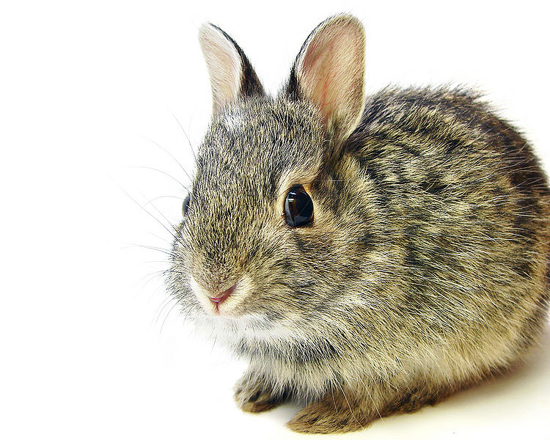
AMINOGLYCOSIDES
Yes… we still use them sometimes!
MECHANISM OF ACTION:
Inhibits 30S subunit of bacterial ribosome
SPECTRUM OF COVERAGE:
In general, they have broad gram (-) coverage (including pseudomonas). Aerobes only!
SIDE EFFECTS:
Monitoring drug levels is very important
A broad array of side-effects limits use:
Renal toxicity
Ototoxicity
COMMENTS:
Still 1st line for tularemia, brucellosis, and plague!
Notes:
Almost always used in combination with cell wall synthesis inhibitor
Oral neomycin before elective bowel surgery bc not absorbed
Aerobes only!!
http://naturalunseenhazards.wordpress.com/2012/07/31/wild-rabbits-in-arizona-dying-from-tularemia-west-nile-virus-approaching-emergency-risk-level-in-dallas-fort-worth-area-of-texas-west-nile-virus-reports-from-ga-il-nj-oh-cdc-reports-zo/

Slide 125
AMINOGLYCOSIDES
GENTAMICIN
Combine with Penicillin, Ampicillin, or Vancomycin to treat severe (like endocarditis) Enterococci or Strep infections.
Note: For MSSA or MRSA endocarditis, adding Gentamicin to Nafcillin or Vancomycin worsens outcomes (study), unless prosthetic valve
TOBRAMYCIN
Most active aminoglycoside against pseudomonas.
Use as combination therapy in Ventilator-Associated PNA (VAP) with cefepime, zosyn, or another similar drug.
AMIKACIN
Occasionally used to treat UTI’s from broadly-resistance gram negatives.
Notes:
Almost always used in combination with cell wall synthesis inhibitor
Oral neomycin before elective bowel surgery bc not absorbed
Aerobes only!!
http://naturalunseenhazards.wordpress.com/2012/07/31/wild-rabbits-in-arizona-dying-from-tularemia-west-nile-virus-approaching-emergency-risk-level-in-dallas-fort-worth-area-of-texas-west-nile-virus-reports-from-ga-il-nj-oh-cdc-reports-zo/

Slide 126
AMINOGLYCOSIDES
 | Gram positives |  |  |  |  | Gram negatives |  | Anaerobes | Atypicals | Comments
 | Strep | MSSA | MRSA | VSE | VRE | “Normals” | Pseudomonas
Gentamicin | ++ | ++ | ++ | 0 | 0 | +++ | ++ | 0 | Plague, tularemia | Strep or enterococcus endocarditis (in combination)
Tobramycin | + | + | + | 0 | 0 | +++ | +++ | 0 | 0 | VAP (as combo add on)
Amikacin | + | + | + | 0 | 0 | ++++ | ++ | 0 | 0 | Tough UTI’s
Notes:
Almost always used in combination with cell wall synthesis inhibitor
Oral neomycin before elective bowel surgery bc not absorbed
Aerobes only!!
http://naturalunseenhazards.wordpress.com/2012/07/31/wild-rabbits-in-arizona-dying-from-tularemia-west-nile-virus-approaching-emergency-risk-level-in-dallas-fort-worth-area-of-texas-west-nile-virus-reports-from-ga-il-nj-oh-cdc-reports-zo/

Slide 127
ANTIBIOTICS: Overview (click to jump to a section)
PENICILLINS
CEPHALOSPORINS
FLUOROQUINOLONES
MACROLIDES
TETRACYCLINES
AZTREONAM
AMINOGLYCOSIDES
METRONIDAZOLE
NITROFURANTOIN
COLISTIN
CARBAPENEMS
RIFAXIMIN
VANCOMYCIN
DAPTOMYCIN
LINEZOLID
CLINDAMYCIN
BACTRIM
What you will use intern year!
Jump to the end

Slide 128
ANTIBIOTICS: Overview
PENICILLINS
CEPHALOSPORINS
FLUOROQUINOLONES
MACROLIDES
TETRACYCLINES
AZTREONAM
AMINOGLYCOSIDES
METRONIDAZOLE
NITROFURANTOIN
COLISTIN
CARBAPENEMS
RIFAXIMIN
VANCOMYCIN
DAPTOMYCIN
LINEZOLID
CLINDAMYCIN
BACTRIM
What you will use intern year!

Slide 129
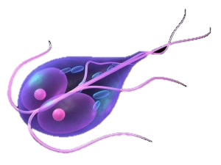
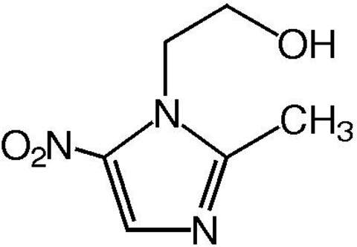
METRONIDAZOLE
MECHANISM OF ACTION:
Creates intermediates toxic to energy production in the bacterial cell. (Creates free radicals that bind to protein/DNA and lead to cell death).
SPECTRUM OF COVERAGE:
Anaerobes, C. dif, Some protozoa (Giardia, Entamoeba Histolytica)
Gram +: Minimal. Gets C. diff (which is an anaerobe)
Gram -: minimal
Anaerobes: Very broad. > 95% of anaerobes are sensitive.
Atypicals: covers some protozoa (Giardia, Entamoeba histolytica)
“ANAEROBIC GO-TO”
Drug functional when it is partially reduced, reduction mainly occurs in anaerobic cells, so less likely to affect aerobes and human cells
Notes:
http://tudosobrecachorros.com.br/2014/03/giardia-giardiase.html

Slide 130
METRONIDAZOLE
DOSING:
IV or PO
SIDE EFFECTS:
Diarrhea, cramping
Disulfuram reaction with alcohol
Neurotoxicity
COMMENTS:
Add in for anaerobe coverage.
Also used for C. dif
“ANAEROBIC GO-TO”
 | Gram positives |  |  |  |  | Gram negatives |  | Anaerobes | Atypicals | Comments
 | Strep | MSSA | MRSA | VSE | VRE | “Normals” | Pseudomonas
Metronid-azole | 0 | 0 | 0 | 0 | 0 | 0 | 0 | ++++, including C dif | Some protozoa | Good anaerobe coverage

Slide 131
ANTIBIOTICS: Overview (click to jump to a section)
PENICILLINS
CEPHALOSPORINS
FLUOROQUINOLONES
MACROLIDES
TETRACYCLINES
AZTREONAM
AMINOGLYCOSIDES
METRONIDAZOLE
NITROFURANTOIN
COLISTIN
CARBAPENEMS
RIFAXIMIN
VANCOMYCIN
DAPTOMYCIN
LINEZOLID
CLINDAMYCIN
BACTRIM
What you will use intern year!
Jump to the end

Slide 132
ANTIBIOTICS: Overview
PENICILLINS
CEPHALOSPORINS
FLUOROQUINOLONES
MACROLIDES
TETRACYCLINES
AZTREONAM
AMINOGLYCOSIDES
METRONIDAZOLE
NITROFURANTOIN
COLISTIN
CARBAPENEMS
RIFAXIMIN
VANCOMYCIN
DAPTOMYCIN
LINEZOLID
CLINDAMYCIN
BACTRIM
What you will use intern year!

Slide 133
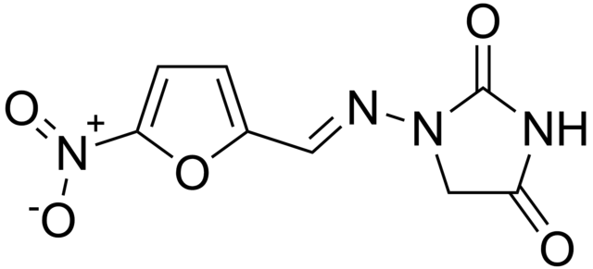
NITROFURANTOIN
MECHANISM OF ACTION:
Complex mechanism, activated most rapidly by bacterial cells > mammalian cells. Inhibits multiple bacterial enzymes and damages bacterial DNA.
SPECTRUM OF COVERAGE:
A relatively weak gram (-) antibiotic.
Sufficient for uncomplicated UTI’s and not much else.
Gram +: Minimal.
Gram -: Typical organisms that cause UTI’s
(enterics like E. coli)
Anaerobes: Minimal
Atypicals: Minimal
“UNCOMPLICATED UTI’s”
Notes:
http://mahler-chiropractic.com/2012/04/17/causes-of-uti/

Slide 134
NITROFURANTOIN
DOSING:
PO
SIDE EFFECTS:
Diarrhea, rare but fatal liver and lung toxicity
COMMENTS:
Caution in the elderly, side effects more common.
Use for uncomplicated UTI.
“UNCOMPLICATED UTI’s”
 | Gram positives |  |  |  |  | Gram negatives |  | Anaerobes | Atypicals | Comments
 | Strep | MSSA | MRSA | VSE | VRE | “Normals” | Pseudomonas
Nitrofur-antoin | + | - | - | + | + | ++ | 0 | 0 | 0 | Uncomplicated UTI
Notes:
http://mahler-chiropractic.com/2012/04/17/causes-of-uti/

Slide 135
ANTIBIOTICS: Overview (click to jump to a section)
PENICILLINS
CEPHALOSPORINS
FLUOROQUINOLONES
MACROLIDES
TETRACYCLINES
AZTREONAM
AMINOGLYCOSIDES
METRONIDAZOLE
NITROFURANTOIN
COLISTIN
CARBAPENEMS
RIFAXIMIN
VANCOMYCIN
DAPTOMYCIN
LINEZOLID
CLINDAMYCIN
BACTRIM
What you will use intern year!
Jump to the end

Slide 136
ANTIBIOTICS: Overview
PENICILLINS
CEPHALOSPORINS
FLUOROQUINOLONES
MACROLIDES
TETRACYCLINES
AZTREONAM
AMINOGLYCOSIDES
METRONIDAZOLE
NITROFURANTOIN
COLISTIN
CARBAPENEMS
RIFAXIMIN
VANCOMYCIN
DAPTOMYCIN
LINEZOLID
CLINDAMYCIN
BACTRIM
What you will use intern year!

Slide 137
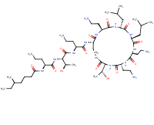
COLISTIN: Polymixin E
An old drug (1949), it actually fell out of favor because aminoglycosides had a similar spectrum and less side effects! Now we occasionally use it for really resistant organisms.
MECHANISM OF ACTION:
Binds to cell membrane and ruptures it
SPECTRUM OF COVERAGE
Gram -, including pseudomonas
Gram +: Minimal.
Gram -: Broad coverage
Anaerobes: Minimal
Atypicals: Minimal
DOSING:
IV
SIDE EFFECTS:
Renal toxicity in 8-50% of patients. ATN. Neurotoxicity as well.
Remember, this makes gentamicin look nice.
COMMENTS:
Last resort in pan-resistant gram (-) infections
 | Gram positives |  |  |  |  | Gram negatives |  | Anaerobes | Atypicals | Comments
 | Strep | MSSA | MRSA | VSE | VRE | “Normals” | Pseudomonas
Colistin | 0 | 0 | 0 | 0 | 0 | ++++ | ++++ | 0 | 0 | GNR coverage of last resort

Slide 138
ANTIBIOTICS: Overview (click to jump to a section)
PENICILLINS
CEPHALOSPORINS
FLUOROQUINOLONES
MACROLIDES
TETRACYCLINES
AZTREONAM
AMINOGLYCOSIDES
METRONIDAZOLE
NITROFURANTOIN
COLISTIN
CARBAPENEMS
RIFAXIMIN
VANCOMYCIN
DAPTOMYCIN
LINEZOLID
CLINDAMYCIN
BACTRIM
What you will use intern year!
Jump to the end

Slide 139
ANTIBIOTICS: Overview
PENICILLINS
CEPHALOSPORINS
FLUOROQUINOLONES
MACROLIDES
TETRACYCLINES
AZTREONAM
AMINOGLYCOSIDES
METRONIDAZOLE
NITROFURANTOIN
COLISTIN
CARBAPENEMS
RIFAXIMIN
VANCOMYCIN
DAPTOMYCIN
LINEZOLID
CLINDAMYCIN
BACTRIM
What you will use intern year!

Slide 140
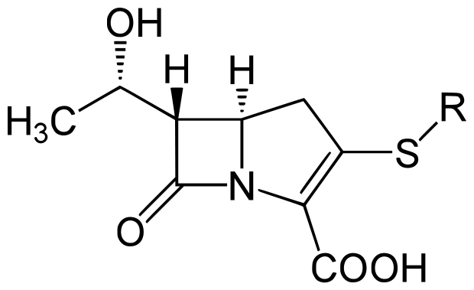
CARBAPENEMS
“HIGHLY RESISTANT ESBL ORGANISMS”
B-lactam antibiotics with very broad spectrum of activity.
Resistance is already mounting and this is very concerning.
Very small molecule, so has excellent penetration, and thus broad spectrum.
MEROPENEM
IMIPENEM
ERTAPENEM

Slide 141
CARBAPENEMS
“HIGHLY RESISTANT ESBL ORGANISMS”
MECHANISM OF ACTION:
B-lactam ring (but resistant to beta-lactamases)
SPECTRUM OF COVERAGE:
What don’t they cover? MRSA, atypicals
Gram +: Broad, but not MRSA
Gram -: Very broad, including pseudomonas and ESBL (extended spectrum beta-lactamase) E coli and Klebsiella
Anaerobes: Broad
Atypicals: Several, such as odd mycobacteria, but not things that have no cell wall (IE mycoplasma…still a B-lactam ring)
MEROPENEM
IMIPENEM
ERTAPENEM

Slide 142
CARBAPENEMS
DOSING:
IV
SIDE EFFECTS:
Imipenem can cause seizures.
COMMENTS: Save these for when you really need them.
Ertapenem doesn’t cover pseudomonas, but is convenient once-daily dosing so often used for highly resistant UTI’s.
Carbapenem resistant enterobacter species are on the rise!
“HIGHLY RESISTANT ESBL ORGANISMS”
 | Gram positives |  |  |  |  | Gram negatives |  | Anaerobes | Atypicals | Comments
 | Strep | MSSA | MRSA | VSE | VRE | “Normals” | Pseudomonas
Meropenem | +++ | +++ | 0 | + | 0 | ++++ | +++ | ++++ | + | Use for ESBL
Ertapenem | +++ | +++ | 0 | 0 | 0 | ++++ | 0 | ++++ | + | No pseudomonas, but convenient dosing

Slide 143
ANTIBIOTICS: Overview (click to jump to a section)
PENICILLINS
CEPHALOSPORINS
FLUOROQUINOLONES
MACROLIDES
TETRACYCLINES
AZTREONAM
AMINOGLYCOSIDES
METRONIDAZOLE
NITROFURANTOIN
COLISTIN
CARBAPENEMS
RIFAXIMIN
VANCOMYCIN
DAPTOMYCIN
LINEZOLID
CLINDAMYCIN
BACTRIM
What you will use intern year!
Jump to the end

Slide 144
ANTIBIOTICS: Overview
PENICILLINS
CEPHALOSPORINS
FLUOROQUINOLONES
MACROLIDES
TETRACYCLINES
AZTREONAM
AMINOGLYCOSIDES
METRONIDAZOLE
NITROFURANTOIN
COLISTIN
CARBAPENEMS
RIFAXIMIN
VANCOMYCIN
DAPTOMYCIN
LINEZOLID
CLINDAMYCIN
BACTRIM
What you will use intern year!

Slide 145
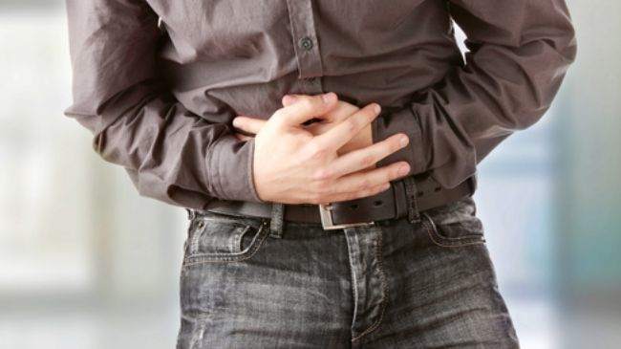
RIFAXIMIN
MECHANISM:
Binds to bacterial RNA polymerase. Very poor bioavailability, so when given PO stays in GI tract
SPECTRUM OF COVERAGE:
Enteric gram negatives
DOSING:
PO. It has very poor bioavailability.
SIDE EFFECTS:
Generally well tolerated. Can cause diarrhea.
COMMENTS: used for traveler’s diarrhea, small bowel overgrowth, nd to prevent hepatic encephalopathy
 | Gram positives |  |  |  |  | Gram negatives |  | Anaerobes | Atypicals | Comments
 | Strep | MSSA | MRSA | VSE | VRE | “Normals” | Pseudomonas
Rifaximin | 0 | 0 | 0 | 0 | 0 | ++ | 0 | 0 | 0 | Hepatic encephalopathy

Slide 146
ANTIBIOTICS: you covered them all!!
PENICILLINS
CEPHALOSPORINS
FLUOROQUINOLONES
MACROLIDES
TETRACYCLINES
AZTREONAM
AMINOGLYCOSIDES
METRONIDAZOLE
NITROFURANTOIN
COLISTIN
CARBAPENEMS
RIFAXIMIN
VANCOMYCIN
DAPTOMYCIN
LINEZOLID
CLINDAMYCIN
BACTRIM
What you will use intern year!
Jump to the end

Slide 147
Outline
Click a section to jump ahead to it
Classifying bacteria
Microbiome of common infections
Antibiotics review!
Quick antibiotics review

Slide 148
QUICK ANTIBIOTICS
OVERVIEW

Slide 149
 | Gram + | Gram - | Anaerobe | Atypical | Comments
Penicillin | ++ | 0 | + | Spirochetes | GAS, lyme, syphilis
Ampicillin Amoxicillin | ++ | ++ | 0 | 0 | Otitis media, UTI, Listeria
Augmentin Unasyn | ++ | +++ | +++ | 0 | Sinusitis, aspiration PNA, bites, cholangitis
Nafcillin Oxacillin | #1 for MSSA | 0 | 0 | 0 | MSSA
Zosyn | ++ | ++++ pseudomonas | ++++ | 0 | GI, HCAP
Cefazolin Cephalexin | +++ | 0 | 0 | 0 | Skin, MSSA
Cefotetan | ++ | ++ | ++ | 0 | Abdominal infections
Ceftriaxone | + | +++ | 0 | CNS/cardiac Lyme, gonorrhea | UTI, CAP, meningitis
Cefpodoxime | + | +++ | 0 | 0 | UTI, CAP
Ceftazidime | + | ++++, pseudomonas | 0 | 0 | Febrile neutropenia
Cefepime | + | ++++, pseudomonas | 0 | 0 | Febrile neutropenia
Ceftaroline | MRSA | +++ | 0 | 0 | MRSA cellulitis/PNA

Slide 150
 | Gram + | Gram - | Anaerobe | Atypical | Comments
Ciprofloxacin | 0 | +++, 60% pseudomonas | 0 | 0 | GI, GU
Levofloxacin | ++ | +++, 60% pseudomonas | 0 | TB, Legionella, mycoplasma | CommunityAcquired PNA, $
Moxifloxacin | similar | to | Levo- | -floxacin | “
Azithromycin | ++ | + | 0 | +++ respiratory atypicals, chlamydia | CAP. Don’t over-prescribe
Doxycycline | ++ | + | 0 | ++++, broad | CAP, wide range of atypical infections
Tigecycline | +++ | +++ | + | ++, C dif | 3rd line agent, may increase mortality vs other abx

Slide 151
 | Gram + | Gram - | Anaerobe | Atypical | Comments
Bactrim | ++, MRSA occasionally | ++ | 0 | PCP, Nocardia | Diarrhea, elevated K+ and Cr
Clindamycin | +++, MRSA occasionally | 0 | +++ | 0 | diarrhea
Vancomycin | ++++, MRSA | 0 | C dif | 0 | HCAP. Empiric for gram (+) bacteremia
Daptomycin | ++++, MRSA, VRE | 0 | 0 | 0 | MRSA, VRE, $$
Linezolid | ++++, MRSA, VRE | 0 | 0 | 0 | MRSA, VRE, $$

Slide 152
 | Gram + | Gram - | Anaerobe | Atypical | Comments
Gentamicin | + | ++++, pseudomonas | 0 | Plague, tularemia | Strep or enterococcus endocarditis (in combo)
Tobramycin | + | ++++, pseudomonas | 0 |  | VAP (in combo)
Amikacin | + | ++++, pseudomonas | 0 |  | Tough UTI’s
Aztreonam | 0 | ++++, pseudomonas | 0 | 0 | 2nd line febrile neutropenia
Imipenem | +++ | ++++, pseudomonas | ++++ | ++ | seizures
Meropenem | +++ | ++++, pseudomonas | ++++ | ++
Ertapenem | ++ | ++++ | ++++ | ++ | No pseudomonas but once daily dosing
Colistin | 0 | +++ | 0 | 0 | Last resort
Nitrofurantoin | 0 | ++ | 0 | 0 | Uncomplicated UTI
Metronidazole | 0 | 0 | ++++ | Some protozoa | Use if you need anaerobe coverage
Rifaxamin | 0 | + | 0 | 0 | Traveler’s diarrhea and hepatic encephalopathy

Slide 153
PSEUDOMONAS DRUGS
Zosyn (pipercillin/tazobactam) (IV)
Ceftazidime (IV)
Cefepime (IV)
Zerbaxa (ceftolozane/tazobactam) (IV)
Aztreonam (IV)
Fluoroquinoles (~60% of the time) (PO)
Aminoglycosides (IV)
Carbapenems (not ertapenem) (IV)
Colistin (V)

Slide 154
MRSA DRUGS
Vancomycin (IV)
Daptomycin (IV)
Ceftaroline (IV)
Linezolid (PO)
Bactrim (PO)
Clindamycin (PO)
Doxycycline (PO)

Slide 155
Common C.A.P. DRUGS
Azithromycin (PO)
Doxycycline (PO)
Levofloxacin (PO)
Amoxicillin (PO)
Ceftriaxone (IV)
Cefpodoxime (PO)

Slide 156
Common U.T.I. DRUGS
Amoxicillin (PO)
Nitrofurantoin (PO)
Bactrim (PO)
Ciprofloxacin (PO)
Ceftriaxone (IV)

Slide 157
Drugs of choice
MSSA: nafcillin, oxacillin, or cefazolin
MRSA: vancomycin
Enterococcus: ampicillin

Slide 158
Congratulations!
Please take the 2 minute post-module quiz:
https://docs.google.com/forms/d/e/1FAIpQLSdBIsaQBpBLukQFJbw_3Ef3taH_Xv8vrEe3w_Hcf2SMaF45IQ/viewform

